Slide 1

Systematic Reviews
Dr Sharon Mickan
Centre for Evidence-based Medicine
University of Oxford

Slide 2
Learning Objectives - overview
Review purpose of a Systematic Review
Types of systematic review
  Best question for each study type
Process of designing a systematic review
Critical appraisal of a systematic review

Slide 3
What do you do?
For an patient with a painful sore throat, you wonder whether corticosteroids will help with pain relief?
You do a search and find several studies:
  some suggest that steroids reduce pain; some do not
What do you do?
  Ask a consultant? Peer? Patient?
  Ask research student to find all studies & select the best?
How do you know which study to believe?

Slide 4

You find this review

Slide 5
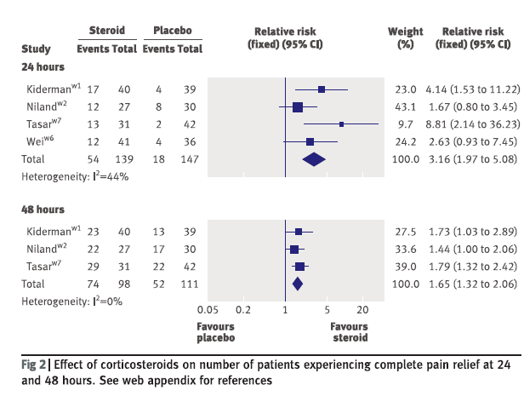

Slide 6
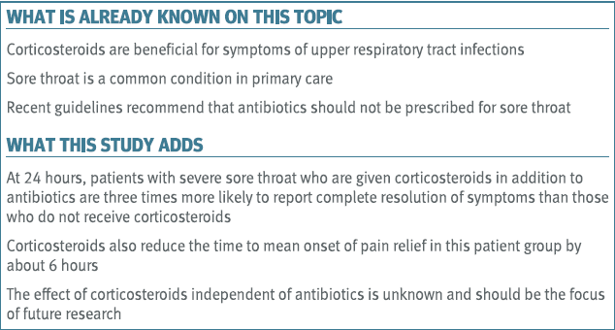
How confident are you of the evidence?

Slide 7
Purpose of systematic reviews
Provide up to date summary of all published research literature
Allow large amounts of data to be assimilated
Provide an objective collation of results of research
Provide reliable recommendations

Slide 8
Clarify the differences
Systematic Review
Narrative Review
Meta-analysis
Any other similar terms?

Slide 9
Systematic Review or meta-analysis?
A Systematic Review is a review of a clearly formulated question that uses systematic and explicit methods to identify, select and critically appraise relevant research, and to collect and analyse data from the studies that are included in the review.
Statistical methods (meta-analysis) may or may not be used to analyse and summarise the results of the included studies.

Slide 10
Narrative vs systematic review
Narrative
  Many questions
  No search methods
  No inclusion criteria
  No combining studies
  Prone to random and systematic error
  Provide conflicting summaries
Systematic
  One question
  Explicit search
    Reproducible
  Explicit inclusion criteria
  Combine study results
  (meta-analysis)
WHY do we need Systematic Reviews?

Slide 11
Benefits of systematic reviews
Up to date resource for clinicians
Starting point for clinical guidelines
Policy guidance
Basis for new primary research
  Important for grant funding bodies
Management guidance
Research training tool???

Slide 12
Useful Resources
The Cochrane Collaboration www.thecochranelibrary.com/
  Cochrane Handbook for Systematic Reviews of Interventions (version 5 updated March 2011)
CRD www.crd.york.ac.uk/
  The Centre for Reviews and Dissemination is a department of the University of York and is part of the National Institute for Health Research
EPPI-Centre www.eppi.ioe.ac.uk/
  The Evidence for Policy and Practice Information and Co-ordinating Centre, Social Science Research Unit, Institute of Education, University of London.

Slide 13
Steps of a systematic review
Clear answerable question
Reproducible search strategy
Assessment of literature quality
Summary of the evidence
Statistical, sensitivity analyses
Interpretation
Conclusions, recommendations
Published protocol and review

Slide 14
Types of systematic review
Different research questions require different study designs →generate different types of review
Variations occur in
  Research questions asked
  Primary study designs included
  Methods for synthesis
  Approaches to being systematic
  Types of evidence included

Slide 15
Best evidence for different questions
Treatment | Prognosis | Particular perspective
Systematic Review of … | Systematic Review of … | Systematic Review of …
Randomised trials | Inception Cohorts | Qualitative studies

Slide 16
Types of Systematic Reviews
Cross-sectional analysis Nov 2004
300 Systematic Reviews
  Therapeutic = 213 (71%)
    Cochrane = 125 (59%)
    Non-Cochrane = 88 (41%)
  Diagnosis/Prognosis = 23 (7%)
  Epidemiology = 38 (13%)

Slide 17
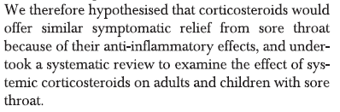
Getting started
KEY = systematic, rigorous, transparent, reproducible
Define the research question
  Clear background, scope, setting
  Research question determines method of review (PICO)
  Specify inclusion and exclusion criteria

Slide 18
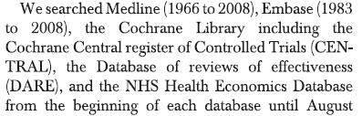
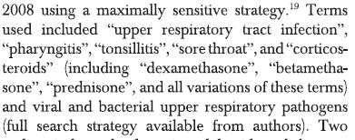
Find the published research
Clear, comprehensive, reproducible search strategy
Search terms
Databases
Other strategies for grey literature

Slide 19
Manage the research evidence
Organise database, hand searching
  Use of forward citation searching, reference lists
Manage references
  Reference Management software eg Endnote
Screen studies to check fit
  2 reviewers, process of agreement
  Record decisions about whether studies meet criteria

Slide 20
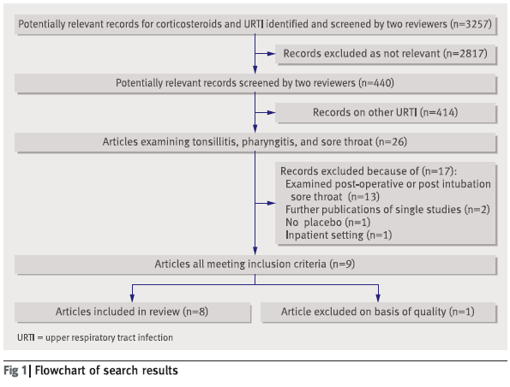

Slide 21
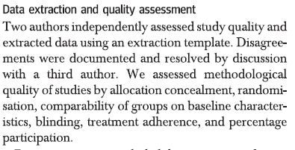
Assess quality of the literature
Dual, independent assessment of design aspects likely to cause bias – depends on study designs
Resource http://www.equator-network.org/home/

Slide 22
The Cochrane risk of bias tool
Risk of bias | Interpretation | Within a study | Across studies
Low risk of bias | Plausible bias unlikely to seriously alter the results. | Low risk of bias for all key domains. | Most information is from studies at low risk of bias.
Unclear risk of bias | Plausible bias that raises some doubt about the results | Unclear risk of bias for one or more key domains. | Most information is from studies at low or unclear risk of bias.
High risk of bias | Plausible bias that seriously weakens confidence in the results. | High risk of bias for one or more key Domains. | The proportion of information from studies at high risk of bias is sufficient to affect the interpretation of the results.

Slide 23
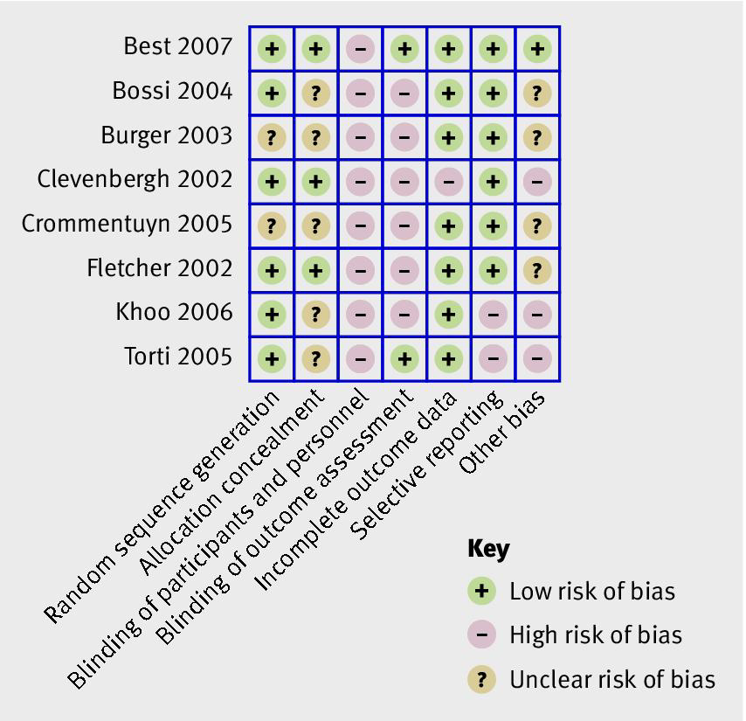
A visual representation - RCTs

Slide 24
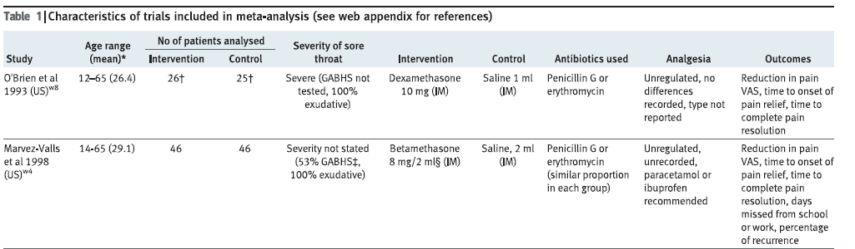
Describe included studies
Design data extraction forms
  General descriptive information
  Research methods
  Key results
  2 reviewers, process of agreement

Slide 25
Decide on process of synthesis
Factors to consider
Consistency of outcome measures
Sub groups
Heterogeneity
Common sense test

Slide 26
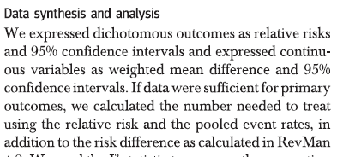
Details of data synthesis
Look for consistent measurement of data, with 95% confidence intervals

Slide 27
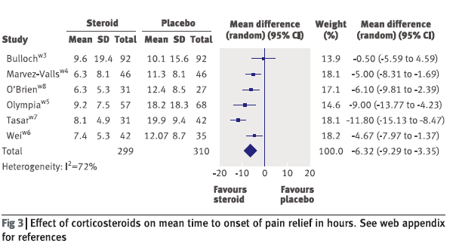
Primary outcome/s
Basis for meta-analysis

Slide 28

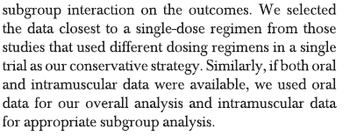
Sub group analysis
Identify in protocol with justification
To enhance usefulness of research answers

Slide 29
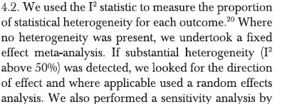
Heterogeneity
Common sense test of study design, outcome measurements, forest plot
Are syntheses meaningful (apples vs oranges)
Influences statistics within meta-analysis

Slide 30
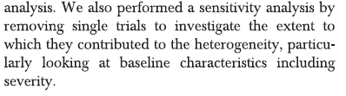
Sensitivity analyses
determine whether the assumptions or decisions made have a major effect on the results of the review.

Slide 31
Protocol development
Define and justify the research question
Find and manage the research evidence
Describe included studies
Synthesise the evidence
Interpret and disseminate

Slide 32
Registration of Systematic Reviews
PROSPERO
International prospective register of systematic reviews
http://www.crd.york.ac.uk/PROSPERO/
Benefits
Provides a public record of planned methods
Raises awareness of the review
Tracks use and impact of published reviews
Permanent record whether final report published or not

Slide 33
Cochrane review process
1. Register title with Review Group
2. Write the protocol
  Protocol reviewed & revised
  Published on CDSR
3. Write the review
  Review reviewed and revised
  Published on CDSR
4. Update (every 2-3 years)

Slide 34
Is the review any good – FAITH?
FINDING
  Did they find most studies?
APPRAISAL
  Did they use appropriate inclusion criteria?
INCLUDE
  Did they include valid studies – for question asked?
TOTAL Up
  Did they synthesise similar outcomes?
HETEROGENEITY

Slide 35
A quick review
Why look for a SR?
What types of SR exist?
What are the key steps in a SR?
Why is a protocol important?
How do you appraise a SR?

