Slide 1

Diagnostic Studies
Dr. Annette Plüddemann
Department of Primary Care Health Sciences
Centre for Evidence-Based Medicine

Slide 2
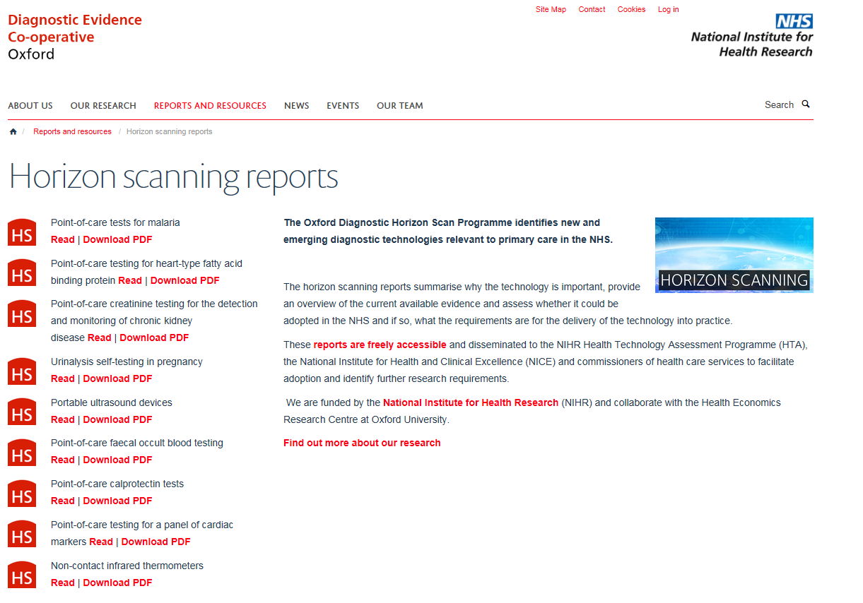
www.oxford.dec.nihr.ac.uk/horizon-scanning

Slide 3
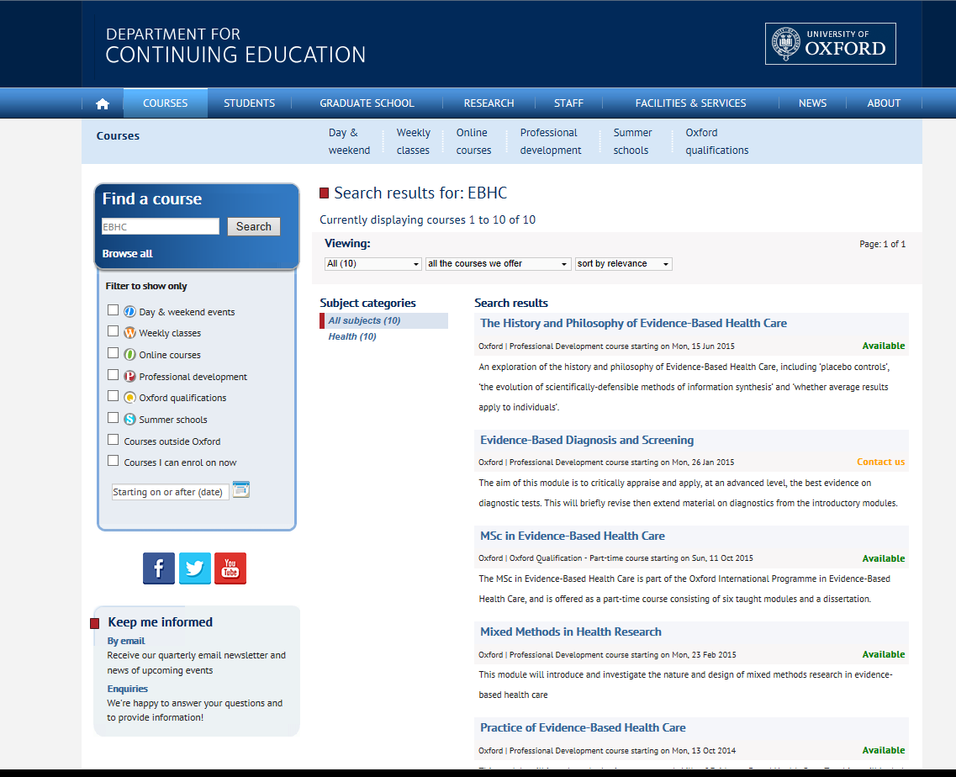
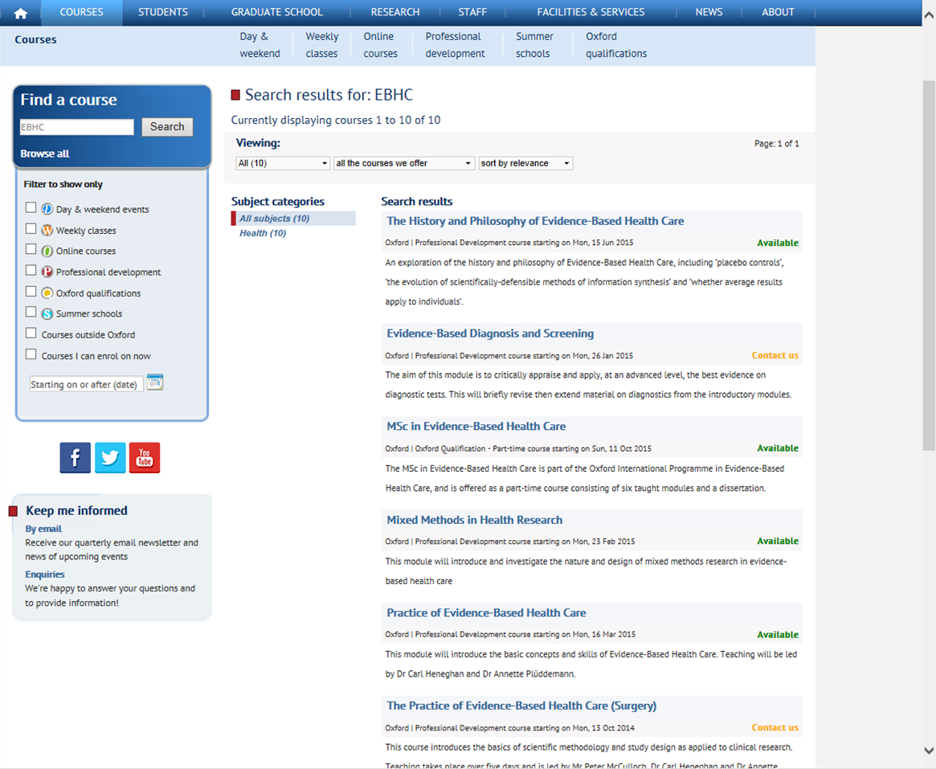

Slide 4
So far….
Does this treatment work?
Is this treatment better than doing nothing?
Which treatment is better?
How should I treat this patient?
Randomised controlled trial
Systematic review

Slide 5
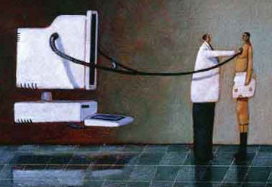
Diagnosis
Typically someone with abnormal symptoms consults a physician, who will obtain a history of their illness and examine them for signs of diseases.
The physician formulates a hypothesis of likely diagnoses and may or may not order further tests to clarify the diagnosis

Slide 6
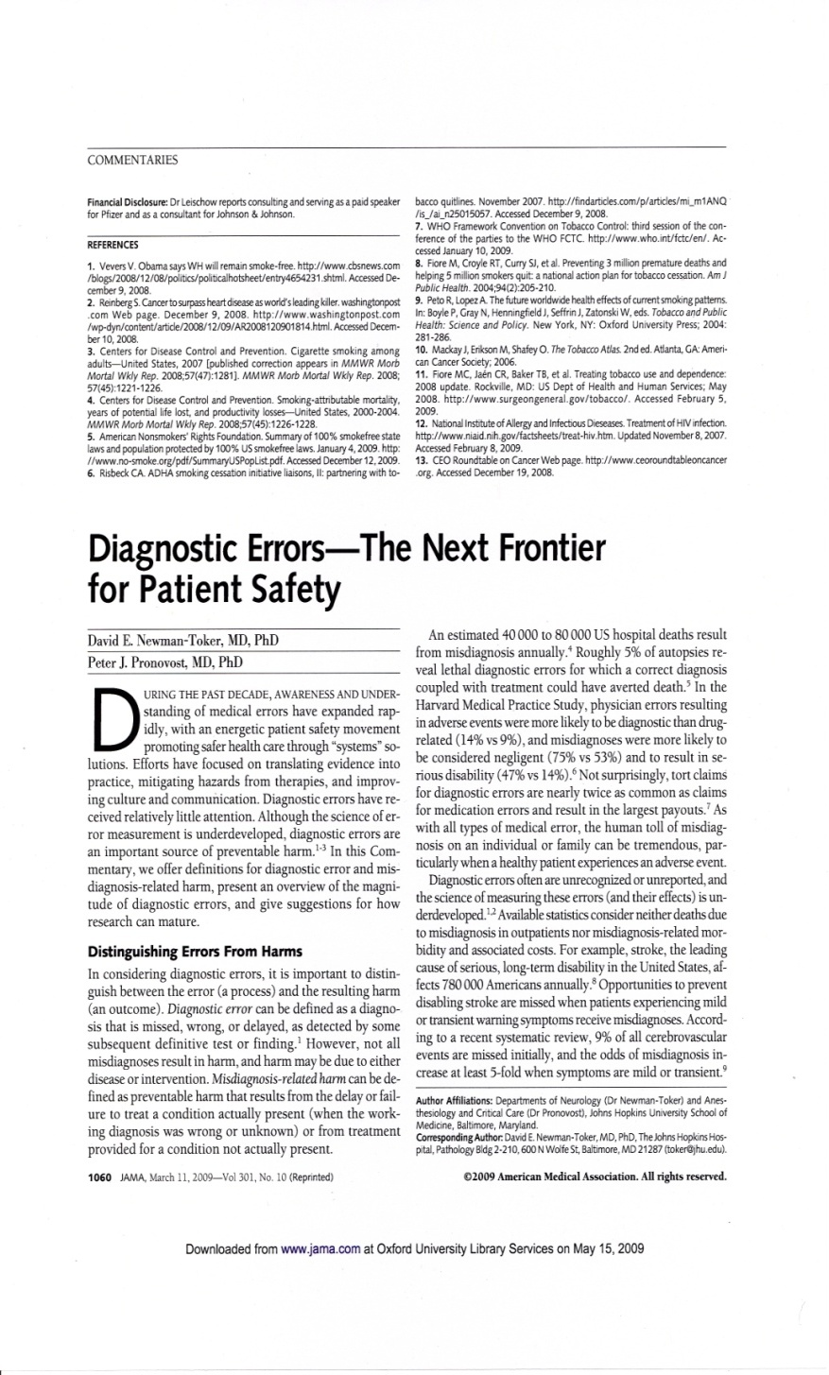
2/3 legal claims against GPs in UK
40,000-80,000 US hospital deaths from misdiagnosis per year
Adverse events, negligence cases, serious disability more likely to be related to misdiagnosis than drug errors
Diagnosis uses <5% of hospital costs, but influences 60% of decision making

Slide 7
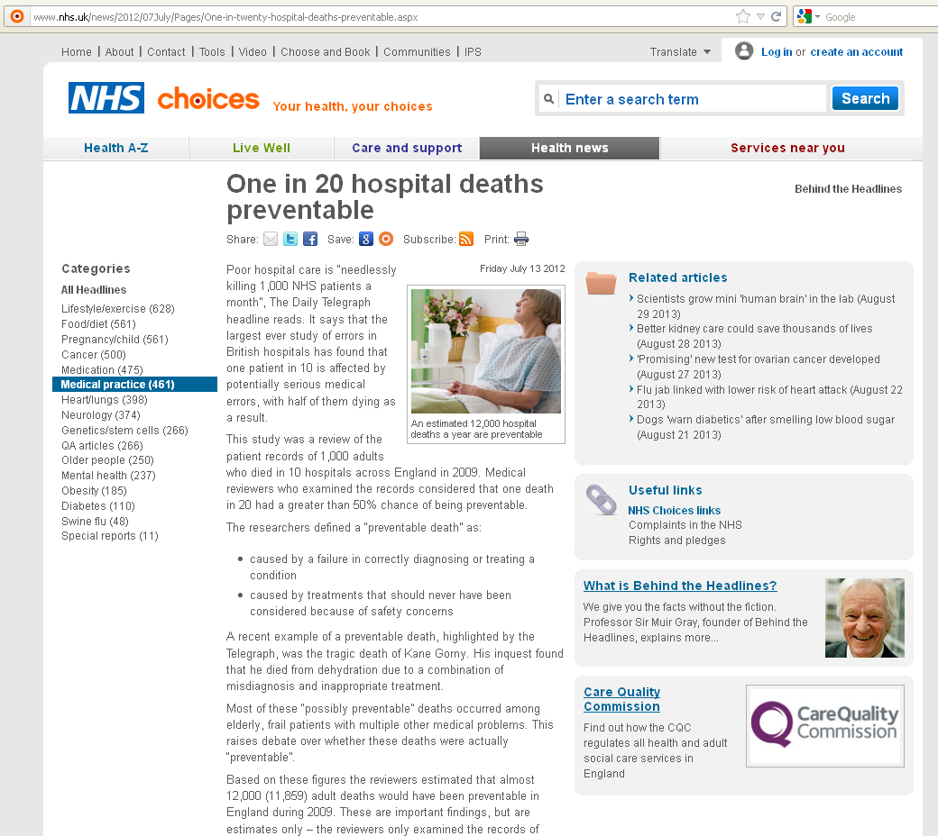
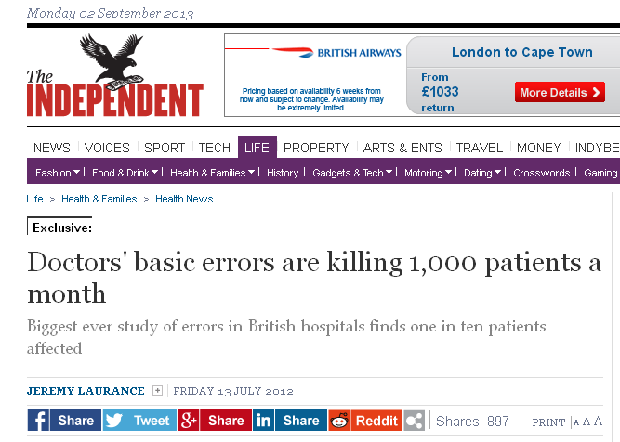
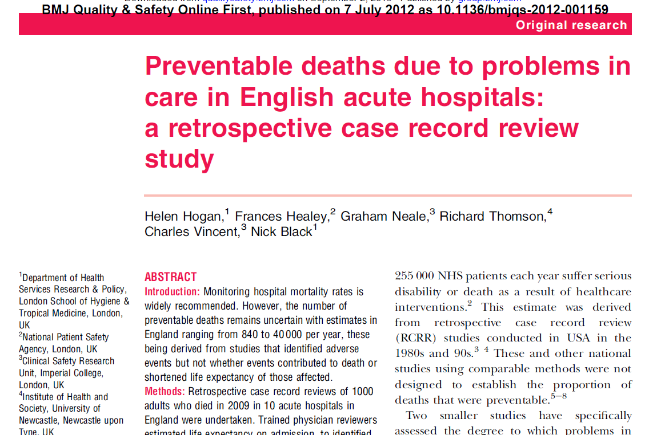
clinical monitoring (such as failure to act upon test results or monitor patients appropriately) – identified as a problem in 31% of preventable deaths
diagnosis (such as problems with physical examination or failure to seek a specialist opinion) – identified as a problem in 30% of preventable deaths
drugs or fluid management – identified as a problem in 21% of preventable deaths

Slide 8
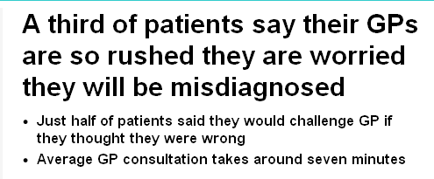
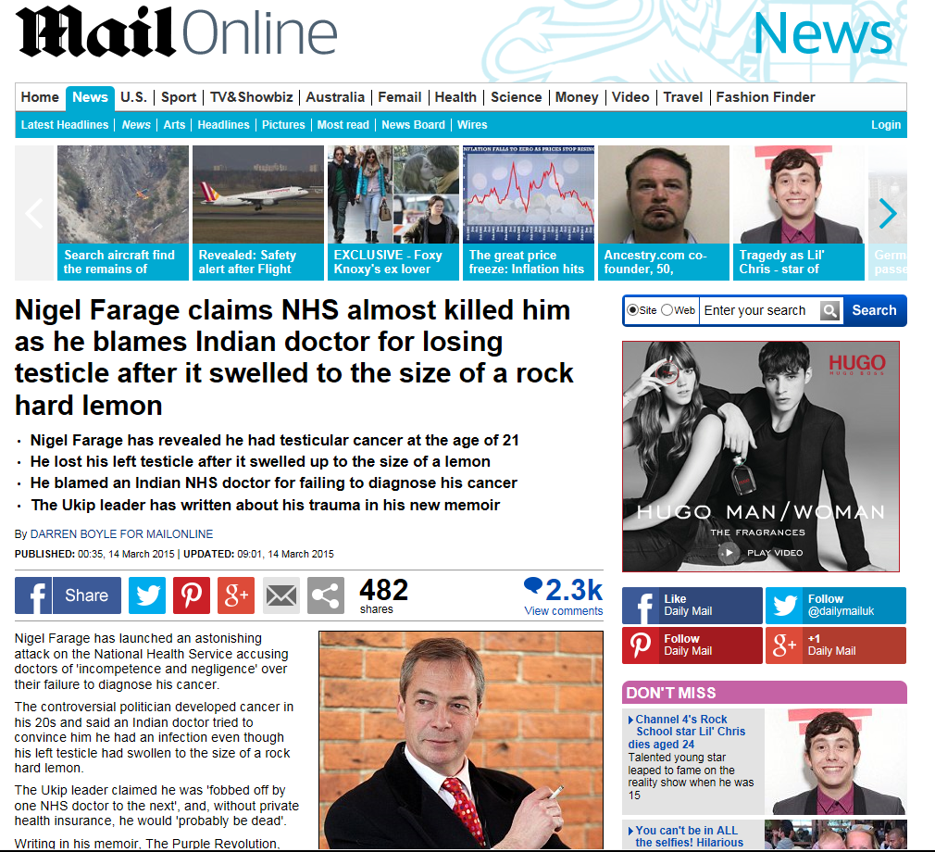
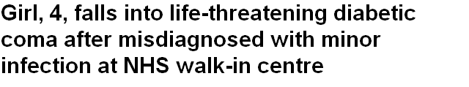
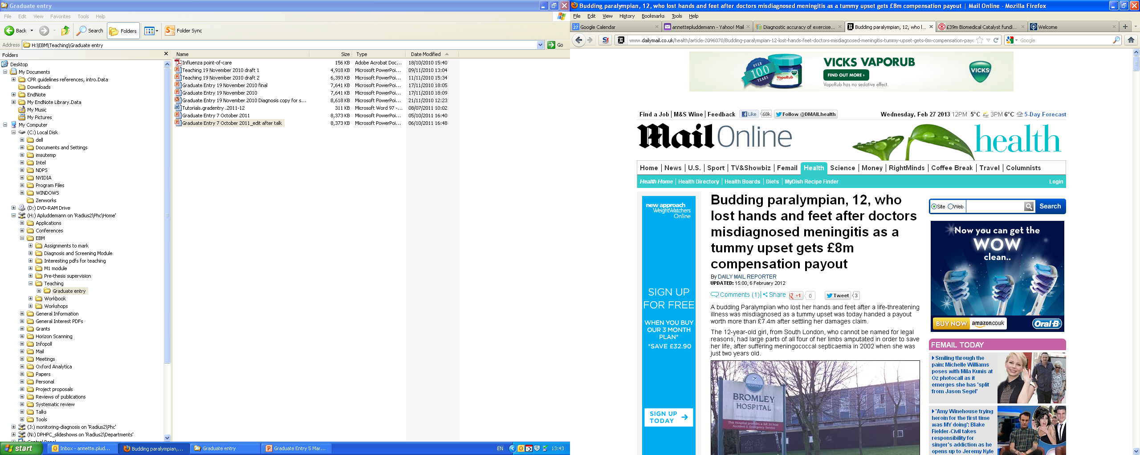

Slide 9
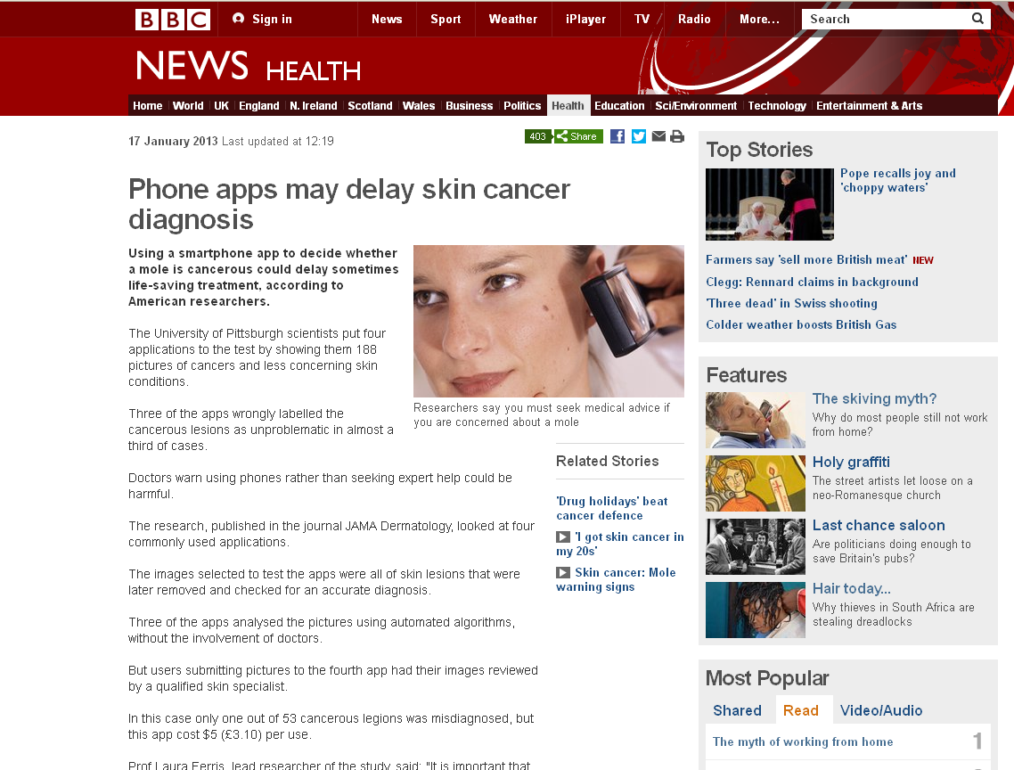
Wolf JA, Moreau J, Akilov O, Patton T, English JC, Ho J, Ferris LK.
Diagnostic Inaccuracy of Smartphone Applications for Melanoma Detection. JAMA Dermatol. 2013 Jan 16:1-4.

Slide 10
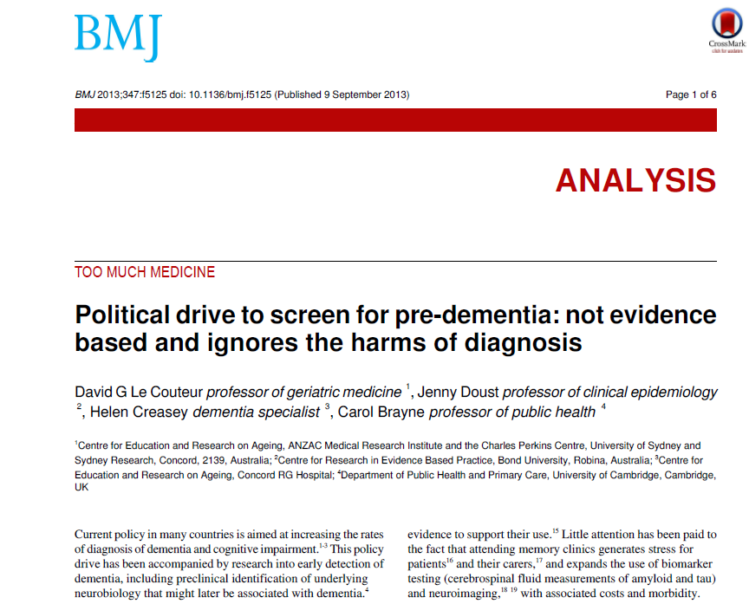
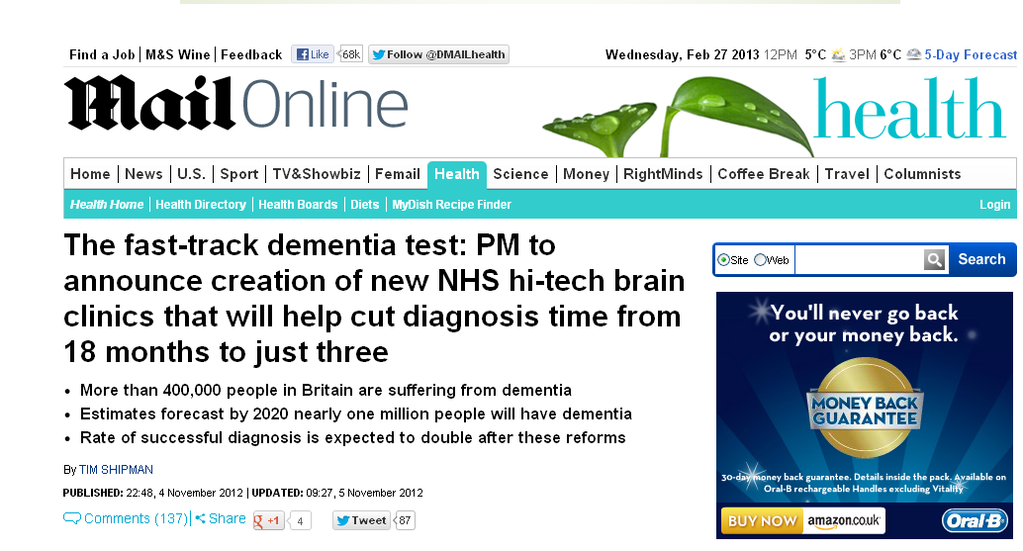

Slide 11
Diagnostic strategies and what tests are used for

Slide 12

How do clinicians make diagnoses?
Patient history…examination…differential diagnosis…final diagnosis
Aim: identify types and frequency of diagnostic strategies used in primary care
  6 GPs collected and recorded strategies used on 300 patients.
(Diagnostic strategies used in primary care. Heneghan, et al,. BMJ 2009. 20;338:b9462009)

Slide 13
Diagnostic stages & strategies
Stage
Strategies used
Spot diagnoses
Self-labelling
Presenting complaint
Pattern recognition
Initiation of the diagnosis
Refinement of the diagnostic causes
Restricted Rule Outs
Stepwise refinement
Probabilistic reasoning
Pattern recognition fit
Clinical Prediction Rule
Defining the final diagnosis
Known Diagnosis
Further tests ordered
Test of treatment
Test of time
No label
(Heneghan et al, BMJ 2009)

Slide 14
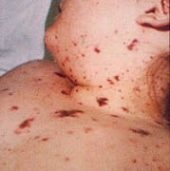
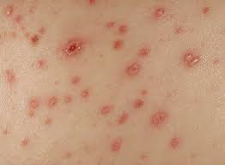
Not all diagnoses need tests?
Spot diagnosis
Meningitis
Chicken Pox

Slide 15
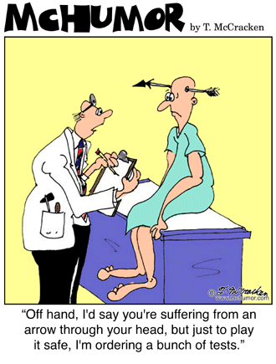
What are tests used for?
Increase certainty about presence/absence of disease
Disease severity
Monitor clinical course
Assess prognosis – risk/stage within diagnosis
Plan treatment e.g., location
Stall for time!

Slide 16
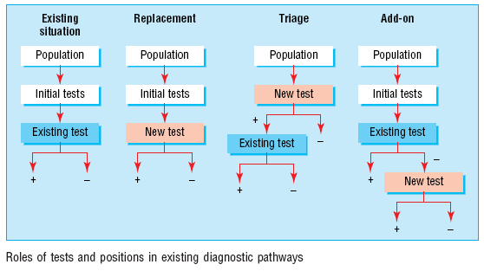
Roles of new tests
Replacement – new replaces old
  E.g. CT colonography for barium enema
Triage – new determines need for old
  E.g. B-natriuretic peptide for echocardiography
Add-on – new combined with old
  E.g. ECG and myocardial perfusion scan
Bossuyt et al BMJ 2006;332:1089–92

Slide 17
Critical appraisal of a diagnostic accuracy study

Slide 18
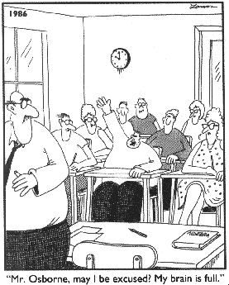
Diagnostic tests: What you need to know
Diagnostic tests: What you need to know
Validity of a diagnostic study
Interpret the results

Slide 19
Defining the clinical question: PICO or PIRT
Patient/Problem
  How would I describe a group of patients similar to mine?
Index test
  Which test am I considering?
Comparator… or …Reference Standard
  What is the best reference standard to diagnose the target condition?
Outcome….or….Target condition
  Which condition do I want to rule in or rule out?

Slide 20
Diagnostic Accuracy Studies
Series of patients
Index test
Reference standard
Compare the results of the index test with the reference standard, blinded

Slide 21
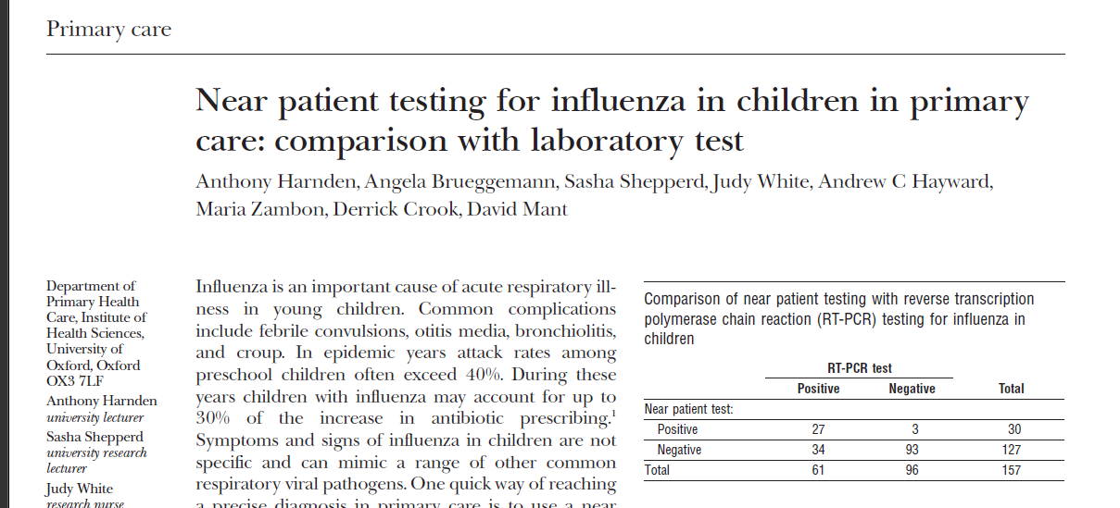
Diagnostic Study Example

Slide 22
Appraising diagnostic studies: 3 easy steps
Appropriate spectrum of patients?
Does everyone get the reference standard?
Is there an independent, blind or objective comparison with the reference standard?
Are the results valid?
What are the results?
Will they help me look after my patients?

Slide 23

Biases in Diagnostic Accuracy Studies…
The Ugly 5….

Slide 24
1. Appropriate spectrum of patients?
Ideally, test should be performed on a group of patients in whom it will be applied in the real world clinical setting
Spectrum bias:
study uses only highly selected patients…….perhaps those in whom you would really suspect have the diagnosis

Slide 25



Case-control vs consecutive

Slide 26
2. Do all patients have the reference standard?
Ideally all patients get the reference standard test
Verification bias:
only some patients get the reference standard…..probably the ones in whom you really suspect have the disease

Slide 27
Partial Reference Bias
Series of patients
Index test
Ref. Std. A
Compare the results of the index test with the reference standard, blinded

Slide 28
Differential Reference Bias
Series of patients
Index test
Ref. Std. A
Ref. Std. B
Blinded cross-classification

Slide 29
Incorporation Bias
Series of patients
Index test
Reference standard….. includes parts of Index test
Blinded cross-classification

Slide 30

3. Independent, blind or objective comparison with the reference standard?
Ideally, the reference standard is independent, blind and objective
Observer bias:
test is very subjective, or done by person who knows something about the patient or samples

Slide 31
Observer Bias
Series of patients
Index test
Reference standard
Unblinded cross-classification

Slide 32
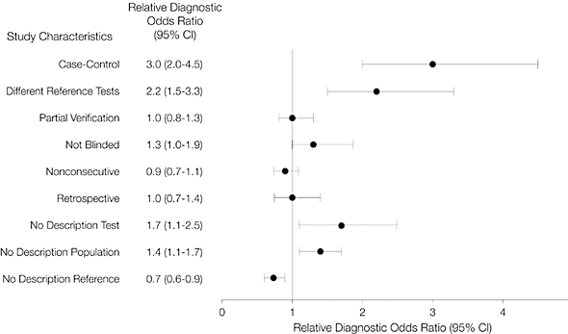
Effect of biases on results
Lijmer, J. G. et al. JAMA 1999;282:1061-1066

Slide 33
Diagnostic Study Example

Slide 34
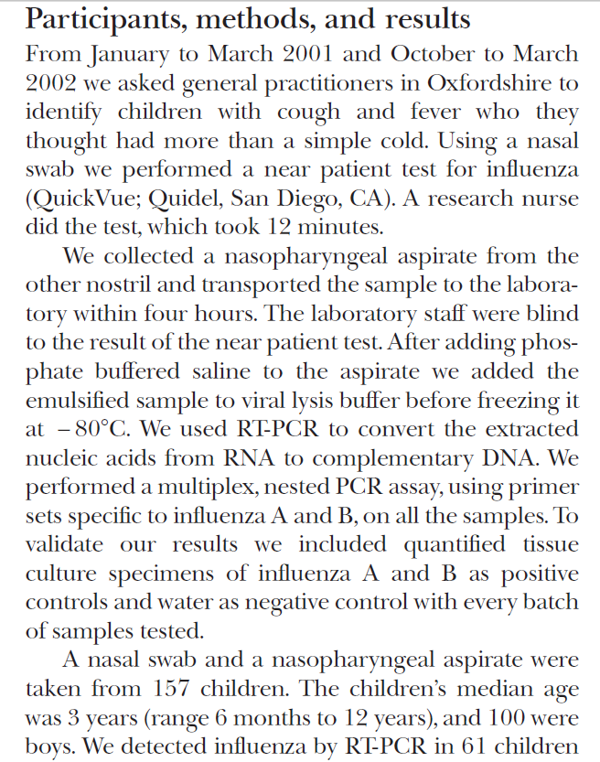
1. Spectrum
2. Index test
3. Reference standard
4. Blinding

Slide 35
The Numbers

Slide 36


Using a brain scan, the researchers detected autism with over 90% accuracy…
You can’t diagnose autism with a brain scan...

Slide 37
Appraising diagnostic tests
Appropriate spectrum of patients?
Does everyone get the reference standard?
Is there an independent, blind or objective comparison with the gold standard?
Are the results valid?
What are the results?
Sensitivity, specificity
Likelihood ratios
Positive and Negative Predictive Values
Will they help me look after my patients?

Slide 38
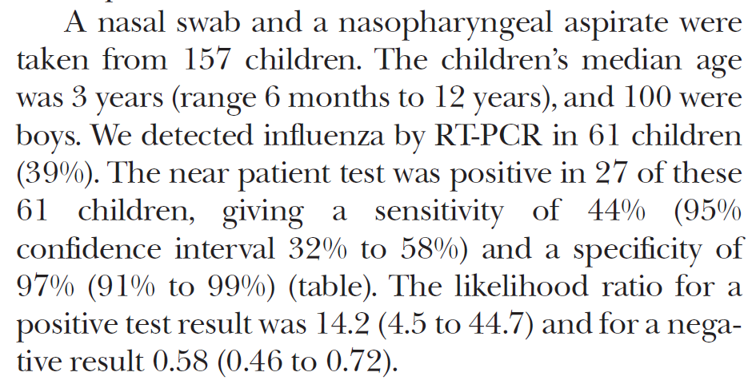

Slide 39
The 2 by 2 table
Disease
+
-
True positives
False positives
+
Test
False negatives
True negatives
-

Slide 40
Sensitivity and Specificity

Slide 41
The 2 by 2 table: Sensitivity
Disease
Proportion of people WITH the disease who have a positive test result.
+
-
84
a
True positives
+
So, a test with 84% sensitivity….means that the test identifies 84 out of 100 people WITH the disease
Test
16
c
False negatives
-
Sensitivity = a / a + c
Sensitivity = 84/100

Slide 42
The 2 by 2 table: Specificity
Disease
+
-
Proportion of people WITHOUT the disease who have a negative test result.
25
b
False positives
+
So, a test with 75% specificity will be NEGATIVE in 75 out of 100 people WITHOUT the disease
Test
75
d
True negatives
-
Specificity = d / b + d
Specificity = 75/100

Slide 43
The Influenza Example
Disease: Lab Test
+
-
There were 61 children who had influenza…the rapid test was positive in 27 of them
27
3
30
+
Test: Rapid Test
34
93
127
There were 96 children who did not have influenza… the rapid test was negative in 93 of them
-
61
96
157
Sensitivity = 27/61 = 0.44 (44%)
Specificity = 93/96 = 0.97 (97%)

Slide 45
Tip
Sensitivity is useful to me
  ‘The new rapid influenza test was positive in 27 out of 61 children with influenza (sensitivity = 44%)’
Specificity seems a bit confusing!
  ‘The new rapid influenza test was negative in 93 of the 96 children who did not have influenza (specificity = 97%)’
So…the false positive rate is sometimes easier
  ‘There were 96 children who did not have influenza… the rapid test was falsely positive in 3 of them’
  So a specificity of 97% means that the new rapid test is wrong (or falsely positive) in 3% of children
False positive rate = 1 - specificity

Slide 46
Ruling In and Ruling Out
High Sensitivity
A good test to help in Ruling Out disease
High sensitivity means there are very few false negatives – so if the test comes back negative it’s highly unlikely the person has the disease
SnNOUT
High Specificity
A good test to help in Ruling In disease
High specificity means there are very few false positives – so if the test comes back positive it’s highly likely the person has the disease
SpPIN
Disease: Influenza
Disease
+
-
+
-
a
True positives
b
False positives
27
3
+
+
Test
Test: Rapid Test
-
c
False negatives
d
True negatives
34
93
-
Sensitivity = 44%
Specificity = 97%
Sensitivity = a/a+c
Specificity = d/b+d

Slide 47
Predictive Values

Slide 48
Positive and Negative Predictive Value
Disease
PPV = Proportion of people with a positive test who have the disease.
+
-
a
True positives
b
False positives
PPV = a / a + b
+
Test
c
False negatives
d
True negatives
NPV = d / c + d
-
NPV = Proportion of people with a negative test who do not have the disease.

Slide 49
The Influenza Example
Disease: Lab Test
+
-
PPV = 27/30 = 90%
27
3
30
+
Test: Rapid Test
NPV = 93/127 = 73%
34
93
127
-
61
96
157

Slide 50

Predictive Value: Natural Frequencies
Your father went to his doctor and was told that his test for a disease was positive. He is really worried, and comes to ask you for help!
After doing some reading, you find that for men of his age:
The prevalence of the disease is 30%
The test has a sensitivity of 50% and specificity of 90%
“Tell me what’s the chance I have this disease?”

Slide 51

Predictive Value
100% Likely
50% Maybe
0% Unlikely
Disease has a prevalence of 30%.
The test has sensitivity of 50% and specificity of 90%.

Slide 52
Natural Frequencies
Disease has a prevalence of 30%.
The test has sensitivity of 50% and specificity of 90%.
Given a positive test, what is the probability your dad has the disease
2:00
1:59
1:58
1:57
1:56
1:55
1:54
1:53
1:52
1:51
1:50
1:49
1:48
1:47
1:46
1:45
1:44
1:43
1:42
1:41
1:40
1:39
1:38
1:37
1:36
1:35
1:34
1:33
1:32
1:31
1:30
1:29
1:28
1:27
1:26
1:25
1:24
1:23
1:22
1:21
1:20
1:19
1:18
1:17
1:16
1:15
1:14
1:13
1:12
1:11
1:10
1:09
1:08
1:07
1:06
1:05
1:04
1:03
1:02
1:01
1:00
0:59
0:58
0:57
0:56
0:55
0:54
0:53
0:52
0:51
0:50
0:49
0:48
0:47
0:46
0:45
0:44
0:43
0:42
0:41
0:40
0:39
0:38
0:37
0:36
0:35
0:34
0:33
0:32
0:31
0:30
0:29
0:28
0:27
0:26
0:25
0:24
0:23
0:22
0:21
0:20
0:19
0:18
0:17
0:16
0:15
0:14
0:13
0:12
0:11
0:10
0:09
0:08
0:07
0:06
0:05
0:04
0:03
0:02
0:01
End

Slide 53
Prevalence of 30%, Sensitivity of 50%, Specificity of 90%
Sensitivity = 50%
Disease +ve
22 people test positive………
of whom 15 have the disease
So, chance of disease is 15/22 = 68%
30
15
100
Testing +ve
70
7
Disease -ve
False positive rate = 10%

Slide 54
Prevalence of 4%, Sensitivity of 50%, Specificity of 90%
Sensitivity = 50%
Disease +ve
11.6 people test positive………
of whom 2 have the disease
So, chance of disease is 2/11.6 = 17%
4
2
100
Testing +ve
96
9.6
Disease -ve
False positive rate = 10%

Slide 55
Positive and Negative Predictive Value
NOTE
PPV and NPV are not intrinsic to the test – they also depend on the prevalence!
NPV and PPV should only be used if the ratio of the number of patients with the disease and the number of patients without the disease is equivalent to the prevalence of the diseases in the studied population
Use Likelihood Ratio - does not depend on prevalence

Slide 56
Likelihood Ratios

Slide 57
Likelihood ratios
Probability of clinical finding in patients with disease
LR =
Probability of same finding in patients without disease
Example:
If 80% of people with a cold have a runny nose
and 10% of people without a cold have a runny nose,
then the LR for runny nose is:
80%/10% = 8

Slide 58
Likelihood ratios
Positive likelihood ratio (LR+)
How much more likely is a positive test to be found in a person with the disease than in a person without it?
LR+ = sens/(1-spec)
Negative likelihood ratio (LR-)
How much more likely is a negative test to be found in a person without the disease than in a person with it?
LR- = (1-sens)/(spec)

Slide 59
What do likelihood ratios mean?
LR=1
No diagnostic value
LR>10 = strong positive test result
LR<0.1 = strong negative test result

Slide 60
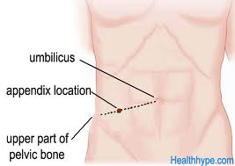
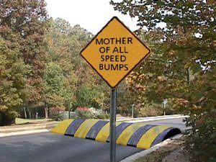
Diagnosis of Appendicitis
Rovsing’s sign
McBurney’s point
If palpation of the left lower quadrant of a person's abdomen results in more pain in the right lower quadrant
Psoas sign
Abdominal pain resulting from passively extending the thigh of a patient or asking the patient to actively flex his thigh at the hip
Ashdown’s sign
Pain when driving over speed bumps

Slide 61
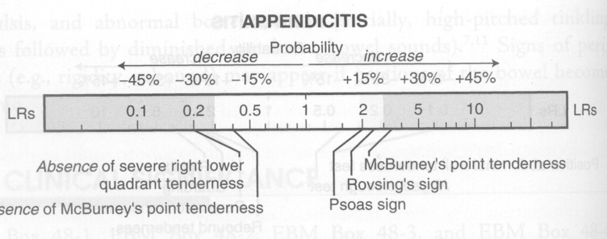
For Example
(LR+ = 3.4)
(LR- = 0.4)
Speed bump test (Ashdown’s sign):
LR+ = 1.4
LR- = 0.1
McGee: Evidence based Physical Diagnosis (Saunders Elsevier)

Slide 62
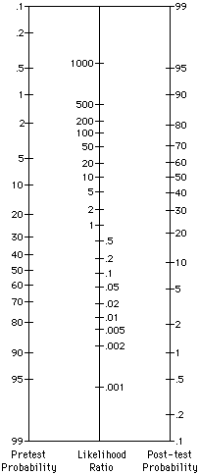
%
Fagan nomogram
Bayesian reasoning
Post-test odds for disease after one test become pre-test odds for next test etc.
Pre test 5%
?Appendicitis:
McBurney tenderness LR+ = 3.4
Post test ~20%
Speed bump test LR- = 0.1
Post-test odds =
Pre-test odds x Likelihood ratio
Post test ~0.5%
%

Slide 63
What about the news story…?

Slide 64
The researchers detected autism with over 90% accuracy, the Journal of Neuroscience reports.

Slide 65
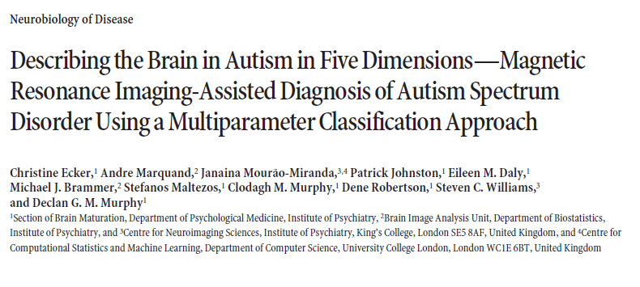
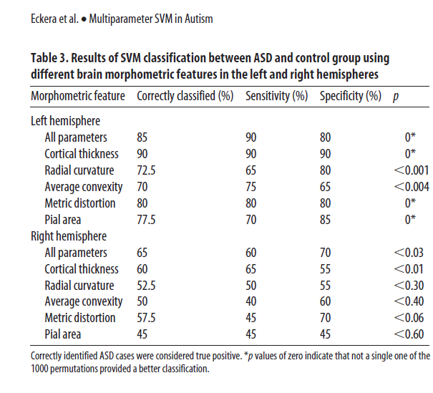

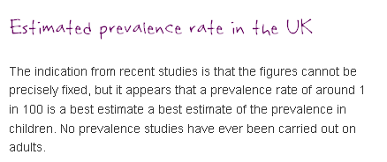

Slide 66
Natural Frequencies
Autism has a prevalence of 1%.
The test has sensitivity of 90% and specificity of 80%.
Given a positive test, what is the probability the child has autism?
2:00
1:59
1:58
1:57
1:56
1:55
1:54
1:53
1:52
1:51
1:50
1:49
1:48
1:47
1:46
1:45
1:44
1:43
1:42
1:41
1:40
1:39
1:38
1:37
1:36
1:35
1:34
1:33
1:32
1:31
1:30
1:29
1:28
1:27
1:26
1:25
1:24
1:23
1:22
1:21
1:20
1:19
1:18
1:17
1:16
1:15
1:14
1:13
1:12
1:11
1:10
1:09
1:08
1:07
1:06
1:05
1:04
1:03
1:02
1:01
1:00
0:59
0:58
0:57
0:56
0:55
0:54
0:53
0:52
0:51
0:50
0:49
0:48
0:47
0:46
0:45
0:44
0:43
0:42
0:41
0:40
0:39
0:38
0:37
0:36
0:35
0:34
0:33
0:32
0:31
0:30
0:29
0:28
0:27
0:26
0:25
0:24
0:23
0:22
0:21
0:20
0:19
0:18
0:17
0:16
0:15
0:14
0:13
0:12
0:11
0:10
0:09
0:08
0:07
0:06
0:05
0:04
0:03
0:02
0:01
End

Slide 67
Prevalence of 1%, Sensitivity of 90%, Specificity of 80%
Sensitivity = 90%
Disease +ve
20.7 people test positive………
of whom 0.9 have the disease
So, chance of disease is 0.9/20.7 = 4.5%
1
0.9
100
Testing +ve
99
19.8
Disease -ve
False positive rate = 20%

Slide 68


Slide 69


Slide 70


Slide 71
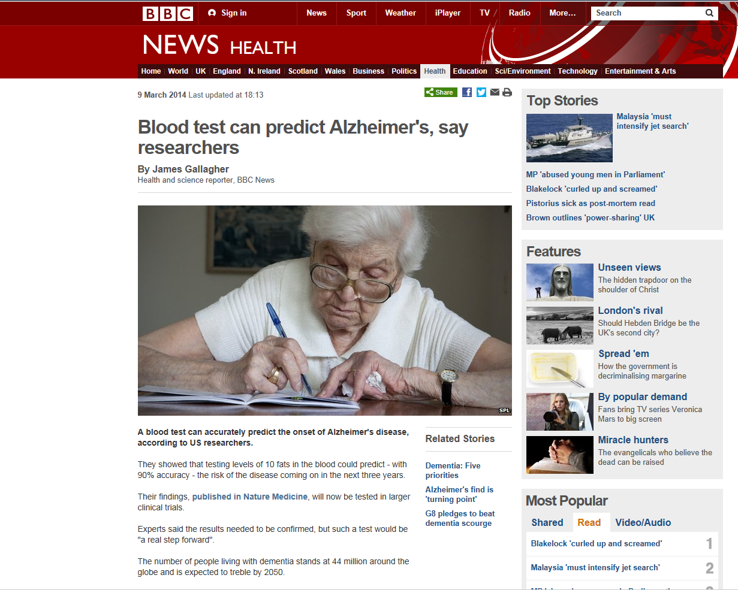
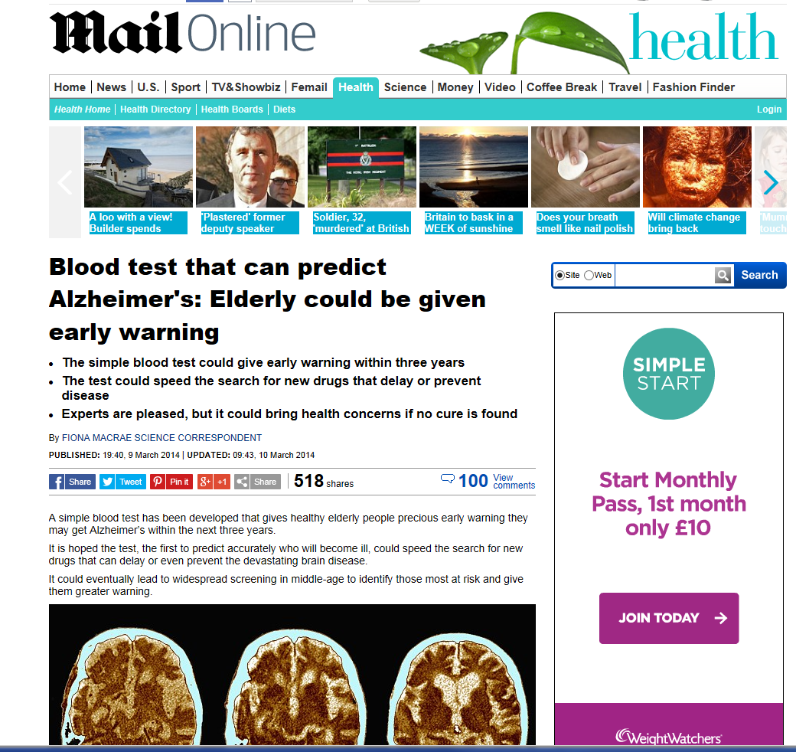
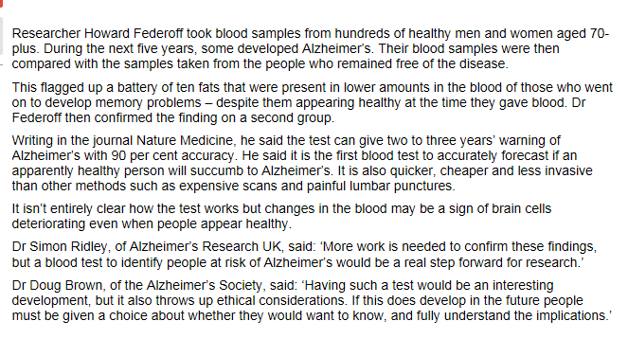

Slide 72
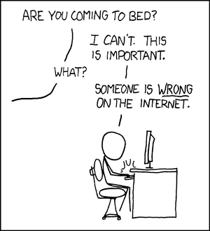
www.xkcd.com

Slide 73
Appraising diagnostic tests
Appropriate spectrum of patients?
Does everyone get the gold standard?
Is there an independent, blind or objective comparison with the gold standard?
Are the results valid?
What are the results?
Sensitivity, specificity
Likelihood ratios
Positive and Negative Predictive Values
Will they help me look after my patients?
Can I do the test in my setting?
Do results apply to the mix of patients I see?
Will the result change my management?
Costs to patient/health service?

Slide 74
Will the test apply in my setting?
Reproducibility of the test and interpretation in my setting
Do results apply to the mix of patients I see?
Will the results change my management?
Impact on outcomes that are important to patients?
Where does the test fit into the diagnostic strategy?
Costs to patient/health service?

Slide 75
What is the ONE thing I need to remember from today?
Are the results valid?
What are the results?
Will they help me look after my patients?
Don’t believe everything you are told,
Ask for the Evidence!

Slide 76
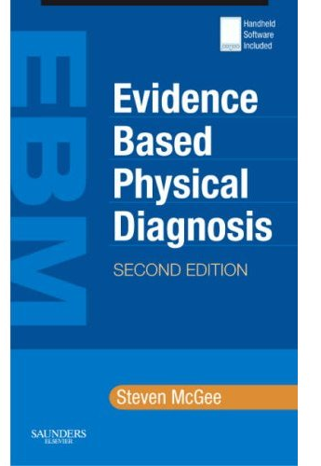
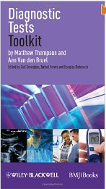
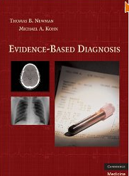
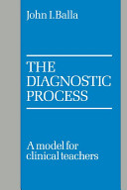
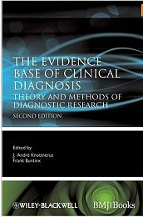
Useful books on diagnostics
Evidence based Physical Diagnosis. Steven McGee. Saunders
Diagnostic Tests Toolkit. Thompson & Van den Bruel. Wiley-Blackwell.
Evidence-based Diagnosis.
Newman & Kohn. Cambridge Univ. Press
The Diagnostic Process. John Balla.
Cambridge Univ. Press
Evidence base of Clinical Diagnosis.
Knottnerus & Buntinx.
Wiley-Blackwell

Slide 77
Useful journal articles on diagnostics
Bossuyt. Additional patient outcomes and pathways in evaluations of testing. Med Decis Making 2009
Heneghan et al. Diagnostic strategies used in primary care. BMJ 2009
Ferrante di Ruffano. Assessing the value of diagnostic tests: a framework for designing and evaluating trials. BMJ 2012
Mallett et al. Interpreting diagnostic accuracy studies for patient care. BMJ 2012
Bossuyt et al. STARD initiative. Ann Int Med 2003
Lord et al. Using priniciples of RCT design to guide test evaluation. Med Decis Making 2009
Rutjes et al. Evidence of bias and variation in diagnostic accuracy studies. CMAJ 2006
Lijmer et al. Proposals for phased evaluation of medical tests. Med Decis Making 2009
Whiting et al. QUADAS-2: revised tool for quality assessment of diagnostic accuracy studies. Ann Int Med 2011
Halligan S, Altman DG, Mallett S. Disadvantages of using the area under the receiver operating characteristic curve to assess imaging tests: A discussion and proposal for an alternative approach. Eur Radiol. 2015

