Slide 1
Developing a Lesson Plan
Identify elements that can make up a successful lesson.
Design a lesson to meet the needs of a specific group of learners.
On your green post-it, describe your group of students.

Slide 2
My Students
Will, Alex, Dan, Josh, Beth, Ben, Charlie, Natalia
& John, absent

Slide 3
My Students

Slide 4
Teaching vs ‘Giving a Talk’

Slide 6
Teacher

Slide 7
Learning objectives vs outcomes
Objectives | Outcomes
What a student will learn during the lesson. ‘Identify elements that can make up a successful lesson.’ | How the student could demonstrate their learning. ‘Design a lesson to meet the needs of a specific group of learners.’

Slide 8
Your learning objectives
E.g. ‘Understand the concept of a RCT and how to critically appraise one’
Write one on your first pink post-it

Slide 9
Your learning outcomes
How do you assess what your students have learned?
Is this idea of assessment common in your teaching practice? If not, is there a reason why not?
If you can identify a learning outcome, write one on your second pink post-it

Slide 10
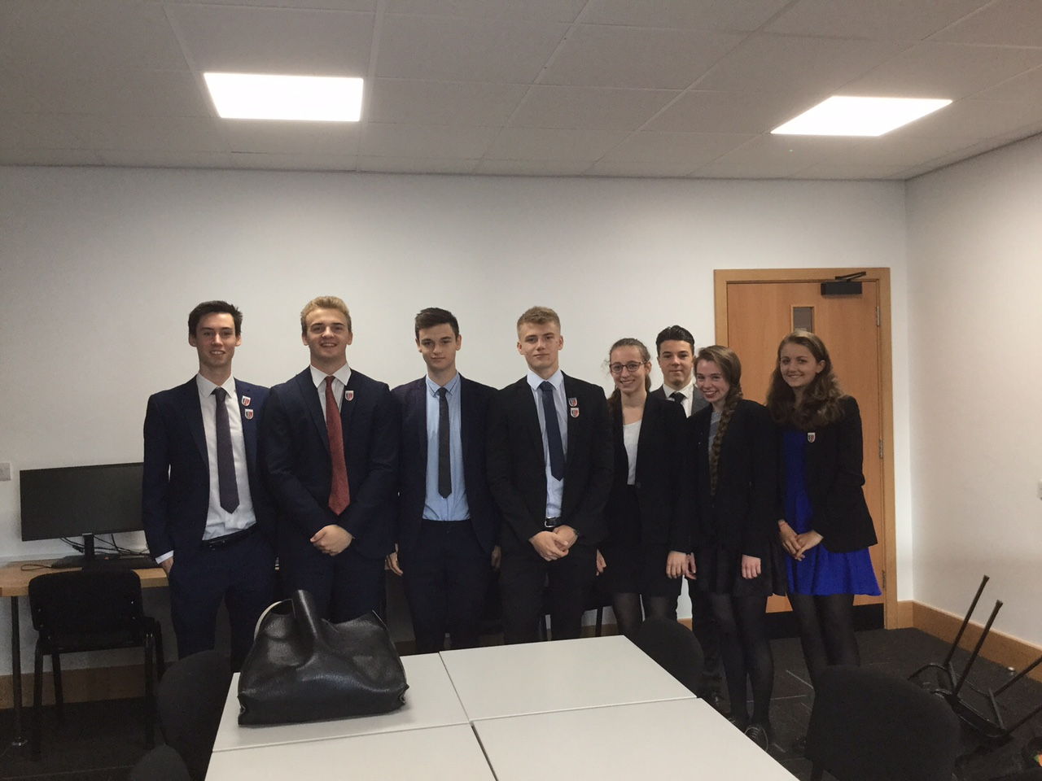
Lesson structure – the hook
What is going to engage your students straight away?
Is it something to think about?
Is it something they need to write?
Is it something they need to discuss?

Slide 11
Lesson structure – the hook
With the person next to you, spend 2 minutes discussing your hook.
Then write it on your first yellow post-it.
Don’t forget to consider your students and your lesson objective!

Slide 12
Lesson structure – ‘the middle bit’
The main content of your lesson.
Vary activities if possible.
Depends on how you like to teach and your audience.
Lots of considerations here!

Slide 13
Lesson structure – ‘the middle bit’
5-10 mins
Hook
5-10 mins
Plenary

Slide 14
Some considerations
Variation
Challenge
Differentiation
Improvisation
Be thinking – how can you develop activities that stretch, challenge, support and engage your students?

Slide 15
Variation
Varying activities allows learners to engage in the material in different ways.
Q & A
Discussion (pairs, groups, whole class)
Critical reading
Analysis
Summarising
Practical planning
Debate
Role play

Slide 16
Challenge:
“Zone of Proximal
Development”
Vygotsky
~ 1930
Frankly, there’s
no chance
I could do this
with some help
I’ve got this

Slide 17
Differentiation
What might prevent students from accessing a task?
Adjustment of teaching to meet student needs
Allowing all to learn effectively
Accounting for differences in prior knowledge & understanding

Slide 18
Ways to support students
Modeling
Running through an example yourself in front of the group, before asking them to try it themselves
Worked examples
Providing samples of pre-completed tasks for them to compare their own work against
Scaffolding
Giving structured steps for students to complete – breaking a task down into manageable chunks

Slide 19
Improvisation

Slide 20
Ideas about content
Consider your students and your lesson objective(s).
On your orange post-its, briefly describe two activities that could help your students to understand your objective.

Slide 21
Lesson structure – the plenary
Plenarius = complete
Wrapping up
Summarise the lesson
Refer back to the learning objective
How do they know what they know?
How do you know what they know?

Slide 22
Lesson structure – the plenary
With the person next to you, spend 2 minutes discussing your plenary.
Then write it on your second yellow post-it.

Slide 24
Plenary
You should have six post-its with ideas.
Spend 2 minutes telling someone else about your plan, then swap over.

Slide 25
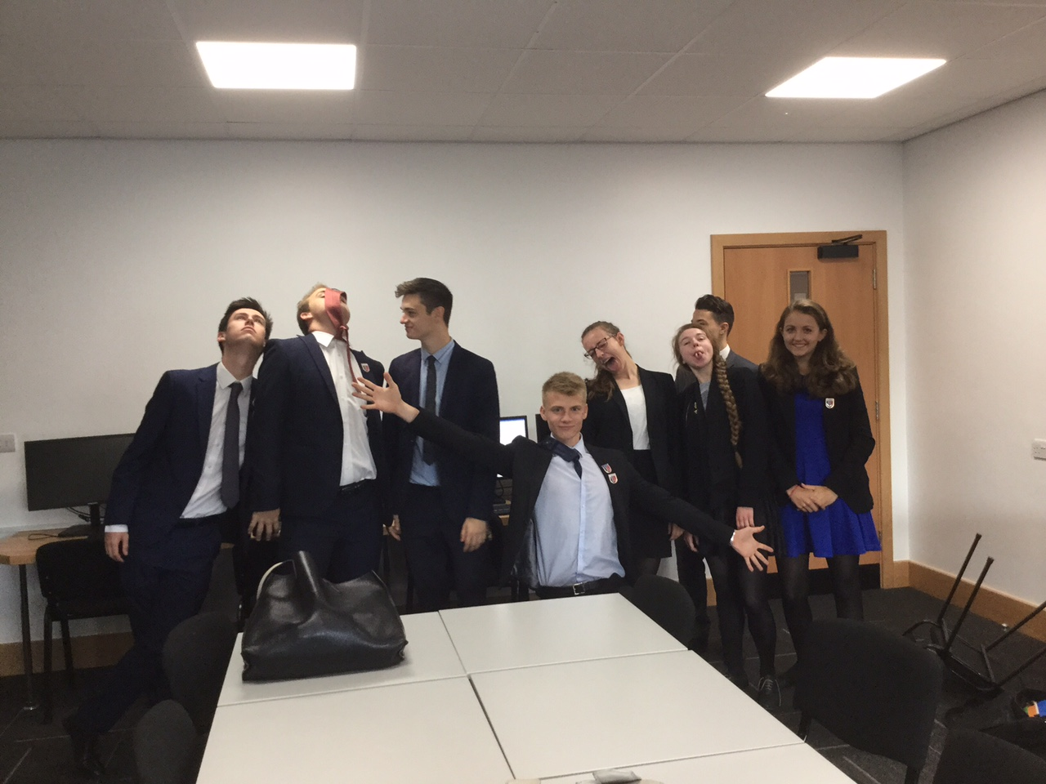
Lots of copying from slides.
Teachers who just read straight off their PowerPoint!
When the lesson takes forever to get to the point.
When the teacher spends the lesson talking and the students just have to listen.
Sitting in silence doing questions or reading the textbook and making notes on it.

Slide 26
Competition, especially working in teams against others.
Activities where students can participate, also a lesson where information is presented in different ways.
Group discussion or practical work.
When the teacher is actually interested in what they are telling you so they tell you more than you need to know so you understand it properly – but then give you printed notes or time to write down the vital bits.

