Slide 1


Teaching Tips for Diagnostic Studies
Dr. Annette Plüddemann
Nuffield Department of Primary Care Health Sciences
Centre for Evidence-Based Medicine

Slide 2
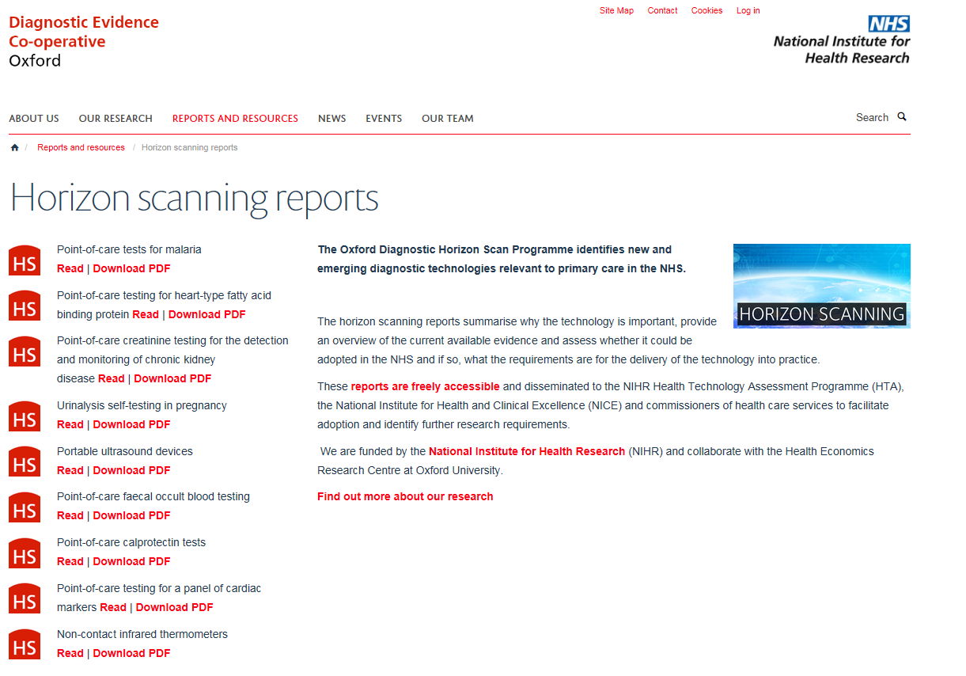
www.oxford.dec.nihr.ac.uk/horizon-scanning

Slide 3
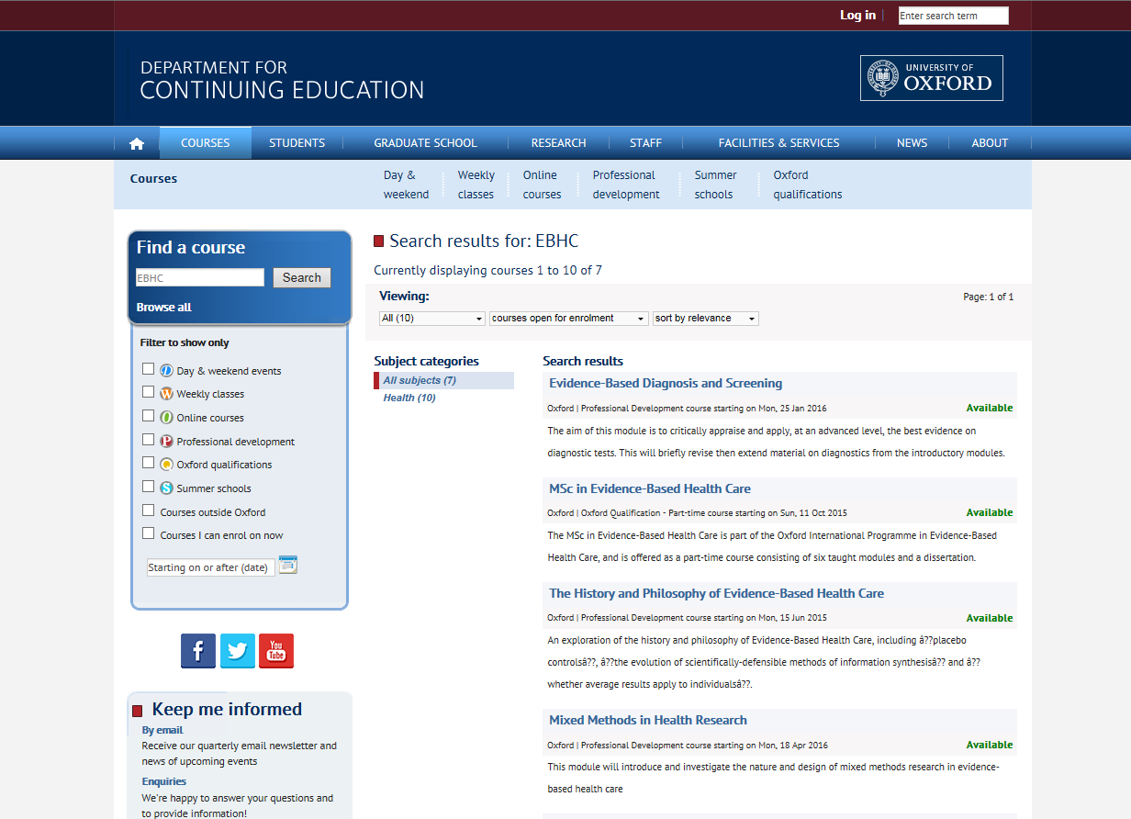

Slide 4
So far….
Does this treatment work?
Is this treatment better than doing nothing?
Which treatment is better?
How should I treat this patient?
Randomised controlled trial
Systematic review of an intervention
Notes:
Why is diagnosis important, how does it fit in EBHC

Slide 5
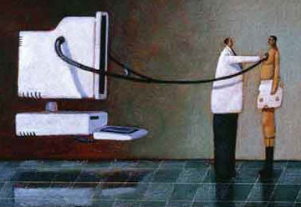
Diagnosis
Typically someone with abnormal symptoms consults a physician, who will obtain a history of their illness and examine them for signs of diseases.
The physician formulates a hypothesis of likely diagnoses and may or may not order further tests to clarify the diagnosis

Slide 6
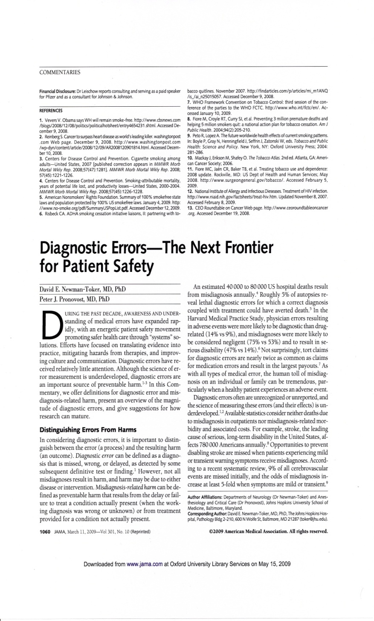
2/3 legal claims against GPs in UK
40,000-80,000 US hospital deaths from misdiagnosis per year
Adverse events, negligence cases, serious disability more likely to be related to misdiagnosis than drug errors

Slide 7
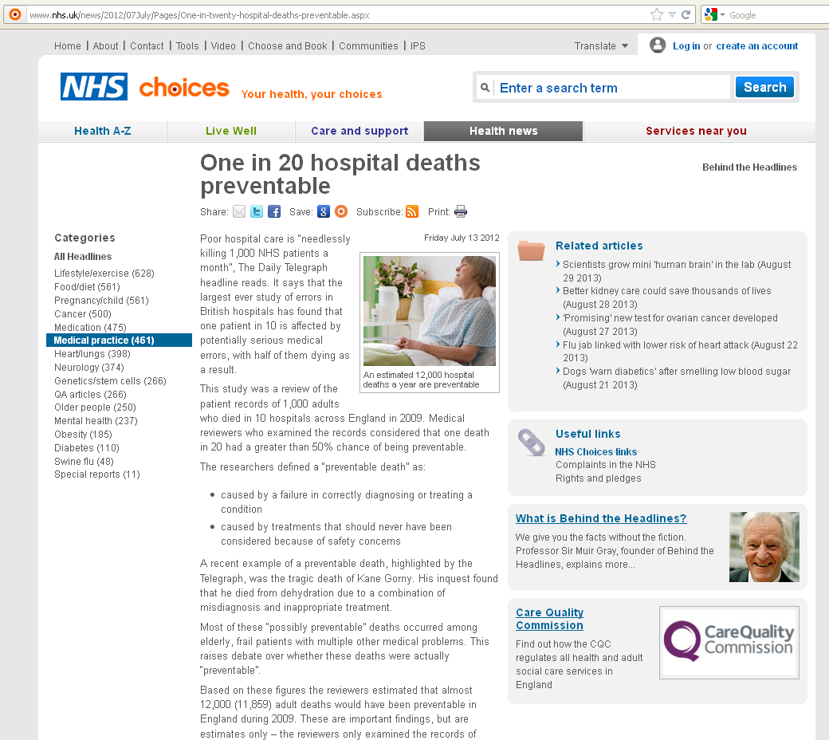
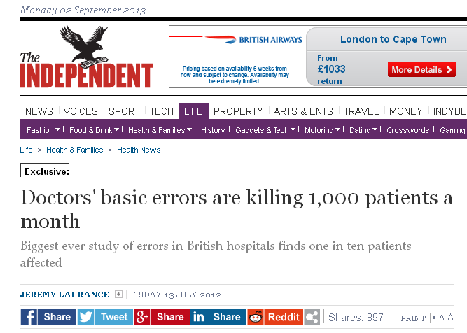
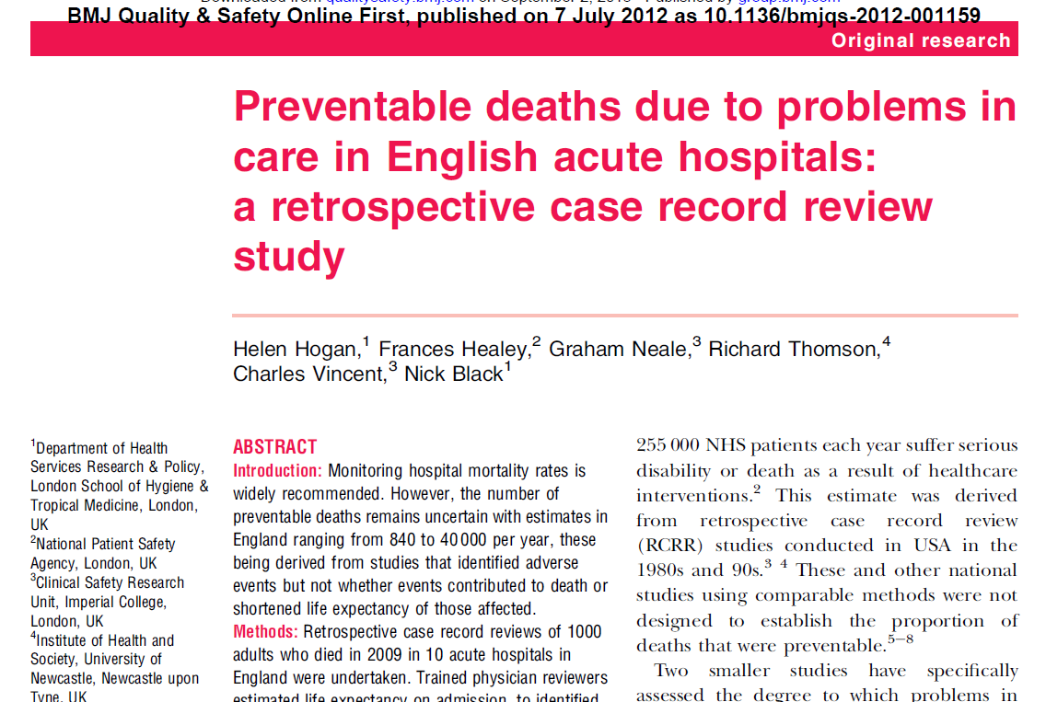
clinical monitoring (such as failure to act upon test results or monitor patients appropriately) – identified as a problem in 31% of preventable deaths
diagnosis (such as problems with physical examination or failure to seek a specialist opinion) – identified as a problem in 30% of preventable deaths
drugs or fluid management – identified as a problem in 21% of preventable deaths

Slide 8
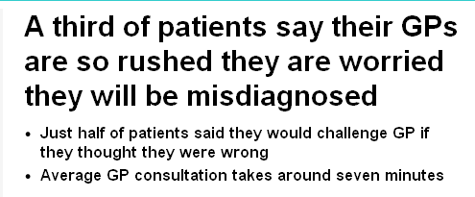
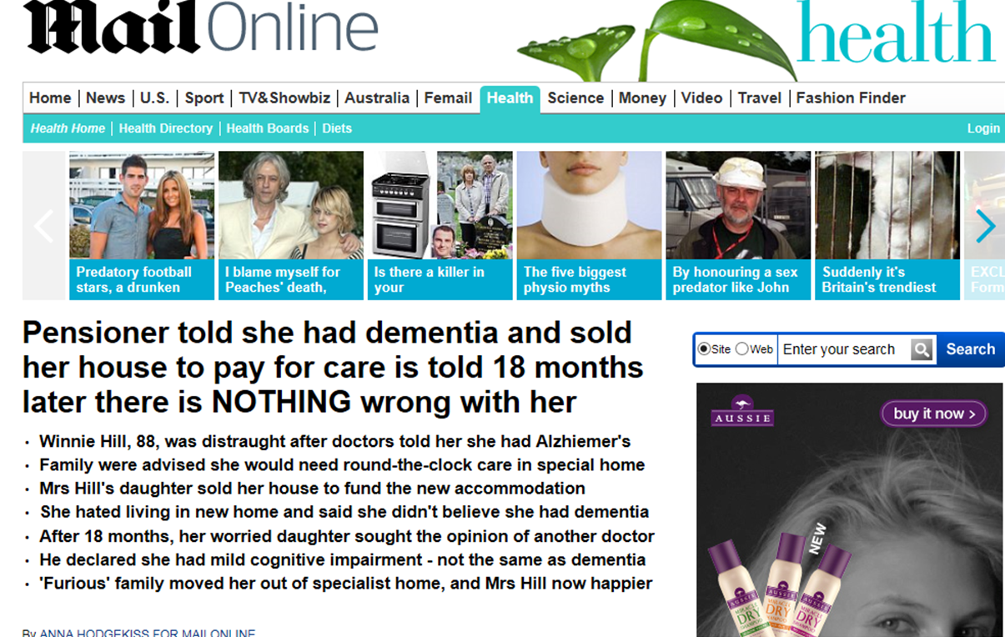
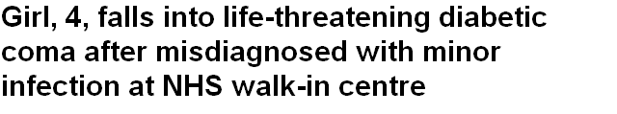
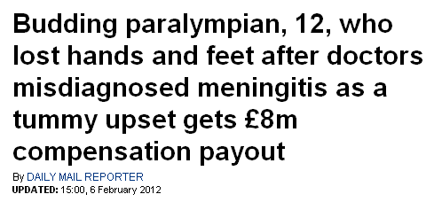

Slide 9
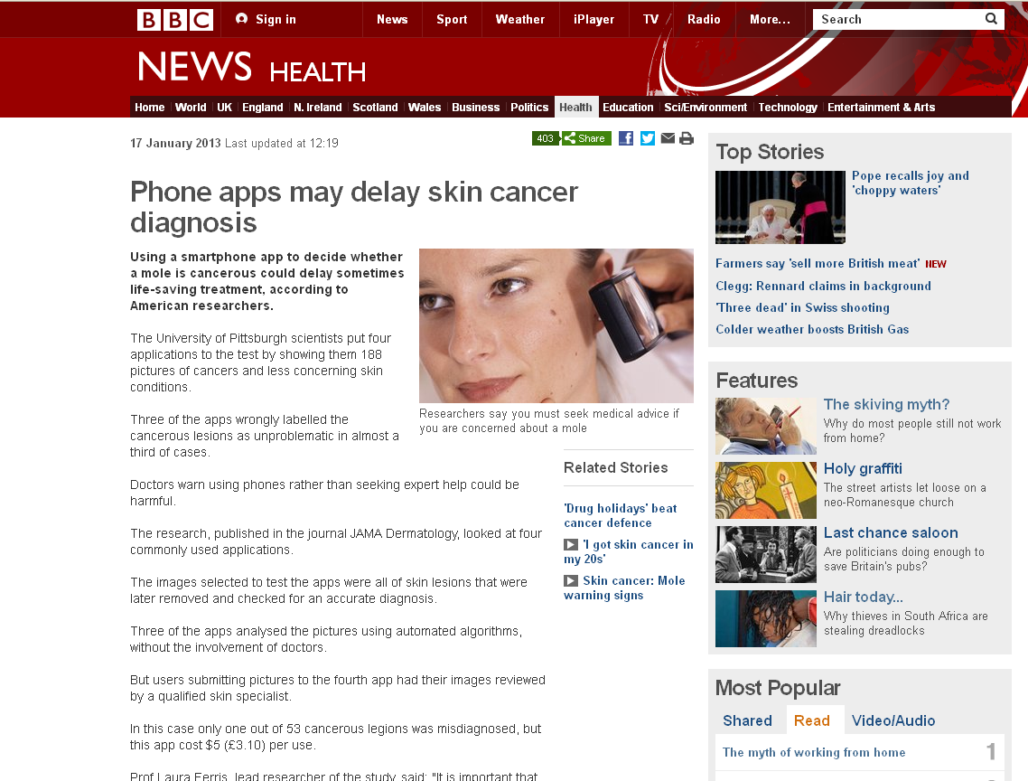
Wolf JA, Moreau J, Akilov O, Patton T, English JC, Ho J, Ferris LK.
Diagnostic Inaccuracy of Smartphone Applications for Melanoma Detection. JAMA Dermatol. 2013 Jan 16:1-4.

Slide 10
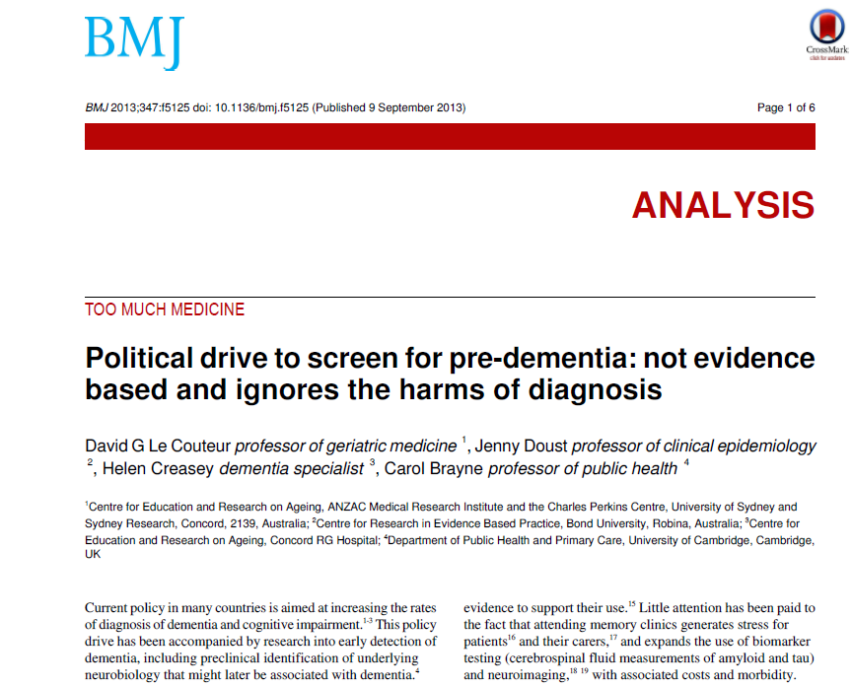
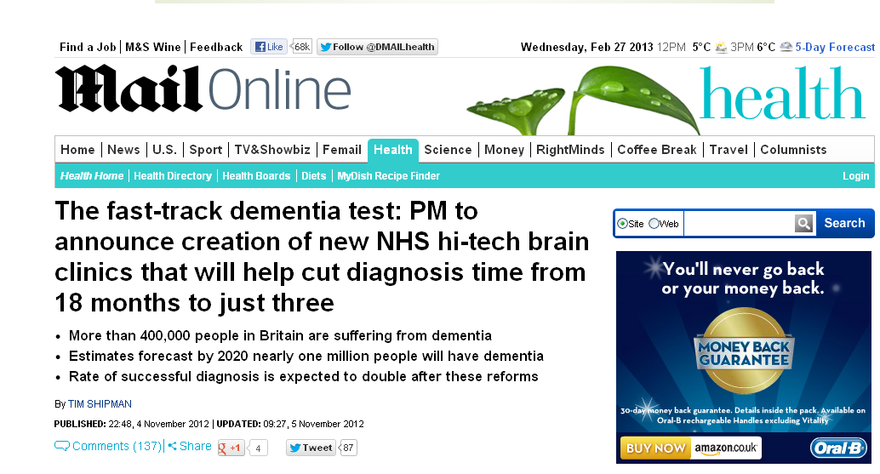

Slide 11
Module Timetable
 | Monday | Tuesday | Wednesday | Thursday | Friday
8.30 | Registration | Registration | Registration | Registration | Registration
9.00-10.30
10.30-11.00 | Coffee | Coffee | Coffee | Coffee | Coffee
11.00-12.30
12.30-13.30 | Lunch | Lunch | Lunch | Lunch | Lunch
13.30-15.00
15.00-15.30 | Coffee | Coffee | Coffee | Coffee | Coffee
15.30-17.00
Notes:
Groups of 3, 10min, populate a timetable for diagnostics module. What kind of things would you cover?

Slide 12
Module Timetable
 | Monday 26 January | Tuesday 27 January | Wednesday 28 January | Thursday 29 January | Friday 30 January
8.30 | Registration | Registration | Registration | Registration | Registration
9.00-10.30 | Introduction Carl Heneghan Annette Plüddemann | Diagnostic studies – the numbers Annette Plüddemann | Visualising and presenting diagnostic accuracy studies Rafael Perera | Screening Paul Hewitson | Rational monitoring Jason Oke and Richard Stevens
10.30-11.00 | Coffee | Coffee | Coffee | Coffee | Coffee
11.00-12.30 | Diagnostic study design Ann Van den Bruel | Sample size calculations Richard Stevens | Multiple tests Ann Van den Bruel | Overdiagnosis Jason Oke | Rational monitoring Jason Oke and Richard Stevens
12.30-13.30 | Lunch | Lunch | Lunch | Lunch | Lunch
13.30-15.00 | Searching skills Nia Roberts | Appraisal workshop Ann Van den Bruel | Systematic reviews of diagnostic studies Clare Bankhead | Evidence-based diagnostics for practice (including Q&A) Carl Heneghan | Student presentations
15.00-15.30 | Coffee | Coffee | Coffee | Coffee | Coffee
15.30-17.00 | Own search | Intermediate, indeterminate and uninterpretable results Beth Shinkins | Systematic reviews of diagnostic studies (2) Clare Bankhead | Using evidence to support the business case for a diagnostic test Chris Price | Evaluation and finish by 4.30
18.00-19.00 | Invited guest speaker:
19.00 | Drinks reception, Rewley House

Slide 13
Diagnostic strategies and what tests are used for

Slide 14
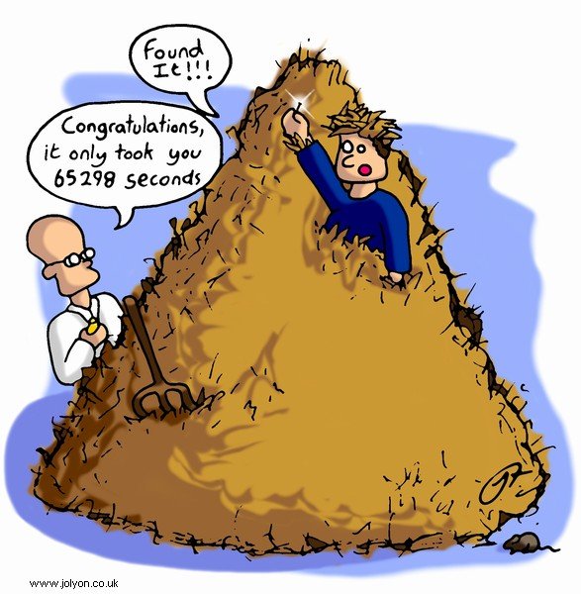
How do clinicians make diagnoses?
Patient history…examination…differential diagnosis…final diagnosis
Aim: identify types and frequency of diagnostic strategies used in primary care
  6 GPs collected and recorded strategies used on 300 patients.
(Diagnostic strategies used in primary care. Heneghan, et al,. BMJ 2009. 20;338:b9462009)

Slide 15
Diagnostic stages & strategies
Stage
Strategies used
Spot diagnoses
Self-labelling
Presenting complaint
Pattern recognition
Initiation of the diagnosis
Refinement of the diagnostic causes
Restricted Rule Outs
Stepwise refinement
Probabilistic reasoning
Pattern recognition fit
Clinical Prediction Rule
Defining the final diagnosis
Known Diagnosis
Further tests ordered
Test of treatment
Test of time
No label
(Heneghan et al, BMJ 2009)

Slide 16
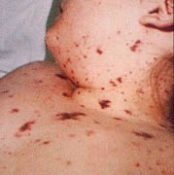
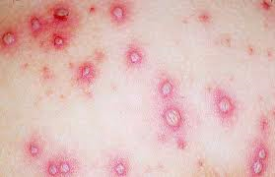
Not all diagnoses need tests?
Spot diagnosis
Meningitis
Chicken Pox
Notes:
Fig 2 Strategies used by general practitioners in making an initial diagnosis. Bars indicate means

Slide 17
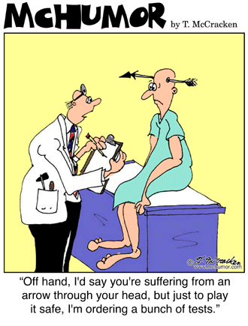
What are tests used for?
Increase certainty about presence/absence of disease
Disease severity
Monitor clinical course
Assess prognosis – risk/stage within diagnosis
Plan treatment e.g., location
Stall for time!

Slide 18
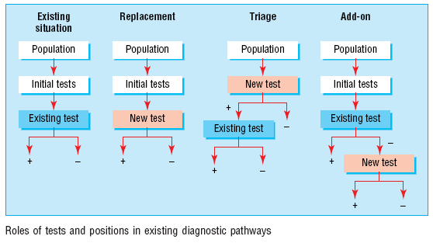
Roles of new tests
Replacement – new replaces old
  E.g. CT colonography for barium enema
Triage – new determines need for old
  E.g. B-natriuretic peptide for echocardiography
Add-on – new combined with old
  E.g. ECG and myocardial perfusion scan
Bossuyt et al BMJ 2006;332:1089–92

Slide 19
Critical appraisal of a diagnostic accuracy study

Slide 20
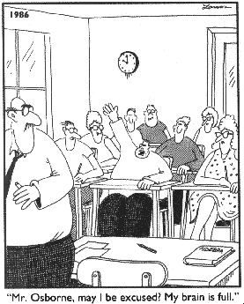
Diagnostic tests: What you need to know
Diagnostic tests: What you need to know
Validity of a diagnostic study
Interpret the results

Slide 21
Defining the clinical question: PICO or PIRT
Patient/Problem
  How would I describe a group of patients similar to mine?
Index test
  Which test am I considering?
Comparator… or …Reference Standard
  What is the best reference standard to diagnose the target condition?
Outcome….or….Target condition
  Which condition do I want to rule in or rule out?

Slide 22
Diagnostic Accuracy Studies
Series of patients
Index test
Reference standard
Compare the results of the index test with the reference standard, blinded

Slide 23
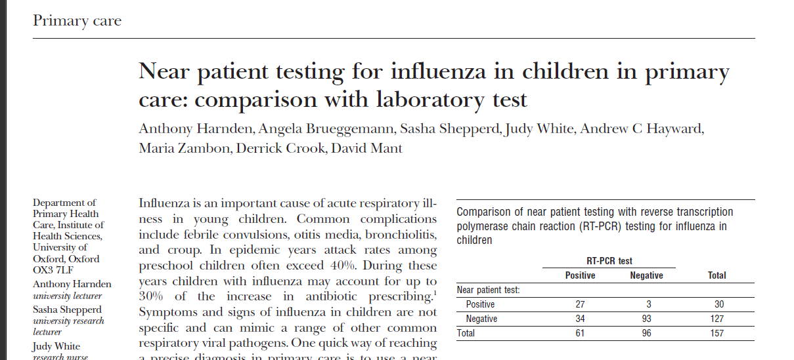
Diagnostic Study Example

Slide 24
Appraising diagnostic studies: 3 easy steps
Appropriate spectrum of patients?
Does everyone get the reference standard?
Is there an independent, blind or objective comparison with the reference standard?
Are the results valid?
What are the results?
Will they help me look after my patients?

Slide 25

Biases in Diagnostic Accuracy Studies…
The Ugly 5….
Notes:
Warthog hyena vulture marabou stork wildebeest

Slide 26
1. Appropriate spectrum of patients?
Ideally, test should be performed on a group of patients in whom it will be applied in the real world clinical setting
Spectrum bias:
study uses only highly selected patients…….perhaps those in whom you would really suspect have the diagnosis

Slide 27



Case-control vs consecutive
Notes:
Other examples of concrete imagery??

Slide 28
2. Do all patients have the reference standard?
Ideally all patients get the reference standard test
Verification bias:
only some patients get the reference standard…..probably the ones in whom you really suspect have the disease

Slide 29
Partial Reference Bias
Series of patients
Index test
Ref. Std. A
Compare the results of the index test with the reference standard, blinded

Slide 30
Differential Reference Bias
Series of patients
Index test
Ref. Std. A
Ref. Std. B
Blinded cross-classification

Slide 31
Incorporation Bias
Series of patients
Index test
Reference standard….. includes parts of Index test
Blinded cross-classification

Slide 32

3. Independent, blind or objective comparison with the reference standard?
Ideally, the reference standard is independent, blind and objective
Observer bias:
test is very subjective, or done by person who knows something about the patient or samples

Slide 33
Observer Bias
Series of patients
Index test
Reference standard
Unblinded cross-classification

Slide 34
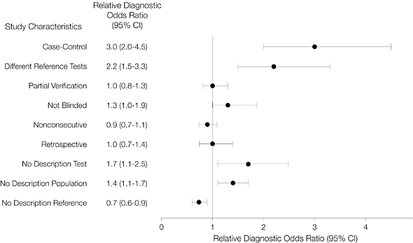
Effect of biases on results
Lijmer, J. G. et al. JAMA 1999;282:1061-1066

Slide 35
Diagnostic Study Example

Slide 36
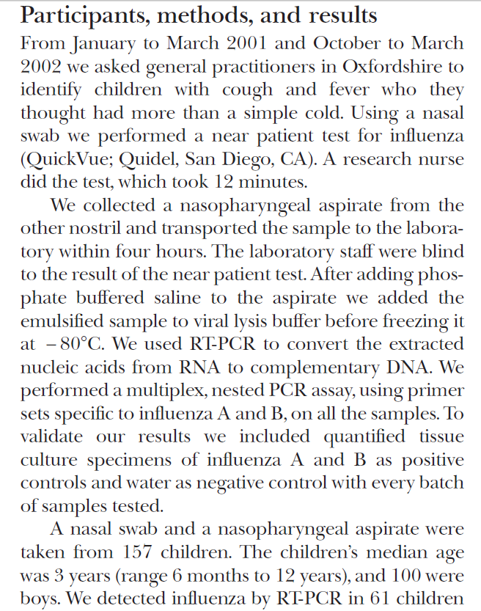
1. Spectrum
2. Index test
3. Reference standard
4. Blinding

Slide 37

Teaching tips….

Slide 38
Diagnostic tests: What you need to know
Diagnostic tests: What you need to know
Validity of a diagnostic study
Interpret the results
Set the scene, create a relaxed atmosphere; Humour

Slide 39
Diagnostic Accuracy Studies
Series of patients
Series of patients
Don’t use “gold” standard
In pictures
Index test
Index test
Reference standard
Ref. Std. A
Ref. Std. B
Compare the results of the index test with the reference standard, blinded
Blinded cross-classification

Slide 40
Biases in Diagnostic Accuracy Studies…
Think about how to help people remember; bring in some of your interests/personality
The Ugly 5….

Slide 41
Case-control vs consecutive
Use analogies that are not medical
Get tips from other teachers!
Notes:
Other examples of concrete imagery??

Slide 42
Effect of biases on results
Show some evidence, but don’t make it too complex
Lijmer, J. G. et al. JAMA 1999;282:1061-1066

Slide 43
Diagnostic Study Example
Interactive;
Use an easy example!
…

Slide 44
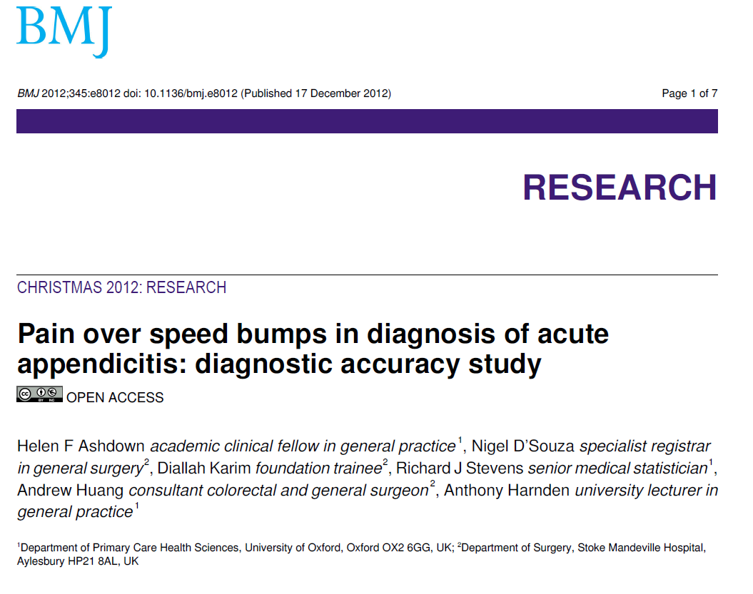
Diagnostic Study Example
If you want to use something which shows potential bias, don’t use a complex test

Slide 45
The Numbers

Slide 46


Using a brain scan, the researchers detected autism with over 90% accuracy…
You can’t diagnose autism with a brain scan...

Slide 47
Appraising diagnostic tests
Appropriate spectrum of patients?
Does everyone get the reference standard?
Is there an independent, blind or objective comparison with the gold standard?
Are the results valid?
What are the results?
Sensitivity, specificity
Likelihood ratios
Positive and Negative Predictive Values
Will they help me look after my patients?

Slide 48
Diagnostic Study Example

Slide 49
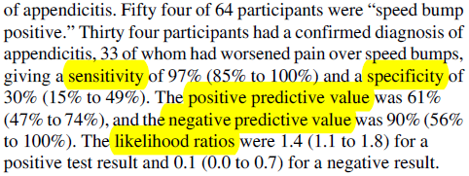

Slide 50
Sensitivity and Specificity

Slide 51
The 2 by 2 table
Disease
+
-
True positives
False positives
+
Test
False negatives
True negatives
-

Slide 52
The 2 by 2 table: Sensitivity
Disease
Proportion of people WITH the disease who have a positive test result.
+
-
90
a
True positives
+
So, a test with 90% sensitivity….means that the test identifies 90 out of 100 people WITH the disease
Test
10
c
False negatives
-
Sensitivity = a / a + c
Sensitivity = 90/100

Slide 53
The 2 by 2 table: Specificity
Disease
+
-
Proportion of people WITHOUT the disease who have a negative test result.
25
b
False positives
+
So, a test with 75% specificity will be NEGATIVE in 75 out of 100 people WITHOUT the disease
Test
75
d
True negatives
-
Specificity = d / b + d
Specificity = 75/100

Slide 54
The Speed bump Example
Disease: Appendicitis
+
-
There were 34 people who had appendicitis…the speed bump test was positive in 33 of them
33
21
54
+
Test: Pain over speed bump
1
9
10
There were 30 people who did not have appendicitis… the speed bump test was negative in 9 of them
-
34
30
64
Sensitivity = 33/34 = 0.97 (97%)
Specificity = 9/30 = 0.30 (30%)

Slide 55
Tip
Sensitivity is useful to me
  ‘The new speed bump test was positive in 33 out of 34 people with appendicitis (sensitivity = 97%)’
Specificity seems a bit confusing!
  ‘The new speed bump test was negative in 9 of the 30 people who did not have appendicitis (specificity = 30%)’
So…the false positive rate is sometimes easier
  ‘There were 30 people who did not have appendicitis… the speed bump test was falsely positive in 21 of them’
  So a specificity of 30% means that the new speedbump test is wrong (or falsely positive) in 70% of people
False positive rate = 1 - specificity

Slide 56
Ruling In and Ruling Out
High Sensitivity
A good test to help in Ruling Out disease
High sensitivity means there are very few false negatives – so if the test comes back negative it’s highly unlikely the person has the disease
SnNOUT
High Specificity
A good test to help in Ruling In disease
High specificity means there are very few false positives – so if the test comes back positive it’s highly likely the person has the disease
SpPIN
Disease: Appendicitis
Disease
+
-
+
-
a
True positives
b
False positives
33
21
+
+
Test
Test: Pain over speed bump
-
c
False negatives
d
True negatives
1
9
-
Sensitivity = 97%
Specificity = 30%
Sensitivity = a/a+c
Specificity = d/b+d

Slide 57
Predictive Values

Slide 58
Positive and Negative Predictive Value
Disease
PPV = Proportion of people with a positive test who have the disease.
+
-
a
True positives
b
False positives
PPV = a / a + b
+
Test
c
False negatives
d
True negatives
NPV = d / c + d
-
NPV = Proportion of people with a negative test who do not have the disease.

Slide 59
The Speed bump Example
Disease: Appendicitis
+
-
PPV = 33/54 = 61%
33
21
54
+
Test: Pain over speedbump
NPV = 9/10 = 90%
1
9
10
-
34
30
64

Slide 60

Predictive Value: Natural Frequencies
Your father went to his doctor and was told that his test for a disease was positive. He is really worried, and comes to ask you for help!
After doing some reading, you find that for men of his age:
The prevalence of the disease is 30%
The test has sensitivity of 50% and specificity of 90%
“Tell me what’s the chance I have this disease?”

Slide 61

Predictive Value
100% Likely
50% Maybe
0% Unlikely
Disease has a prevalence of 30%.
The test has sensitivity of 50% and specificity of 90%.

Slide 62
Natural Frequencies
Disease has a prevalence of 30%.
The test has sensitivity of 50% and specificity of 90%.
Given a positive test, what is the probability your dad has the disease
2:00
1:59
1:58
1:57
1:56
1:55
1:54
1:53
1:52
1:51
1:50
1:49
1:48
1:47
1:46
1:45
1:44
1:43
1:42
1:41
1:40
1:39
1:38
1:37
1:36
1:35
1:34
1:33
1:32
1:31
1:30
1:29
1:28
1:27
1:26
1:25
1:24
1:23
1:22
1:21
1:20
1:19
1:18
1:17
1:16
1:15
1:14
1:13
1:12
1:11
1:10
1:09
1:08
1:07
1:06
1:05
1:04
1:03
1:02
1:01
1:00
0:59
0:58
0:57
0:56
0:55
0:54
0:53
0:52
0:51
0:50
0:49
0:48
0:47
0:46
0:45
0:44
0:43
0:42
0:41
0:40
0:39
0:38
0:37
0:36
0:35
0:34
0:33
0:32
0:31
0:30
0:29
0:28
0:27
0:26
0:25
0:24
0:23
0:22
0:21
0:20
0:19
0:18
0:17
0:16
0:15
0:14
0:13
0:12
0:11
0:10
0:09
0:08
0:07
0:06
0:05
0:04
0:03
0:02
0:01
End

Slide 63
Prevalence of 30%, Sensitivity of 50%, Specificity of 90%
Sensitivity = 50%
Disease +ve
22 people test positive………
of whom 15 have the disease
So, chance of disease is 15/22 = 68%
30
15
100
Testing +ve
70
7
Disease -ve
False positive rate = 10%

Slide 64
Prevalence of 4%, Sensitivity of 50%, Specificity of 90%
Sensitivity = 50%
Disease +ve
11.6 people test positive………
of whom 2 have the disease
So, chance of disease is 2/11.6 = 17%
4
2
100
Testing +ve
96
9.6
Disease -ve
False positive rate = 10%

Slide 65
Positive and Negative Predictive Value
NOTE
PPV and NPV are not intrinsic to the test – they also depend on the prevalence!
NPV and PPV should only be used if the ratio of the number of patients in the disease group and the number of patients in the healthy control group is equivalent to the prevalence of the diseases in the studied population
Use Likelihood Ratio - does not depend on prevalence

Slide 66
Teaching tips….

Slide 67
Using a brain scan, the researchers detected autism with over 90% accuracy…
You can’t diagnose autism with a brain scan...
Use examples from the news, blogs, things that people come across – relevant to everyone, not just clinicians;
Suspense…

Slide 68
Find a simple paper with different measures and the actual numbers

Slide 69
The 2 by 2 table: Sensitivity
Disease
Explain the concepts in words. Don’t focus on formulas – some like them (so provide them), but for many this feels too much like “MATHS!”
Proportion of people WITH the disease who have a positive test result.
+
-
90
a
True positives
+
So, a test with 90% sensitivity….means that the test identifies 90 out of 100 people WITH the disease
Test
10
c
False negatives
-
Sensitivity = a / a + c
Sensitivity = 90/100

Slide 70
The Speed bump Example
Disease: Appendicitis
Use numbers from a paper; simple language; It’s more important to understand what it all means than to know how to calculate
+
-
There were 34 people who had appendicitis…the speed bump test was positive in 33 of them
33
21
54
+
Test: Pain over speed bump
1
9
10
There were 30 people who did not have appendicitis… the speed bump test was negative in 9 of them
-
34
30
64
Sensitivity = 33/34 = 0.97 (97%)
Specificity = 9/30 = 0.30 (30%)

Slide 71
Tip
Sensitivity is useful to me
  ‘The new speed bump test was positive in 33 out of 34 people with appendicitis (sensitivity = 97%)’
Specificity seems a bit confusing!
  ‘The new speed bump test was negative in 9 of the 30 people who did not have appendicitis (specificity = 30%)’
So…the false positive rate is sometimes easier
  ‘There were 30 people who did not have appendicitis… the speed bump test was falsely positive in 21 of them’
  So a specificity of 30% means that the new rapid test is wrong (or falsely positive) in 70% of people
False positive rate is easier to understand than specificity – provide options!
False positive rate = 1 - specificity

Slide 72
Ruling In and Ruling Out
High Sensitivity
For beginners this may be a step too far…
Acronyms help some…but confuse others
A good test to help in Ruling Out disease
High sensitivity means there are very few false negatives – so if the test comes back negative it’s highly unlikely the person has the disease
SnNOUT
High Specificity
A good test to help in Ruling In disease
High specificity means there are very few false positives – so if the test comes back positive it’s highly likely the person has the disease
SpPIN
Touch on it…then park it and move on…
Disease: Appendicitis
Disease
+
-
+
-
a
True positives
b
False positives
33
21
+
+
Test
Test: Pain over speed bump
-
c
False negatives
d
True negatives
1
9
-
Sensitivity = 97%
Specificity = 30%
Sensitivity = a/a+c
Specificity = d/b+d

Slide 73
Predictive Value: Natural Frequencies
A simple, common scenario everyone can relate to
Your father went to his doctor and was told that his test for a disease was positive. He is really worried, and comes to ask you for help!
After doing some reading, you find that for men of his age:
The prevalence of the disease is 30%
The test has sensitivity of 50% and specificity of 90%
“Tell me what’s the chance I have this disease?”

Slide 74
Predictive Value
100% Likely
50% Maybe
0% Unlikely
Have a go… interactive… safe environment
Disease has a prevalence of 30%.
The test has sensitivity of 50% and specificity of 90%.

Slide 75
Natural Frequencies
Disease has a prevalence of 30%.
The test has sensitivity of 50% and specificity of 90%.
Given a positive test, what is the probability your dad has the disease
Set a time and stick to it!
2:00
1:59
1:58
1:57
1:56
1:55
1:54
1:53
1:52
1:51
1:50
1:49
1:48
1:47
1:46
1:45
1:44
1:43
1:42
1:41
1:40
1:39
1:38
1:37
1:36
1:35
1:34
1:33
1:32
1:31
1:30
1:29
1:28
1:27
1:26
1:25
1:24
1:23
1:22
1:21
1:20
1:19
1:18
1:17
1:16
1:15
1:14
1:13
1:12
1:11
1:10
1:09
1:08
1:07
1:06
1:05
1:04
1:03
1:02
1:01
1:00
0:59
0:58
0:57
0:56
0:55
0:54
0:53
0:52
0:51
0:50
0:49
0:48
0:47
0:46
0:45
0:44
0:43
0:42
0:41
0:40
0:39
0:38
0:37
0:36
0:35
0:34
0:33
0:32
0:31
0:30
0:29
0:28
0:27
0:26
0:25
0:24
0:23
0:22
0:21
0:20
0:19
0:18
0:17
0:16
0:15
0:14
0:13
0:12
0:11
0:10
0:09
0:08
0:07
0:06
0:05
0:04
0:03
0:02
0:01
End

Slide 76
Prevalence of 30%, Sensitivity of 50%, Specificity of 90%
Simple numbers = year 2 maths; reinforces sensitivity and specificity;
No formulas!
Sensitivity = 50%
Disease +ve
22 people test positive………
of whom 15 have the disease
So, chance of disease is 15/22 = 68%
30
15
100
Testing +ve
70
7
Disease -ve
False positive rate = 10%

Slide 77
Prevalence of 4%, Sensitivity of 50%, Specificity of 90%
Change the prevalence, keep other numbers the same… learning by doing;
Good transition to likelihood ratios
Sensitivity = 50%
Disease +ve
11.6 people test positive………
of whom 2 have the disease
So, chance of disease is 2/11.6 = 17%
4
2
100
Testing +ve
96
9.6
Disease -ve
False positive rate = 10%

Slide 78
Likelihood Ratios

Slide 79
Likelihood ratios
Probability of clinical finding in patients with disease
LR =
Probability of same finding in patients without disease
Example:
If 80% of people with a cold have a runny nose
and 10% of people without a cold have a runny nose,
then the LR for runny nose is:
80%/10% = 8

Slide 80
Likelihood ratios
Positive likelihood ratio (LR+)
How much more likely is a positive test to be found in a person with the disease than in a person without it?
LR+ = sens/(1-spec)
Negative likelihood ratio (LR-)
How much more likely is a negative test to be found in a person without the disease than in a person with it?
LR- = (1-sens)/(spec)

Slide 81
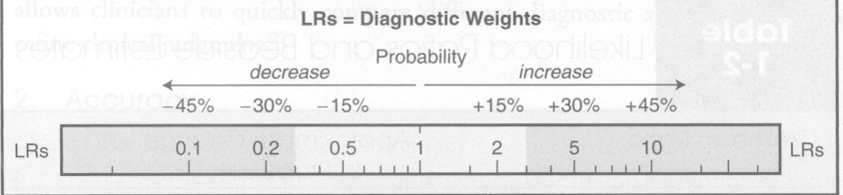
What do likelihood ratios mean?
LR=1
No diagnostic value
LR>10 = strong positive test result
LR<0.1 = strong negative test result

Slide 82
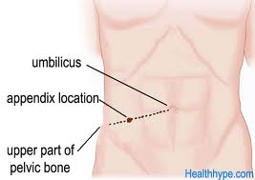
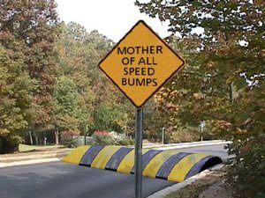
Diagnosis of Appendicitis
Rovsing’s sign
McBurney’s point
If palpation of the left lower quadrant of a person's abdomen results in more pain in the right lower quadrant
Psoas sign
Abdominal pain resulting from passively extending the thigh of a patient or asking the patient to actively flex his thigh at the hip
Ashdown’s sign
Pain when driving over speed bumps

Slide 83
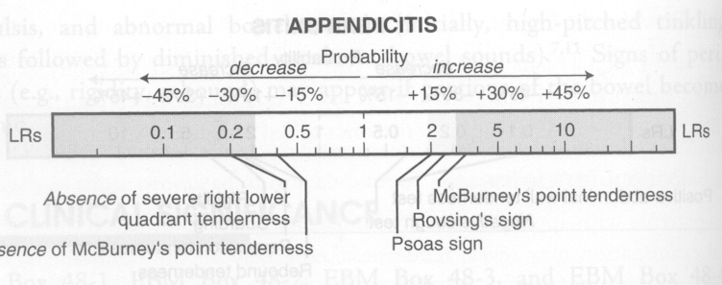
For Example
(LR+ = 3.4)
(LR- = 0.4)
Speed bump test (Ashdown’s sign):
LR+ = 1.4
LR- = 0.1
McGee: Evidence based Physical Diagnosis (Saunders Elsevier)

Slide 84
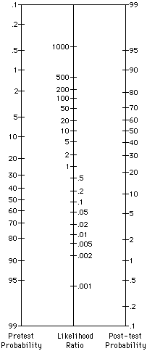
%
Fagan nomogram
Bayesian reasoning
Post-test odds for disease after one test become pre-test odds for next test etc.
Pre test 5%
?Appendicitis:
McBurney tenderness LR+ = 3.4
Post test ~20%
Speed bump test LR- = 0.1
Post-test odds =
Pre-test odds x Likelihood ratio
Post test ~0.5%
%

Slide 85
Teaching tips….

Slide 86
Likelihood ratios
Definition is wordy…so give a simple example
Probability of clinical finding in patients with disease
LR =
Probability of same finding in patients without disease
Example:
If 80% of people with a cold have a runny nose
and 10% of people without a cold have a runny nose,
then the LR for runny nose is:
80%/10% = 8

Slide 87
Likelihood ratios
Positive likelihood ratio (LR+)
How much more likely is a positive test to be found in a person with the disease than in a person without it?
Calculation in terms of sensitivity/ specificity is simpler and more useful than formula from the 2x2 table
LR+ = sens/(1-spec)
Negative likelihood ratio (LR-)
How much more likely is a negative test to be found in a person without the disease than in a person with it?
LR- = (1-sens)/(spec)

Slide 88
What do likelihood ratios mean?
Knowing what LRs mean is more important than how to calculate
LR=1
No diagnostic value
LR>10 = strong positive test result
LR<0.1 = strong negative test result

Slide 89
Diagnosis of Appendicitis
Rovsing’s sign
McBurney’s point
Simple example… related to the paper
If palpation of the left lower quadrant of a person's abdomen results in more pain in the right lower quadrant
Psoas sign
Abdominal pain resulting from passively extending the thigh of a patient or asking the patient to actively flex his thigh at the hip
Ashdown’s sign
Pain when driving over speed bumps

Slide 90
For Example
Putting numbers on the scale makes it clearer
(LR+ = 3.4)
(LR- = 0.4)
Speed bump test (Ashdown’s sign):
LR+ = 1.4
LR- = 0.1
McGee: Evidence based Physical Diagnosis (Saunders Elsevier)

Slide 91
%
Fagan nomogram
Bayesian reasoning
Post-test odds for disease after one test become pre-test odds for next test etc.
Key concept: Nomogram links pre- and post-test odds
Pre test 5%
?Appendicitis:
McBurney tenderness LR+ = 3.4
Post test ~20%
Speed bump test LR- = 0.1
Post-test odds =
Pre-test odds x Likelihood ratio
Post test ~0.5%
%

Slide 92
What about the news story…?

Slide 93
The researchers detected autism with over 90% accuracy, the Journal of Neuroscience reports.

Slide 94
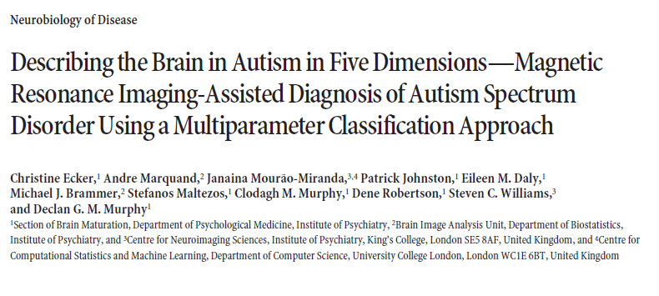
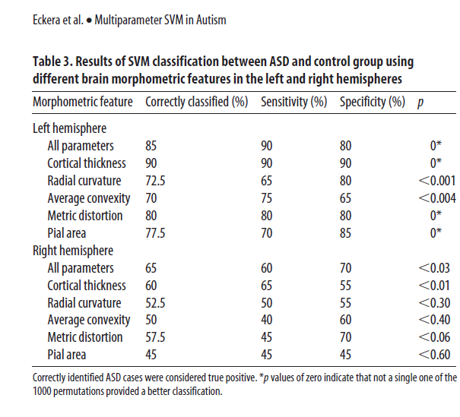

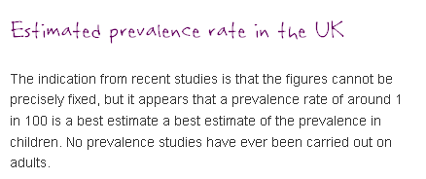

Slide 95
Natural Frequencies
Autism has a prevalence of 1%.
The test has sensitivity of 90% and specificity of 80%.
Given a positive test, what is the probability the child has autism?
2:00
1:59
1:58
1:57
1:56
1:55
1:54
1:53
1:52
1:51
1:50
1:49
1:48
1:47
1:46
1:45
1:44
1:43
1:42
1:41
1:40
1:39
1:38
1:37
1:36
1:35
1:34
1:33
1:32
1:31
1:30
1:29
1:28
1:27
1:26
1:25
1:24
1:23
1:22
1:21
1:20
1:19
1:18
1:17
1:16
1:15
1:14
1:13
1:12
1:11
1:10
1:09
1:08
1:07
1:06
1:05
1:04
1:03
1:02
1:01
1:00
0:59
0:58
0:57
0:56
0:55
0:54
0:53
0:52
0:51
0:50
0:49
0:48
0:47
0:46
0:45
0:44
0:43
0:42
0:41
0:40
0:39
0:38
0:37
0:36
0:35
0:34
0:33
0:32
0:31
0:30
0:29
0:28
0:27
0:26
0:25
0:24
0:23
0:22
0:21
0:20
0:19
0:18
0:17
0:16
0:15
0:14
0:13
0:12
0:11
0:10
0:09
0:08
0:07
0:06
0:05
0:04
0:03
0:02
0:01
End

Slide 96
Prevalence of 1%, Sensitivity of 90%, Specificity of 80%
Sensitivity = 90%
Disease +ve
20.7 people test positive………
of whom 0.9 have the disease
So, chance of disease is 0.9/20.7 = 4.5%
1
0.9
100
Testing +ve
99
19.8
Disease -ve
False positive rate = 20%

Slide 97


Slide 98


Slide 99


Slide 100
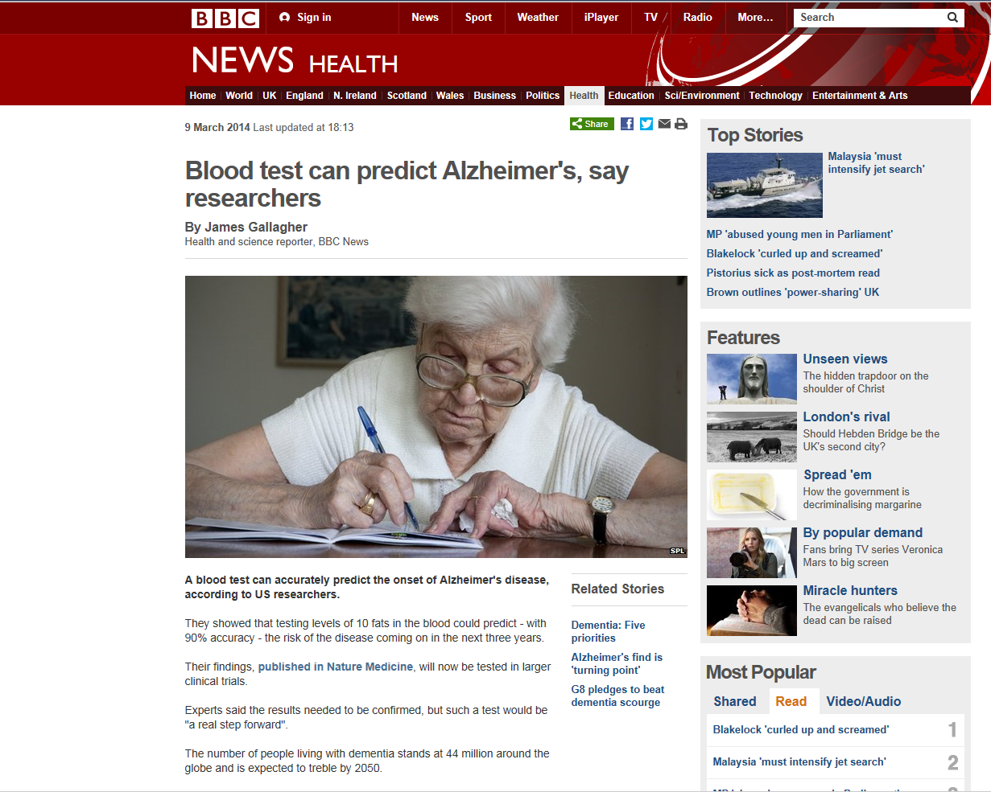
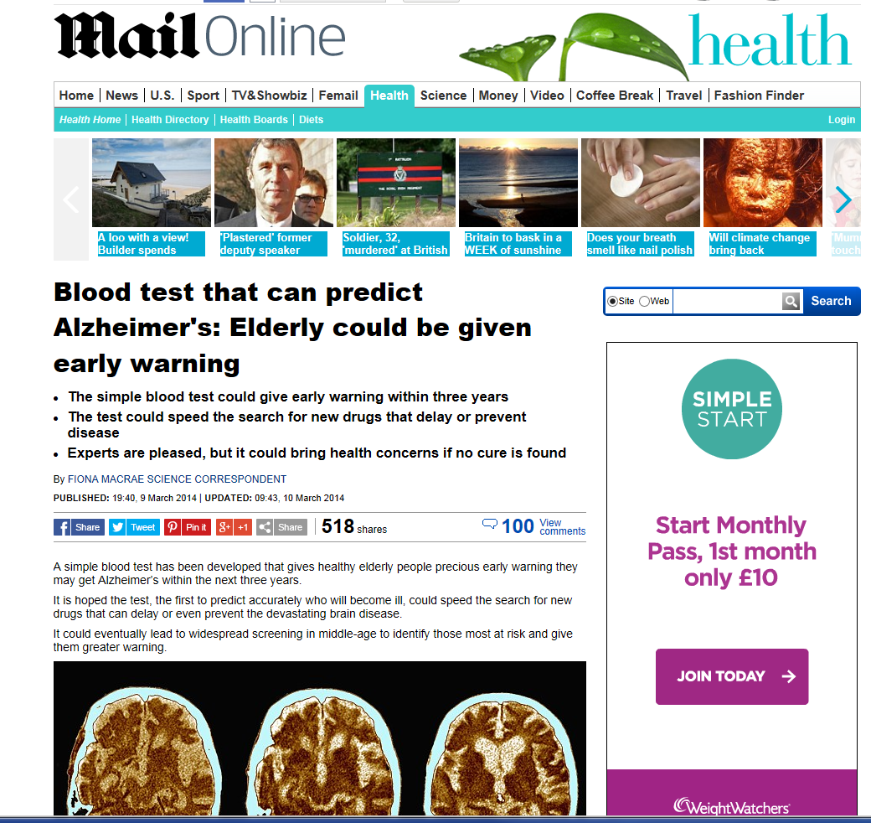
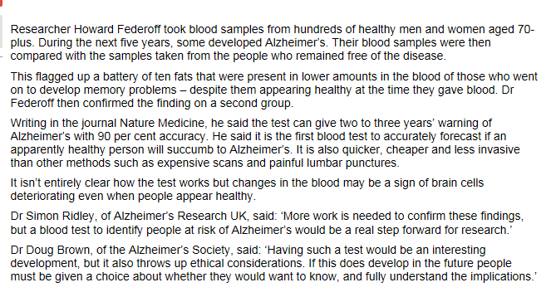

Slide 101
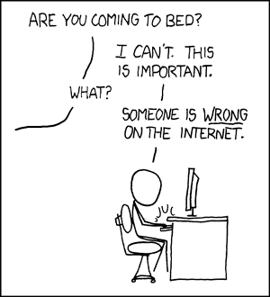
www.xkcd.com

Slide 102
Appraising diagnostic tests
Appropriate spectrum of patients?
Does everyone get the gold standard?
Is there an independent, blind or objective comparison with the gold standard?
Are the results valid?
What are the results?
Sensitivity, specificity
Likelihood ratios
Positive and Negative Predictive Values
Will they help me look after my patients?
Can I do the test in my setting?
Do results apply to the mix of patients I see?
Will the result change my management?
Costs to patient/health service?

Slide 103
Will the test apply in my setting?
Reproducibility of the test and interpretation in my setting
Do results apply to the mix of patients I see?
Will the results change my management?
Impact on outcomes that are important to patients?
Where does the test fit into the diagnostic strategy?
Costs to patient/health service?

Slide 104
What is the ONE thing I need to remember from today?
Are the results valid?
What are the results?
Will they help me look after my patients?
Don’t believe everything you are told,
Ask for the Evidence!

Slide 105
Teaching tips….

Slide 106
Bring it back to the beginning, reinforce…
The researchers detected autism with over 90% accuracy, the Journal of Neuroscience reports.

Slide 107
Will the test apply in my setting?
Reproducibility of the test and interpretation in my setting
Do results apply to the mix of patients I see?
Will the results change my management?
Impact on outcomes that are important to patients?
Where does the test fit into the diagnostic strategy?
Costs to patient/health service?
There is more to diagnostics than accuracy!

Slide 108
What is the ONE thing I need to remember from today?
Are the results valid?
Take home message!
What are the results?
Will they help me look after my patients?
Don’t believe everything you are told,
Ask for the Evidence!

Slide 109
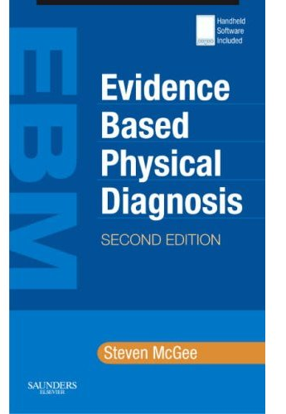
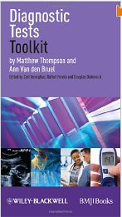
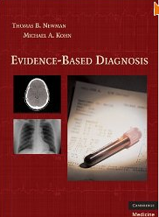
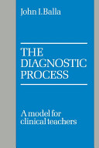
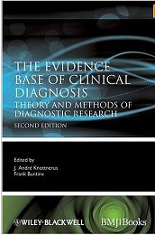
Useful books on diagnostics
Evidence based Physical Diagnosis. Steven McGee. Saunders
Diagnostic Tests Toolkit. Thompson & Van den Bruel. Wiley-Blackwell.
Evidence-based Diagnosis.
Newman & Kohn. Cambridge Univ. Press
The Diagnostic Process. John Balla.
Cambridge Univ. Press
Evidence base of Clinical Diagnosis.
Knottnerus & Buntinx.
Wiley-Blackwell

Slide 110
Useful journal articles on diagnostics
Bossuyt. Additional patient outcomes and pathways in evaluations of testing. Med Decis Making 2009
Heneghan et al. Diagnostic strategies used in primary care. BMJ 2009
Ferrante di Ruffano. Assessing the value of diagnostic tests: a framework for designing and evaluating trials. BMJ 2012
Mallett et al. Interpreting diagnostic accuracy studies for patient care. BMJ 2012
Bossuyt et al. STARD initiative. Ann Int Med 2003
Lord et al. Using priniciples of RCT design to guide test evaluation. Med Decis Making 2009
Rutjes et al. Evidence of bias and variation in diagnostic accuracy studies. CMAJ 2006
Lijmer et al. Proposals for phased evaluation of medical tests. Med Decis Making 2009
Whiting et al. QUADAS-2: revised tool for quality assessment of diagnostic accuracy studies. Ann Int Med 2011
Halligan S, Altman DG, Mallett S. Disadvantages of using the area under the receiver operating characteristic curve to assess imaging tests: A discussion and proposal for an alternative approach. Eur Radiol. 2015

Slide 112
Likelihood Ratio
LR Interpretation
> 10 Large and often conclusive increase in the likelihood of disease
5 – 10 Moderate increase in the likelihood of disease
2 – 5 Small increase in the likelihood of disease
1 – 2 Minimal increase in the likelihood of disease
1 No change in the likelihood of disease
0.5 - 1.0 Minimal decrease in the likelihood of disease
0.2 - 0.5 Small decrease in the likelihood of disease
0.1 - 0.2 Moderate decrease in the likelihood of disease
< 0.1 Large and often conclusive decrease in the likelihood of disease

Slide 113
Diagnostic Odds Ratio
Ratio of the odds of the test being positive if the person has the disease relative to the odds of the test being positive if the person does not have the disease
Disease
+
-
a
True positives
b
False positives
+
a/c
a x d
=
Test
b/d
b x c
c
False negatives
d
True negatives
-

