Slide 1
Practice of
Evidence-Based Medicine Study designs – which one is best?
David Nunan, PhD
Departmental Lecturer & Senior Researcher
Department of Primary Care Health Sciences and Tutor Centre for Evidence-Based Medicine
University of Oxford
December 2015

Slide 2
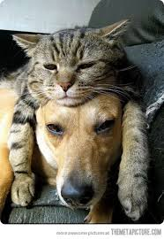
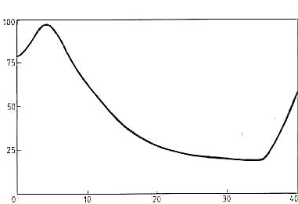
Attentiveness (%)
Time (min)

Slide 3
Discuss
What is the best study design? (1 min)
Why? (1 min)
Compare with your neighbour (1 min)
What did you
Agree on
Disagree on

Slide 4
Objectives
1 paper
1 table
1 concept
1 reflection

Slide 5
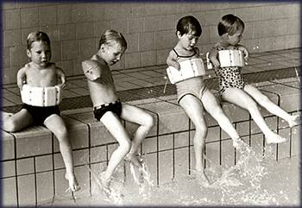
Notes:
1953 The anti-morning sickness drug thalidomide is created in Germany by the Grünenthal Group.
1958 Thalidomide is first licensed for use in the UK.
1961 An Australian doctor, William McBride, writes to the Lancet medical journal after noticing an increase in the number of deformed babies born at his hospital, all to mothers who had taken thalidomide. The drug is withdrawn later the same year.
1968 The UK manufacturer Distillers Biochemicals Ltd (now Diageo) reaches a compensation settlement after a legal battle with the families of those affected.
1972 The Sunday Times publishes a front-page lead under the banner "Our thalidomide children, a cause for national shame", part of a long-running campaign for further compensation. Eventually, a total of £28m is paid out by Diageo during the 1970s.
2004 Thalidomide is made available on a named patient basis, meaning doctors can give it to patients only on a case-by-case basis and at their own discretion, under strict controls.
2005 A Kenyan boy with no arms or legs is granted a visa to travel to the UK to receive medical treatment after a campaign by the charity Thalidomide UK. It is not known what caused 14-month-old Freddie Musean Mtile's disabilities, but the charity says the drug is still used in the treatment of leprosy and Aids in developing countries. Mtile dies from a fungal infection the following year. Separately, Diageo agrees to more than double its compensation payouts to thalidomide victims from £2.8m a year to about £6.5m.
2007 A study shows that thalidomide can significantly improve the survival chances of bone-marrow cancer patients. Researchers say adding thalidomide to standard treatment extended the lives of elderly patients with multiple myeloma by an average of 18 months.
2008 The drug is approved for the treatment of multiple myeloma by the European Medicines Agency.
2009 Scientists at the University of Aberdeen claim they have solved a "50-year puzzle" after discovering how thalidomide causes limb defects. They found that a component of the drug prevented the growth of new blood vessels in developing embryos, stunting limb growth. The government agrees to pay a £20m grant to the Thalidomide Trust over three years, after another campaign by the Sunday Times.
2010 The health minister Mike O'Brien makes a formal apology to thalidomide victims, expressing "sincere regret and deep sympathy" on behalf of the government. The apology gets a mixed response from victims, with some describing it as too little, too late. Eighteen Northern Irish thalidomide survivors receive a formal apology and £1m compensation from the devolved assembly.
2012 The inventor of thalidomide, the Grünenthal Group, releases a statement saying it regrets the consequences of the drug.

Slide 6
Does thalidomide cause Phocomelia?
Notes:
Do you believe that thalidomide causes phocomelia? (Phocomelia = congenital disorder of malformation of the limbs)
What type of study is this?
If randomized trials are the best study design, then we do not have the best evidence to support the claim that thalidomine caused phocomelia. We have a case series.
It is important to be able to distinguish between the different types of study designs and their relative advantages and disadvantages.
The thalidomiders have been campaigning for government support for some years, backed by former Sunday Times editor Sir Harold Evans, whose paper championed the cause in the 1970s. The government should bear its share of responsibility for what happened, they said.
They blamed the government for allowing the drug onto the market without tests to ensure it would not harm the foetus, following assurances from the manufacturer that it was safe. In the United States, a staff member of the government's Food and Drug Administration, Dr Frances Kelsey, refused to grant the drug a licence without further proof of safety in the womb.
In 1957, the World Health Organisation had warned the UK that its lack of adequate pharmaceutical regulation was courting disaster. It took the thalidomide disaster to reform the system, bringing in the sort of regulation we have today. The Medicines Act 1968 laid down stringent standards that had to be met for the safety and efficacy of drugs.

Slide 7
Basic principles of study design
1 PAPER =
Grimmes & Schulz. Bias and confounding in observational research THE LANCET 2002;359:57-61
Notes:
Studies are either experimental or observational by nature, and the easiest way to tell the different is to look at what the investigators did about exposures – specifically did they assign the exposure or not.
Start at the top, “what does it mean for investigators to assign exposure?” Ask them to give examples
Observational: studies that do not involve any intervention or experiment.
Experimental: studies that entail manipulation of the study factor (exposure) and randomization of subjects to treatment (exposure) groups
Do the Vitamin C example = James Lind, ship’s surgeon HMS Sailsbury, 12 patients at similar stage of scurvy, Lind allocated two sailors to receive one of six treatments (cider, suplhuric acid, vinegar, seawater, nutmeg and two oranges + lemon) = he assigned exposure. Lind’s study was the first trial to include control groups. He became known as ‘father of clinical trials’.
What type of study design do you not see in this diagram? (A= case series/report) Ok, where would you put it? (A = under ‘Descriptive study’)

Slide 8
Bias in study design
Lower potential for bias
Randomised controlled trials
Experimental
Cohort studies
Case-control studies/ Cross-sectional studies
Observational
Clinical observation (case reports, case-series)
Higher potential for bias

Slide 9
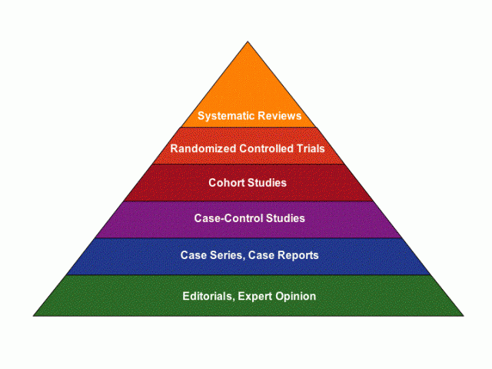
Levels of evidence
Quality
Quantity

Slide 10
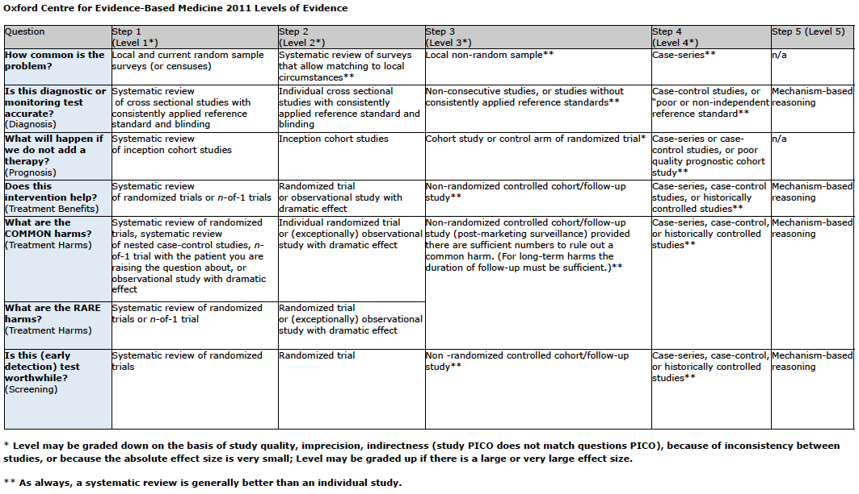
1 Table = Levels of evidence

Slide 11
Practising EBM – the 5 A’s
Clinical questions:
Interventions
Aetiology and risk factors
Diagnosis
Prognosis
Frequency and rate
Step 4
Step 3
Step 2
Step 1
Apply the evidence
Appraise the evidence
Acquire the best evidence
Ask a clinical question
Step 5 Assess the impact and performance
Notes:
The reason it’s important to know about study designs is that it forms an important part of mainly step 1 and step 3 of practising EBM.
Most clinical questions can be classified as being about interventions, aetiology and risk factors, diagnosis, prognosis, frequency and rate or phenomena

Slide 12
What study designs should you be looking for?
Question | Question type | Best study design
What should I do about this condition or problem? | INTERVENTION | RANDOMISED CONTROLLED TRIAL (RCT) > cohort
What causes the problem? | AETIOLOGY AND RISK FACTORS | RCT (?) > cohort > case control
Does this person have the condition or problem? | DIAGNOSIS | CROSS-SECTIONAL (random or consecutive sample)
What will happen with this problem? | PROGNOSIS (PREDICTION) | COHORT (survival) > case control > case series
How common is the problem? | FREQUENCY AND RATE | CROSS SECTIONAL (prevalence) COHORT (incidence)
Notes:
Why ? for RCT to answer aetiology/risk factor = harms (e.g. thalidomide in pregnancy). What about example where can use RCT to assess aetiology. Less severe condition/outcome e.g. stress and blood pressure?
Consecutive sampling = in consecutive sampling, select every patient that meets the inclusion criteria until you get to the required sample size or the survey period is over. Example: Include every HTN patient that meets the inclusion criteria that comes into the HTN clinic during the month of January.
Random sampling = simple random sampling, generate a list of random numbers. Match numbers to a list of patients who meet study criteria until the required sample size is met. Lists of random numbers can be taken from random number tables, or can be generated by computer or other methods.

Slide 13
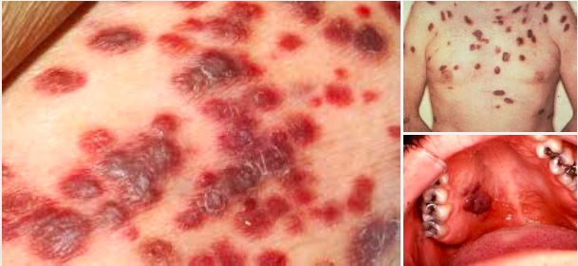

Slide 14
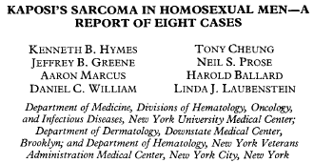
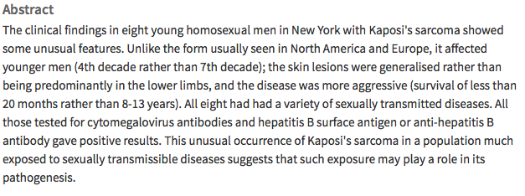
Case reports/series
Notes:
Here we have examples of case reports of two conditions that were the reported first in LA and then in New York in the early 80’s.
Pneumocystis pneumonia = a rare opportunistic infection usually occurring in people with very compromised immune systems (i.e. unlikely to include young adults); and,
Kaposi’s sarcoma = a rare skin cancer
Any one want to guess what this turned out to be?
First signs of an outbreak of an immunodeficiency in young gay men and turned out to be AIDS. This eventually also led on to further studies that discovered HIV.

Slide 15
Case Report
Case Series
Survey
(Cross-sectional)
Qualitative

Slide 16
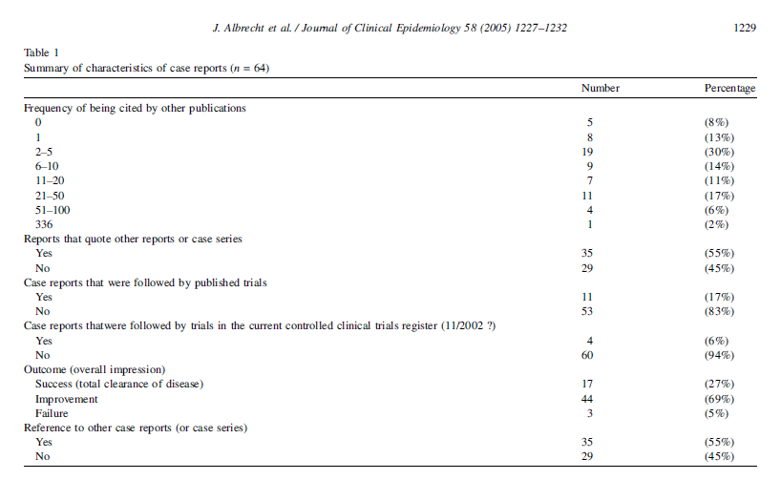
34%
17%
Notes:
Case reports published in the Lancet are cited regularly and a significant number have led to clinical trials.
This is just 1 years worth of published case reports, so it’s evident that case reports and case series have a significant impact on the literature.

Slide 17
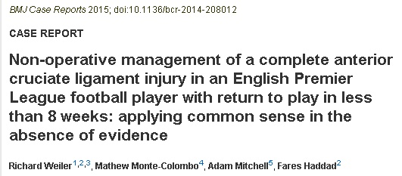
“…at elite level, there are no cases in cutting sports within the literature to guide these decisions ”
“ This case challenges current dogma and provides a starting point for much needed debate…”
Notes:
…so much so that there’s even a journal dedicated to them.
Interestingly, the Lancet is the only high-impact journal that continues to publish case-reports of rare conditions or outcomes.

Slide 18
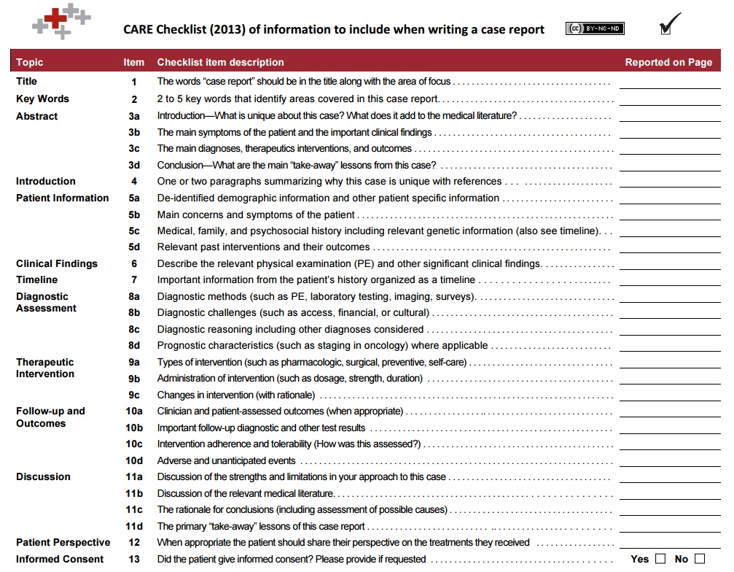
Reporting standards
Notes:
…so much so that there’s even a journal dedicated to them.
Interestingly, the Lancet is the only high-impact journal that continues to publish case-reports of rare conditions or outcomes.

Slide 19
Case reports/series
Advantages
Can help identify new disease/trends
Can have significant influence on subsequent literature and possibly on clinical practice
Disadvantages
Generally short term
Investigator selection bias
Generally no controls
Design pitfalls to look out for
Use CARE checklist to identify reporting of key elements
Notes:
Investigator selection bias = e.g. physicians looking at patients with a certain illness and a suspected linked exposure will have a selection bias in that they have drawn their patients from a narrow selection (namely their hospital or clinic). Would have been the case for the AIDS example but then we saw another case series in a similar demographic but from a different area.
Use CARE checklist to identify reporting of key elements:
Patient(s) described in detail
Carefully reported, unbiased observations
Explore and infer, not confirm, deduce or prove

Slide 21
What’s the study design?
Notes:
Cross-sectional studies most commonly take the form of survey/questionnaires
There useful for identifying population level information but also identifying the current state of play if you like.
They basically take a snap shot of the current position with no time

Slide 22
Case Report
Case Series
Survey
(Cross-sectional)
Qualitative

Slide 23
Bias in cross-sectional studies - 1
Risk of ASthma in Poultry breeders
The RASP cross sectional survey
Non-response bias
How might risk be underestimated?
Notes:
A cross sectional survey of asthma in an occupational group of animal handlers would underestimate risk if the development of respiratory symptoms led people to seek alternative employment and therefore to be excluded from the study.

Slide 24
1. What’s the question? (1 min) 2. What study design would you choose? (1 min) Compare with your neighbour (1 min)
P | Patients with symptoms of peptic ulcer
I/E | Milk (2%)
C | Milk (2%)
O | Peptic ulcer symptoms
Notes:
In pairs

Slide 25
Notes:
In a cross-sectional study a population with a condition and the exposure is studied at one time point (a time slice).
Cross-sectional studies most commonly take the form of survey/questionnaires
There useful for identifying population level information but also identifying the current state of play if you like.
They basically take a snap shot of the current position with no time

Slide 26
Bias in cross-sectional studies - 2
Peptic Ulcers and milK ingEstion
The PUKE cross sectional study
Cause ≠ Effect
Does milk cause peptic ulcers?
Notes:
A cross sectional design may also make it difficult to establish what is cause and what is effect. If milk drinking is associated with peptic ulcer, is that because milk causes the disease, or because ulcer sufferers drink milk to relieve their symptoms?
Because of these difficulties, cross sectional studies of aetiology are best suited to diseases that produce little disability and to the presymptomatic phases of more serious disorders.
Other applications of cross sectional surveys lie in planning health care. For example, an occupational physician planning a coronary prevention programme might wish to know the prevalence of different risk factors in the workforce under his care so that he could tailor his intervention accordingly.

Slide 27
1. What’s the question? (1 min) 2. What study design would you choose? (1 min) Compare with your neighbour (1 min)
P | Young children (0-4 yrs)
I/E | Mobile phone mast
C | Mobile phone mast
O | Cancer
Notes:
In pairs

Slide 28
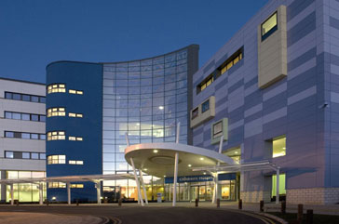
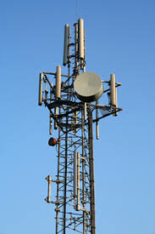
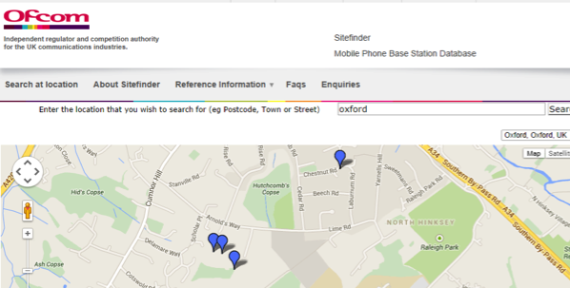
Design the study:
?
Notes:
Nurse working at the JR Children’s

Slide 29
Notes:
So the most appropriate design for this study question = case-control.
And this is because

Slide 30
Case control
Retrospective
Notes:
In a cohort study, an investigator defines a study population (cohort) consisting of subjects who are free of the outcome of interest. This study design aims to determine which factors are associated with the development of the outcome(s). Depending on the exposure status at the start of the study, subjects are classified as exposed or unexposed (controls). Thereafter, subjects are followed over time to see who will develop the outcome and who will not.

Slide 32
Lowest [exposure] = furthest from base station
Highest = nearest to base station
Is there a better study design to answer the question “Mobile phone masts and childhood cancer?”
Notes:
This shows no effect of living closer/nearest to a mobile phone mast.
Could there be a better design? RCT/cohort study? Why/Why not?
This is best design because

Slide 33
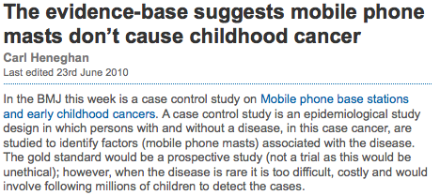
Notes:
The incidence is so low, that a prospective study would take millions.
Or if the exposure time is too long.

Slide 34
Conclusions – case control studies
Advantages
Good for studying rare conditions or diseases
Useful as initial study to establish association
Disadvantages
Retrospective studies have more problems with data quality (recall bias)
Limited to examining one outcome
Not good for study of rare exposures
Design pitfalls to look out for
Confounding – exposure and outcome related to third variable
Notes:
Advantages
Good for studying rare conditions or diseases
Less time needed to conduct the study because the condition or disease has already occurred
Lets you simultaneously look at multiple risk factors
Useful as initial studies to establish an association
Can answer questions that could not be answered through other study designs
Disadvantages
Retrospective studies have more problems with data quality because they rely on memory and people with a condition will be more motivated to recall risk factors (also called recall bias).
Not good for evaluating diagnostic tests because it’s already clear that the cases have the condition and the controls do not
It can be difficult to find a suitable control group
Design pitfalls =
Confounding – exposure and outcome related to third variable e.g. lung cancer patients was linked to exposure to matches – but cigarette smoking not measured.

Slide 36
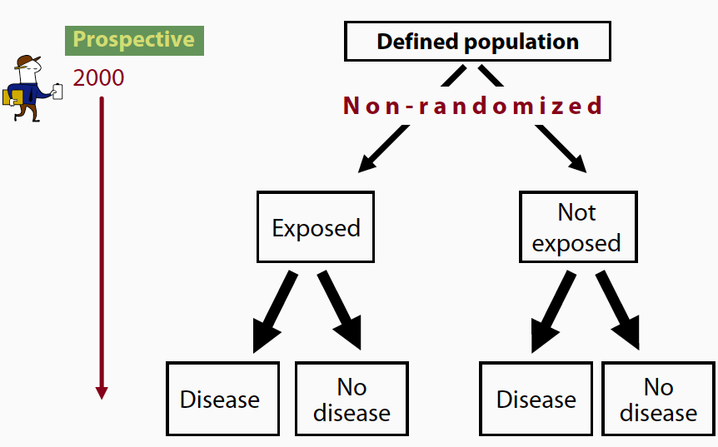
Cohort study 1
= investigator
Notes:
In a cohort study, an investigator defines a study population (cohort) consisting of subjects who are free of the outcome of interest. This study design aims to determine which factors are associated with the development of the outcome(s). Depending on the exposure status at the start of the study, subjects are classified as exposed or unexposed (controls). Thereafter, subjects are followed over time to see who will develop the outcome and who will not.

Slide 37
Cohort study 2
Notes:
In a cohort study, an investigator defines a study population (cohort) consisting of subjects who are free of the outcome of interest. This study design aims to determine which factors are associated with the development of the outcome(s). Depending on the exposure status at the start of the study, subjects are classified as exposed or unexposed (controls). Thereafter, subjects are followed over time to see who will develop the outcome and who will not.

Slide 38
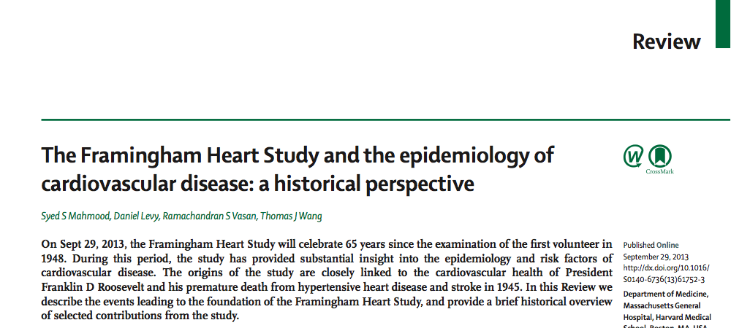

Slide 40
2748 men and women, 50 – 79 years
HDL-C measured at baseline
Followed for 12 years
Death from all causes, CHD, and CVD
No loss to follow-up

Slide 41
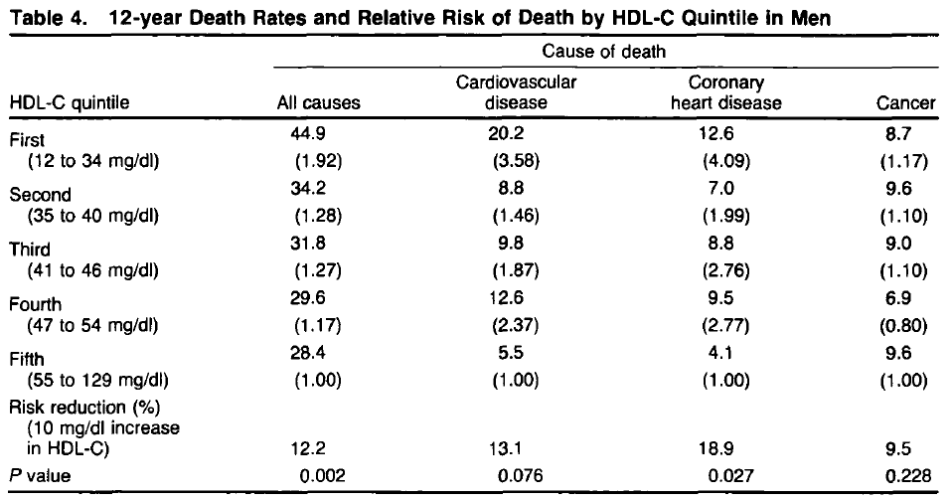
92% or x2
258% or x3.5
309% or x4
“This well conducted study demonstrates that the increased risk of death, CVD and CHD is caused by presence of a higher HDL-C in both men and women”
Notes:
Low levels of HDL-C associated with increase mortality
Risk of death from all-causes 2x higher in low HDL-C versus high HDL-C
Risk of death from CVD and CHD 4x higher in low versus high HDL-C

Slide 42
When are case-control & cohort studies warranted?
Essential and important for questions related to harm and/or where trials not feasible
Pros = feasibility (time and n), ethics issues avoided
Cons = prone to bias and confounding:
Cohort: equal opportunity for outcome
Case-control: equal opportunity for exposure
Confounding: failing to control for unmeasured (or improperly measured) prognostic factors (confounders)
Notes:
42
P1 – where it an RCT is not possible

Slide 43
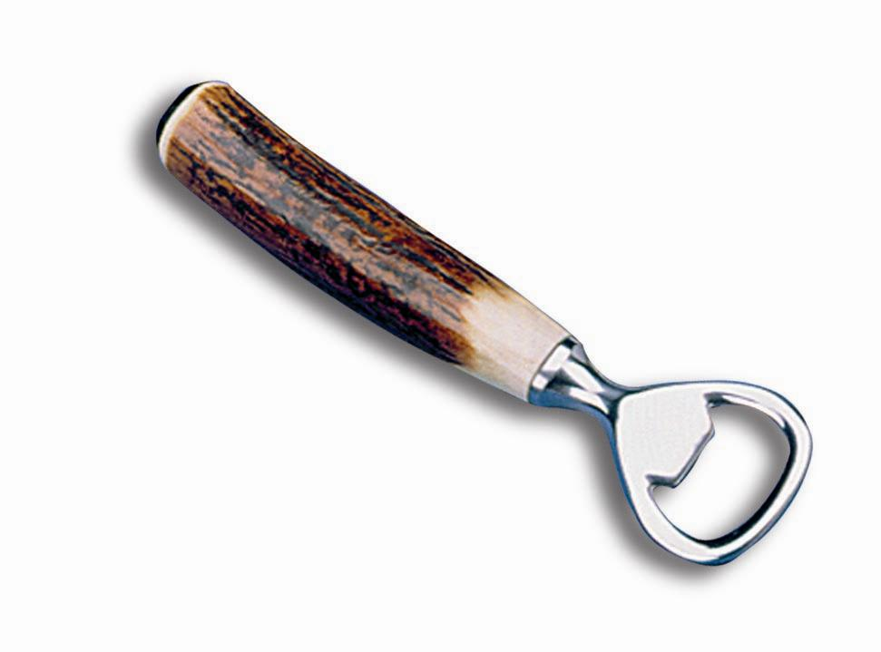
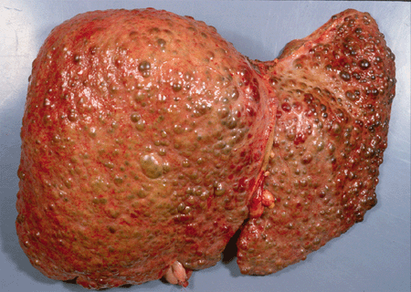
1 CONCEPT = Confounding

Slide 45
Notes:
Key distinguishing feature is that the exposure or intervention being tested is allocated by the investigator to two or more groups.
And this allocation is done randomly

Slide 46
RANDOMISATION
BLINDING
Disease/outcome
Exposure
present
ALLOCATION
No disease/outcome
Study
population
free of
disease
Disease/outcome
Exposure
absent
No disease/outcome
present
future
Time
Study begins here
Notes:
In a cohort study, an investigator defines a study population (cohort) consisting of subjects who are free of the outcome of interest. This study design aims to determine which factors are associated with the development of this outcome. Depending on the exposure status at the start of the study, subjects are classified as exposed or unexposed (controls). Thereafter, subjects are followed over time to see who will develop the outcome and who will not.

Slide 47
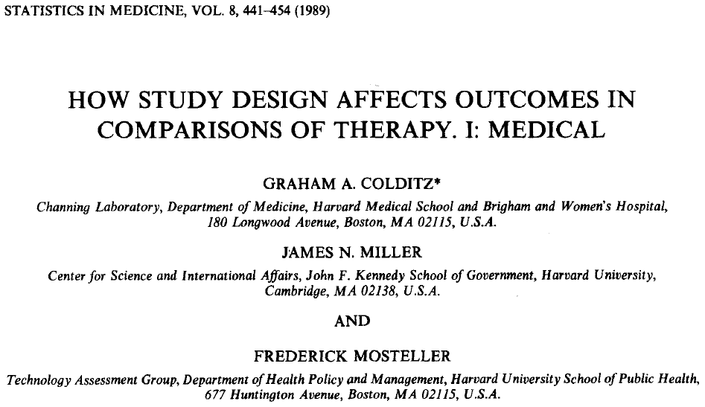
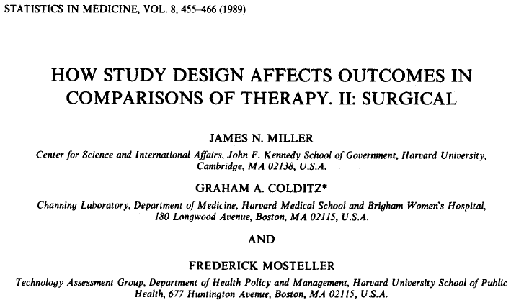
Why random allocation?
Overestimated
Notes:
Colditz paper =
Looked at 113 studies to assess the hypothesis that performance of new treatments in medicine and surgery compared with standard practice was often better in non-randomised studies than in randomized studies
These were key studies in identifying how non-random comparisons and poor-blinding in randomised comparisons can inflate outcomes and interpretation.

Slide 48
Concealing allocation
Odds ratios were exaggerated by 41% for inadequately concealed trials, and
by 30% for unclearly concealed trials
Notes:
Non-randomised controlled trials:
can detect associations between an intervention and an outcome.
But they cannot rule out the possibility that the association was caused by a third factor linked to both intervention and outcome.
Meta-analysis of controlled trials shows that failure to conceal random allocation and the absence of double blinding yield exaggerated estimates of treatment effects
Random allocation ensures no systematic differences between intervention groups in factors, known and unknown, that may affect outcome. Any differences are due to random error (chance)
Double blinding ensures that the preconceived views of subjects and clinicians cannot systematically bias the assessment of outcomes.
Intention to treat analysis maintains the advantages of random allocation, which may be lost if subjects are excluded from analysis through, for example, withdrawal or failure to comply.

Slide 49
Notes:
Any body see any problems with this?

Slide 50
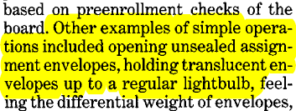
Notes:
Allocation concealment

Slide 51
Difference between randomized & non-randomized studies
Randomized trials
Non-randomized/Cohort studies
Random (and hopefully concealed) procedure decides which participants go in which arm = reduced risk of selection bias (confounding)
Placebo controls and double blinding possible = reduced risk of ascertainment bias
Participants ‘self-select’ or are selected to receive an intervention/exposure = cannot rule out selection bias
Placebo controls and double blinding not possible = increased risk of ascertainment bias
Notes:
Ascertainment bias occurs when the results or conclusions of a trial are systematically distorted by knowledge of which intervention
each participant is receiving. Ascertainment bias can be introduced by the person administering the interventions, the person receiving
the interventions (the participants), the investigator assessing or analyzing the outcomes, and even by the people who write the
report describing the trial

Slide 52
1 REFLECTION

Slide 53
Thank you for listening!

Slide 54
Abstract workshop
60 minutes:
Pairs
Work through abstracts provided in booklets - pages 16 – 20
20 minutes:
Feedback & group discussion

Slide 55
What study design(s) would you choose?
What is the importance of patient preferences in the choice of treatment for benign prostatic hyperplasia? (1 min)
How will you identify and describe misunderstandings between patients and doctors associated with prescribing decisions in general practice? (1 min)
How can you explore how men and women with cancer talk about using the internet? (1 min)
Notes:
(Exercise: what study design will you use to answer this question?)

Slide 56
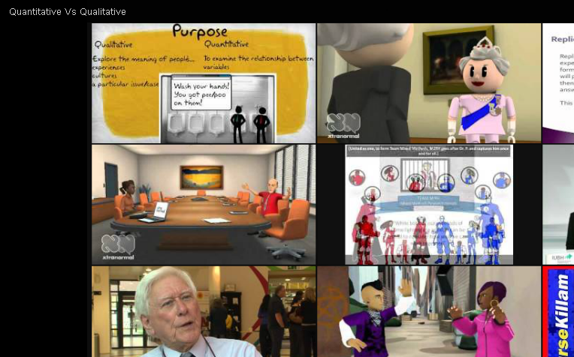
Qualitative research
https://www.youtube.com/watch?v=4oZAIUGFTOk

Slide 57
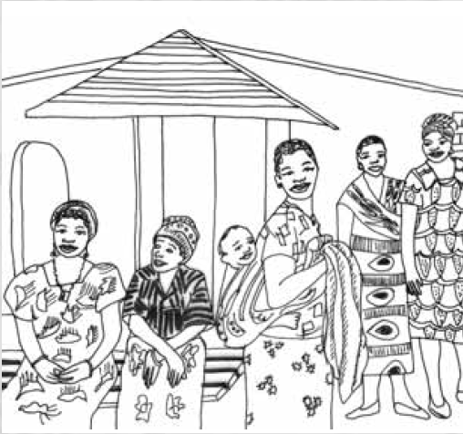
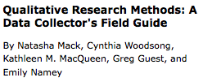
What is qualitative research?
Notes:
Deeper significance
Interpretation
Naturalistic
As someone who’s grown up and and favour’s quantitative approaches to science and research, these terms don’t come naturally to me. But a recent experience highlighted the importance of qualitative research and what it can add.

Slide 58
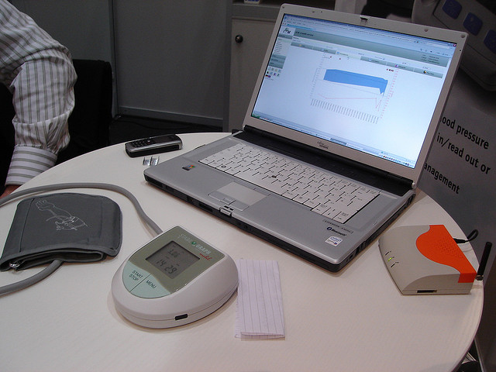
How did patients use the technology?
What did patients think about using the technology?

Slide 59
What are some qualitative research methods?
Participant observation – data on naturally occurring behaviours in their usual contexts
Focus groups – effective in eliciting data on cultural norms of a group and generating broad overviews of issues in groups
In-depth interviews – optimal for collecting data on individuals’ personal histories, perspectives, and experiences

