Slide 1

Evidence-Based Practice
Nov 2015
Professor Carl Heneghan
University of Oxford
Director CEBM

Slide 2
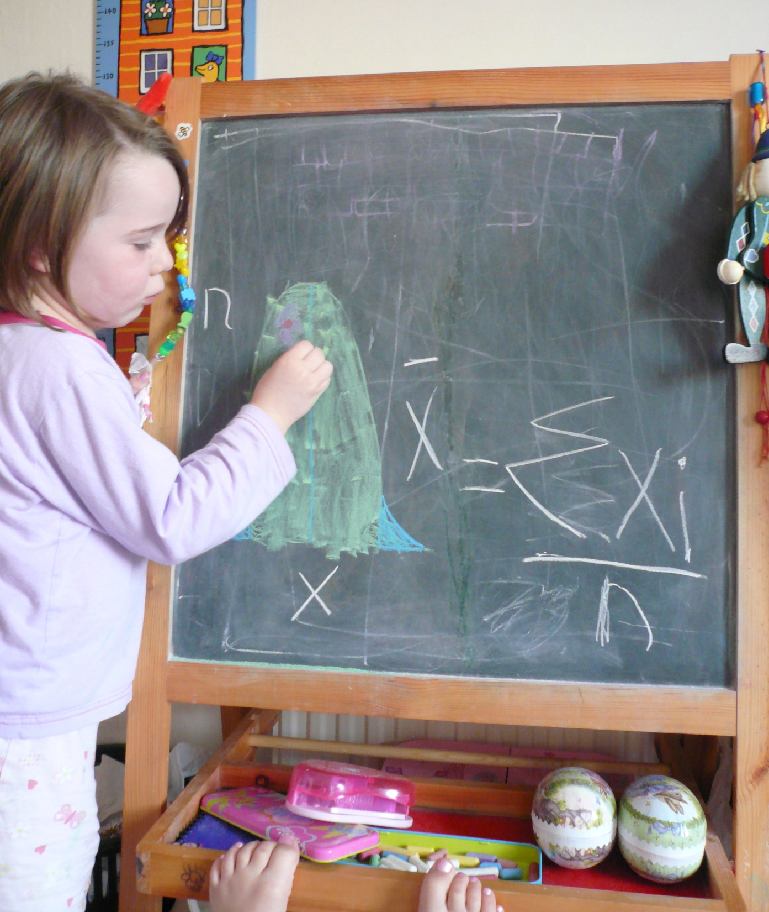
Developing Evidence-Based Practice?
Carl Heneghan MA, MRCGP
Centre for Evidence Based Medicine
University of Oxford

Slide 3
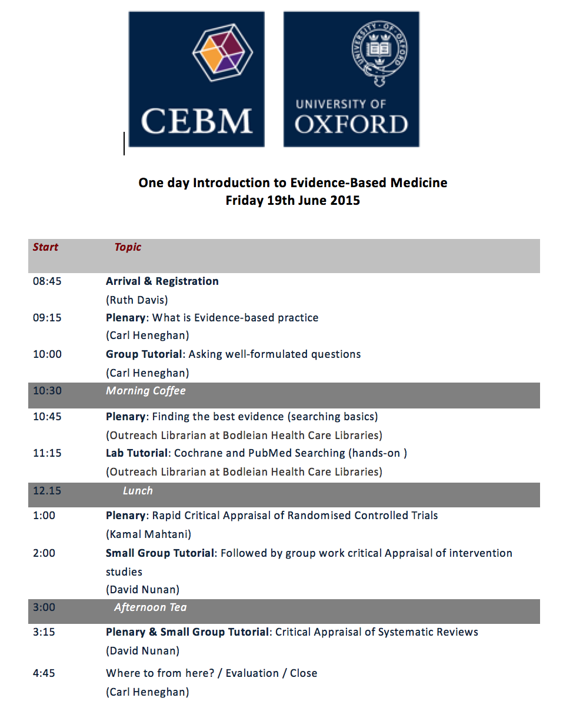

Slide 4
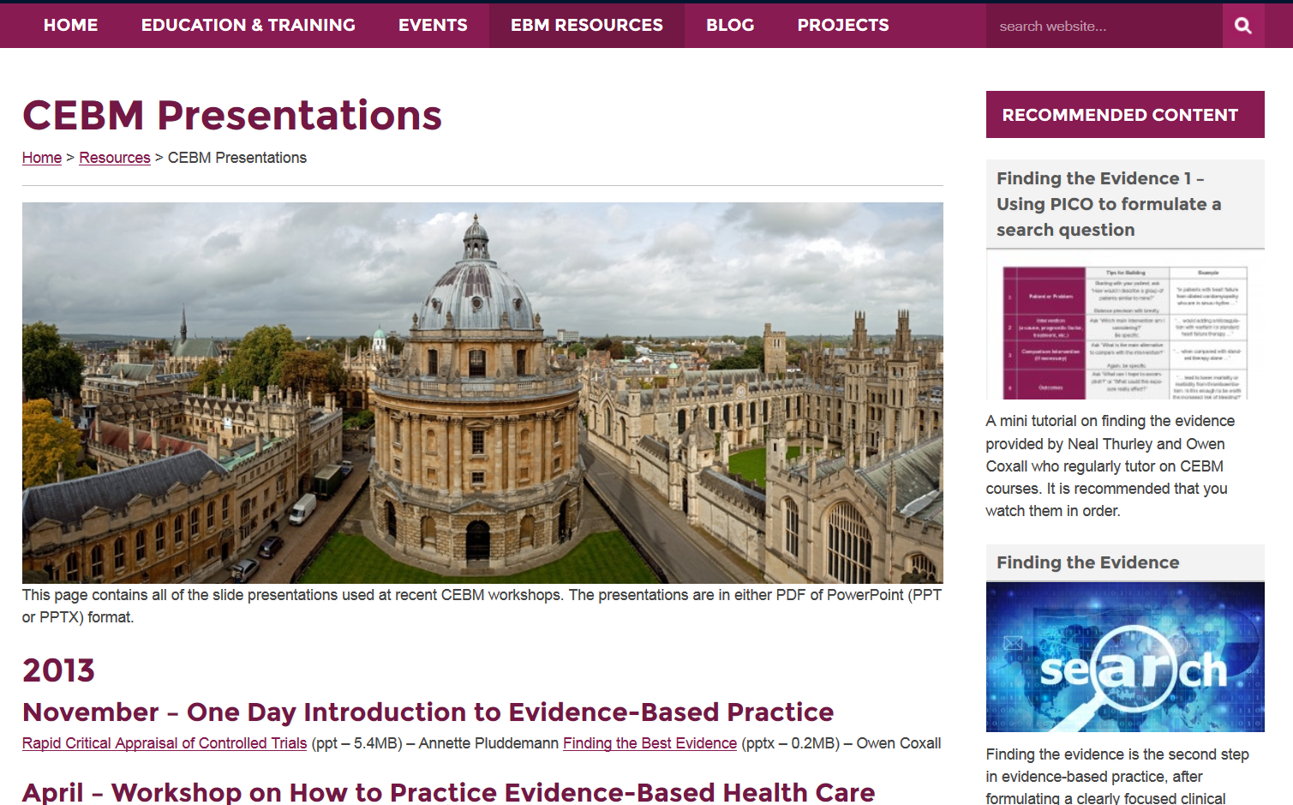

Slide 5
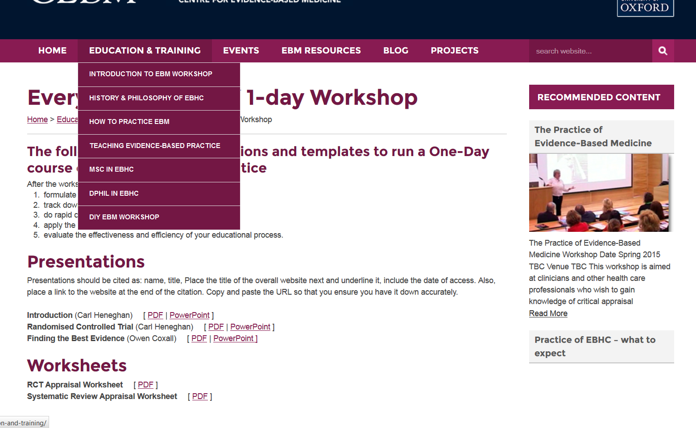

Slide 6
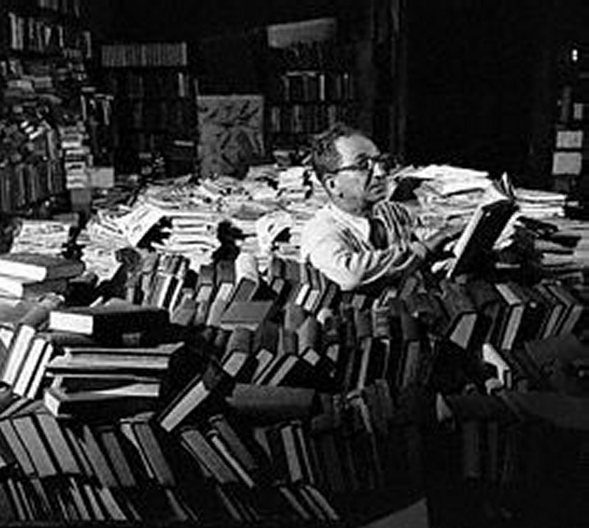
I am here because?
I wanted 3 days of work
Formulate an answerable questions

Slide 7
The aim of today
To understand what is EBM
To recognize health related problems when they arise
To develop a focussed clinical questions
To find an answer to your clinical questions
To assess the validity of a RCT
To assess the validity of a systematic review

Slide 8
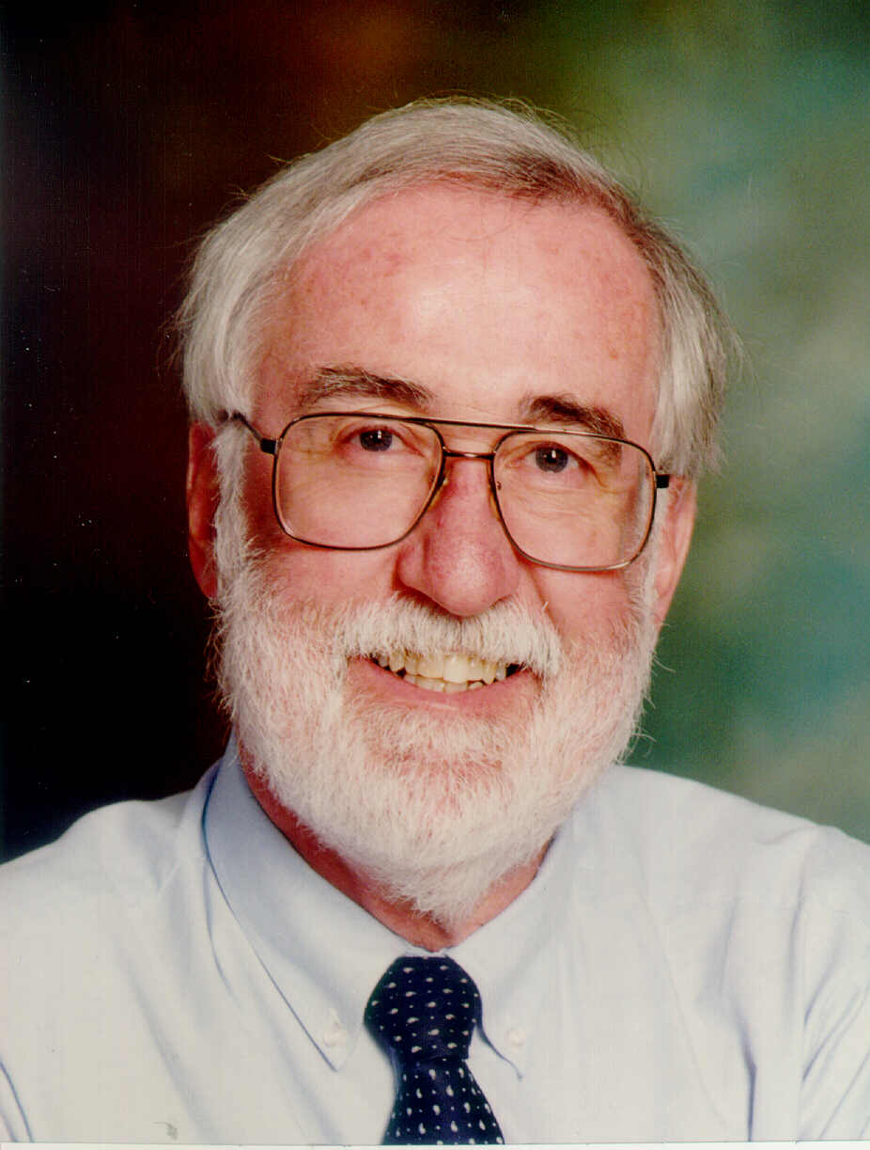
What is Evidence-Based Medicine?
“Evidence-based medicine is the integration of best research evidence with clinical expertise and patient values”
Notes:
Sackett DL, Rosenberg WMC, Gray JAM, Haynes RB, Richardson WS: Evidence based medicine: what it is and what it isn’t. BMJ 1996;312:71-2.
This definition of what EBM is and isn’t has gained wide acceptance and made it easier for us to get our points across.

Slide 9
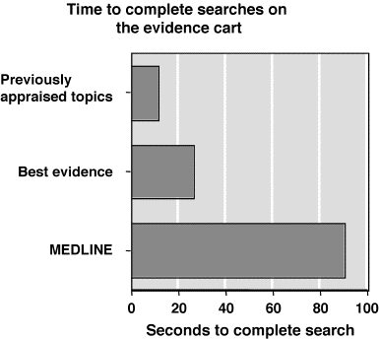
“Just in Time” learning
The EBM Alternative Approach
Shift focus to current patient problems
(“just in time” education)
  Relevant to YOUR practice
  Memorable
  Up to date
Learn to obtain best current answers
Notes:
9

Slide 10
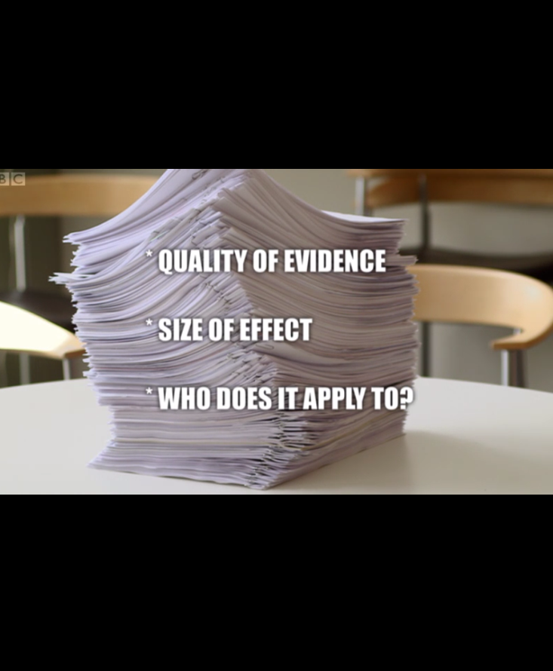
Develop strategies to assess the quality of evidence for health claims, effectiveness and applicability.

Slide 11
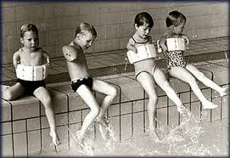
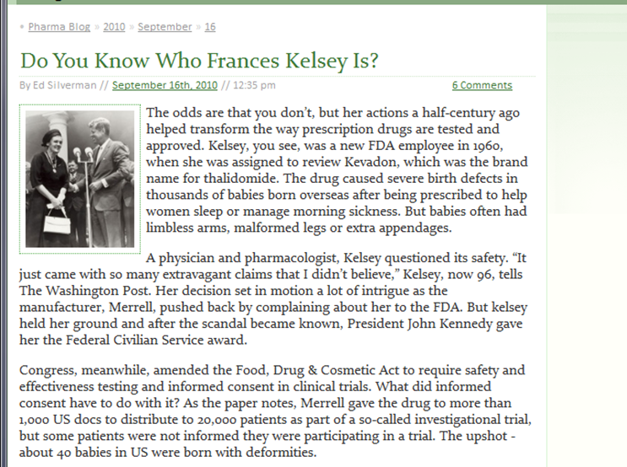
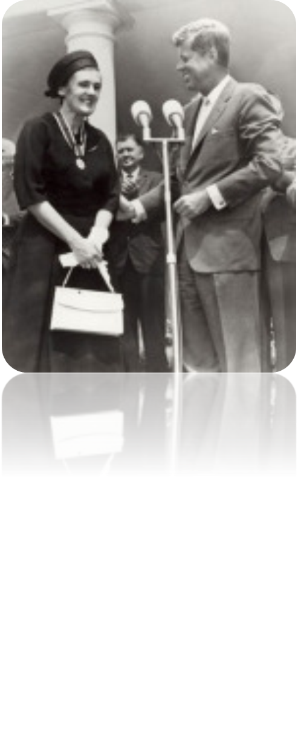

Slide 12
Would any of you have agreed to participate in a placebo controlled trial of prophylactic antibiotics for colorectal surgery after 1975?
Notes:
12

Slide 13
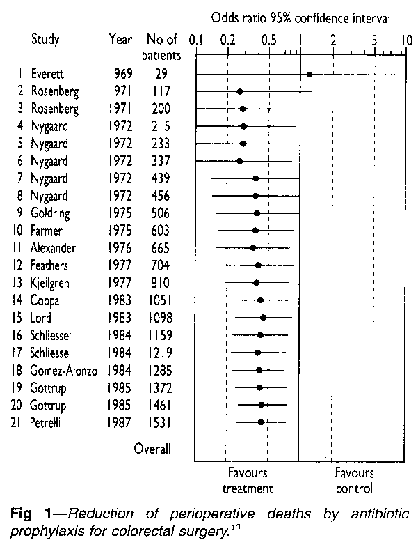
Reduction of perioperative deaths by antibiotic prophylaxis for colorectal surgery
Notes:
13

Slide 14
Would you ever have put babies to sleep on their tummies?
Notes:
14

Slide 15

Expert opinion
Baby and Child Care” has actually sold more that 50 million copies, only outmatched in sales by the Bible
Notes:
15
The sudden shift in favour of front sleeping is best illustrated by ‘Baby and Child Care’ by Dr Benjamin Spock who recommended the back position in his 1955 edition, and the front position in 1956.²⁴ In his 1958 edition, he argued ‘If he vomits, he's more likely to choke on the vomitus. Also, he tends to keep his head turned to the same side—usually toward the centre of the room. This may flatten the side of his head.’ Many authors repeated these arguments. Others argued that front sleeping reduced wind,^{25,26} coughing due to mucus,²⁷ and made respiration easier.²⁶

Slide 16
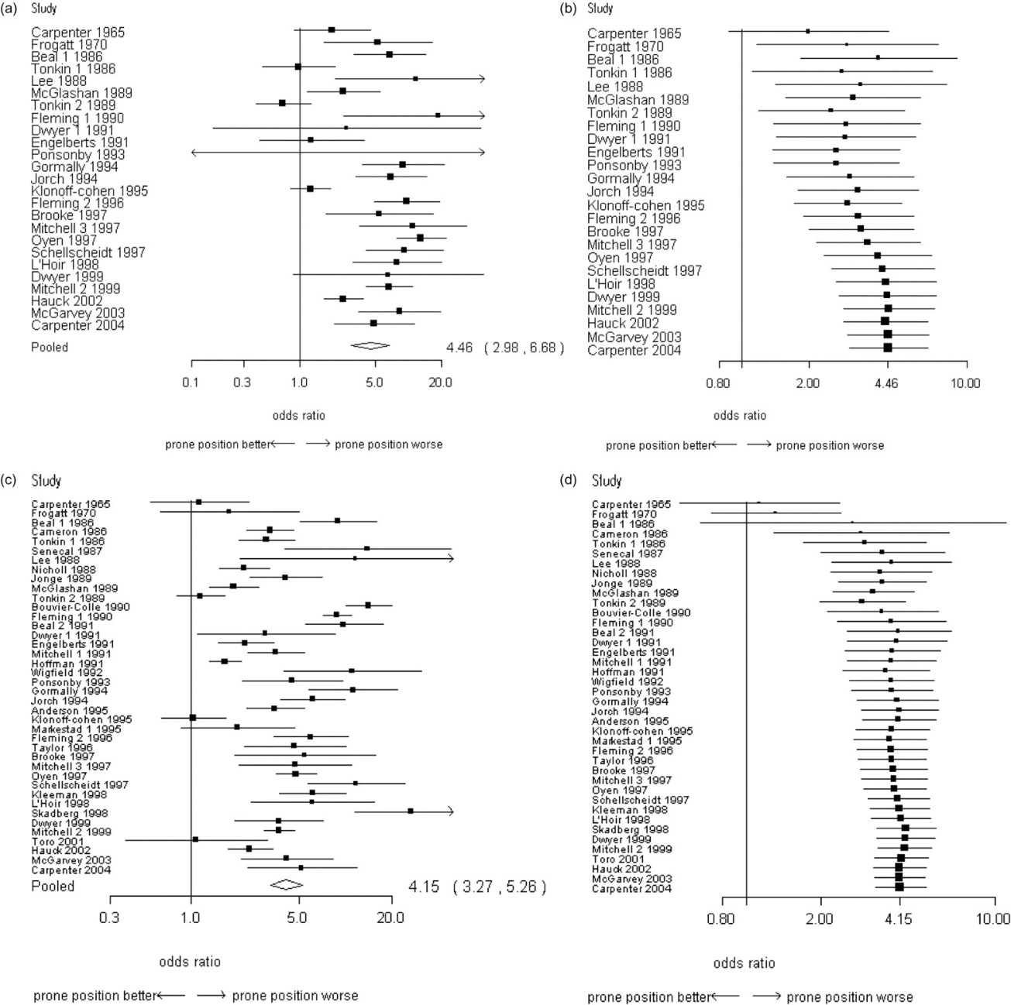
Front vs. back
front vs. non-front
Over four fold increase risk of sudden infant death syndrome
Ruth Gilbert et al. Int. J. Epidemiol. 2005;34:874-887
Notes:
16

Slide 17
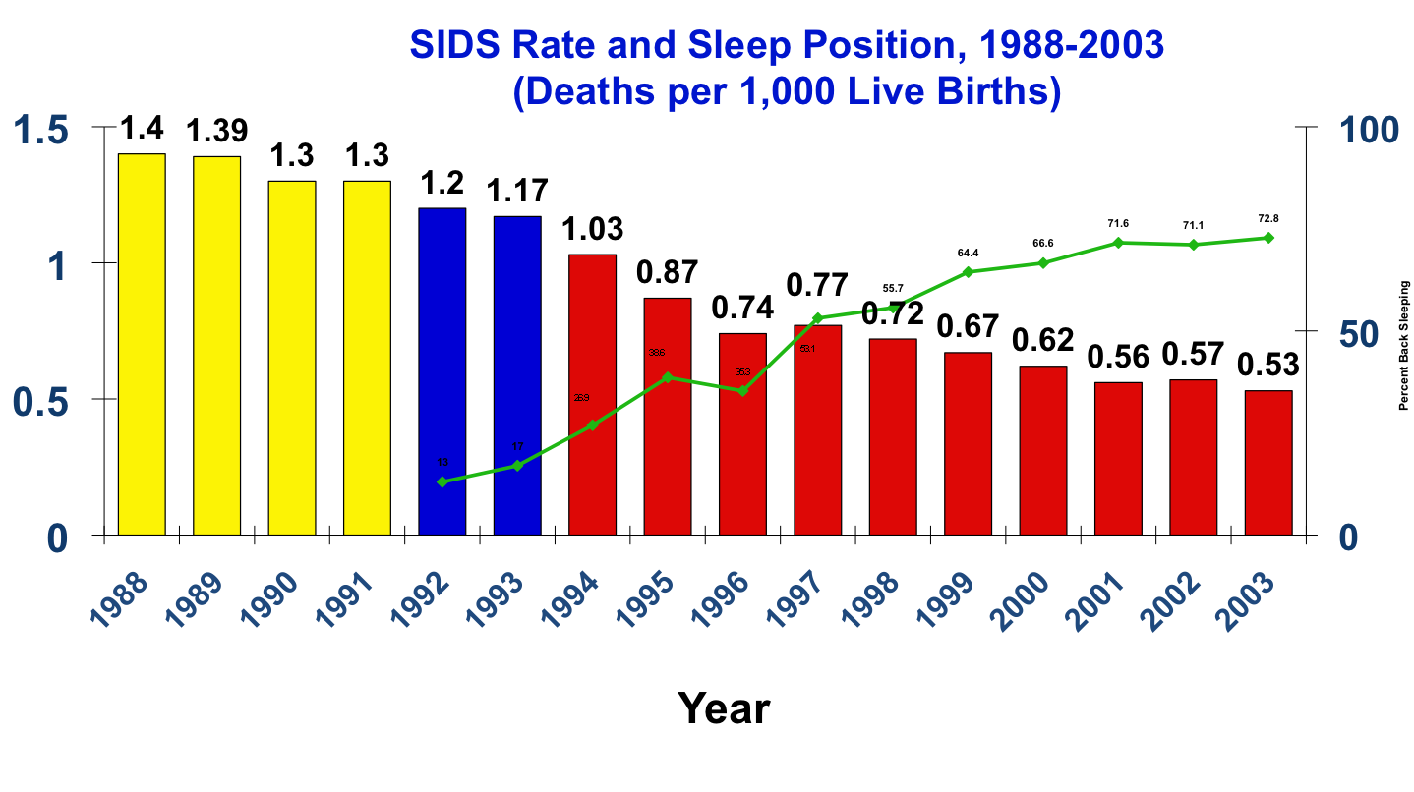
Pre-AAP recommendation Post-AAP BTS Campaign
Sleep Position Source: NICHD Household Survey
SIDS Rate Source: National Center for Health Statistics, CDC

Slide 18

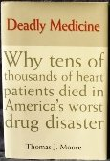

Why do we need RANDOMIZED CONTROLLED TRIALS ?
In the early 1980s newly introduced antiarrhythmics were found to be highly successful at suppressing arrhythmias.
Not until a RCT was performed was it realized that, although these drugs suppressed arrhythmias, they actually increased mortality.
The CAST trial revealed Excess mortality of 56/1000.
By the time the results of this trial were published, at least 100,000 such patients had been taking these drugs.

Slide 19

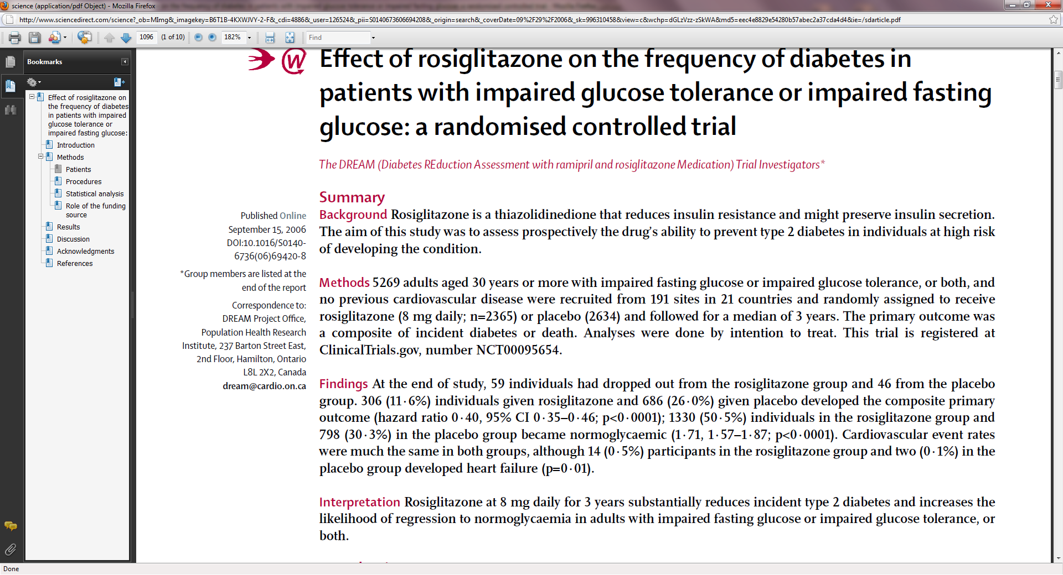


Slide 20
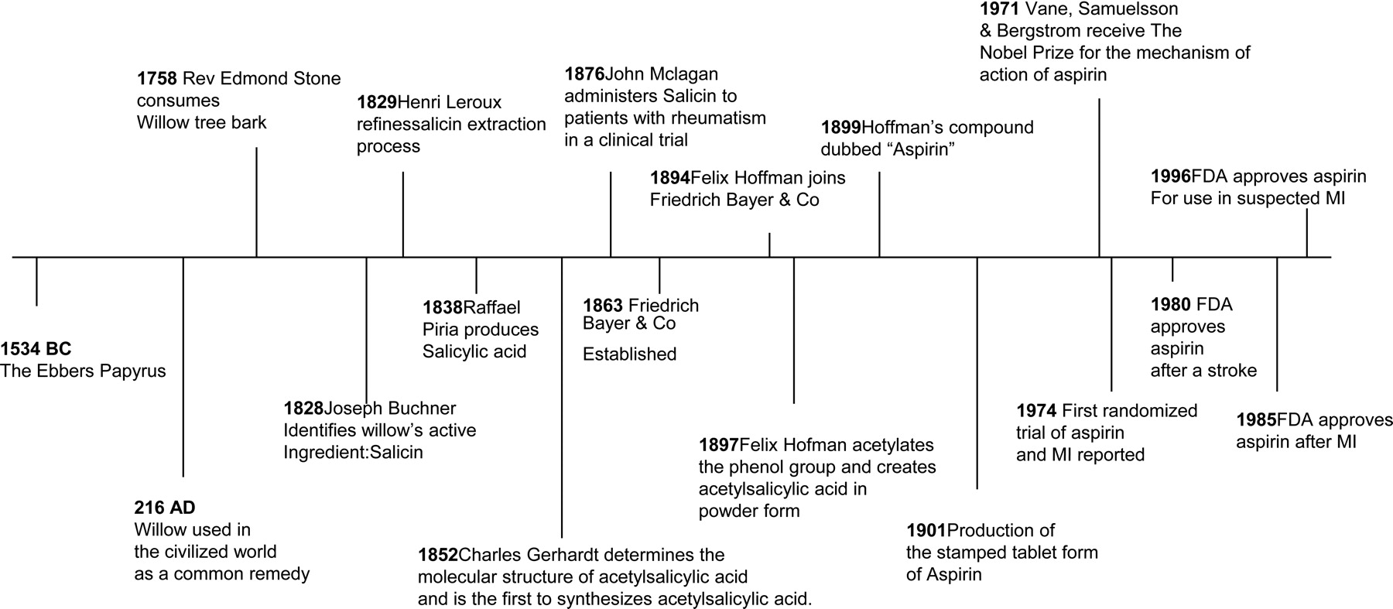
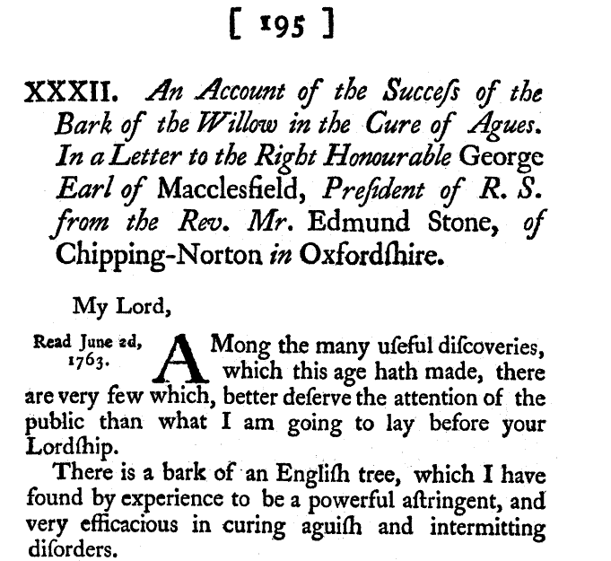

Timeline of historical events in the development of aspirin.
Fuster V , and Sweeny J M Circulation 2011;123:768-778
Copyright © American Heart Association
Notes:
Timeline of historical events in the development of aspirin.

Slide 21
Timeline of historical events in the development of aspirin.
Fuster V , and Sweeny J M Circulation 2011;123:768-778
Notes:
Timeline of historical events in the development of aspirin.

Slide 22
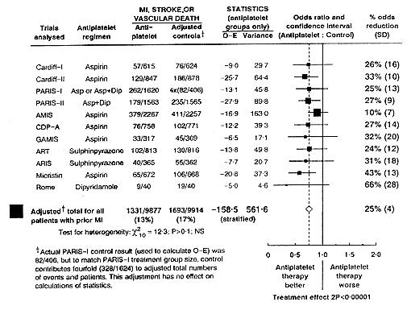
Proportional effects on vascular events (myocardial infarction, stroke, or vascular death) in 11 randomised trials of prolonged antiplatelet therapy (for one month or more) versus control in patients with prior myocardial infarction.
Antiplatelet Trialists' Collaboration BMJ 1994;308:81-106
Notes:
Proportional effects on vascular events (myocardial infarction, stroke, or vascular death) in 11 randomised trials of prolonged antiplatelet therapy (for one month or more) versus control in patients with prior myocardial infarction. O-E=Observed minus expected Asp=Aspirin. Dip=Dipyridamole. MI=Myocardial infarction (In most trials patients were allocated roughly evenly between treatment groups, but in some (for example, PARIS-I) more were deliberately allocated to active treatment. To allow direct comparisons between percentages suffering an event in each treatment group, in figure 1 and elsewhere adjusted totals have been calculated after converting any unevenly randomised trials to even ones by counting control groups more than once. Statistical calculations are, however, based on actual numbers from individual trials. Ratio of odds of an event in treatment group to that in control group is plotted for each trial (black square: area proportional to amount of statistical information contributed by trial) along with its 99% confidence interval (horizontal line). All black squares are to left of solid vertical line, indicating benefit (but benefit is significant at 2P<0.01 only where, in three trials, entire confidence interval is to left of line). Stratified overview of results of all trials (and 95% confidence interval) is represented by open diamond, indicating odds ratio of 0.75 (SD 0.04) or, equivalently, odds reduction of 25% (SD 4%))‏

Slide 23
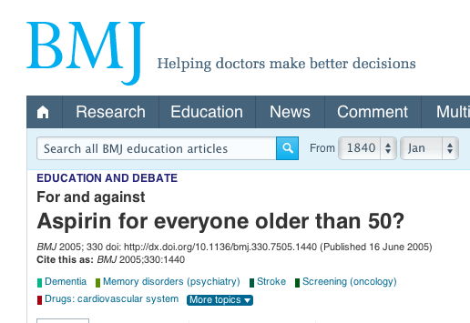
2005
“Aspirin for everyone older than 50?”

Slide 24
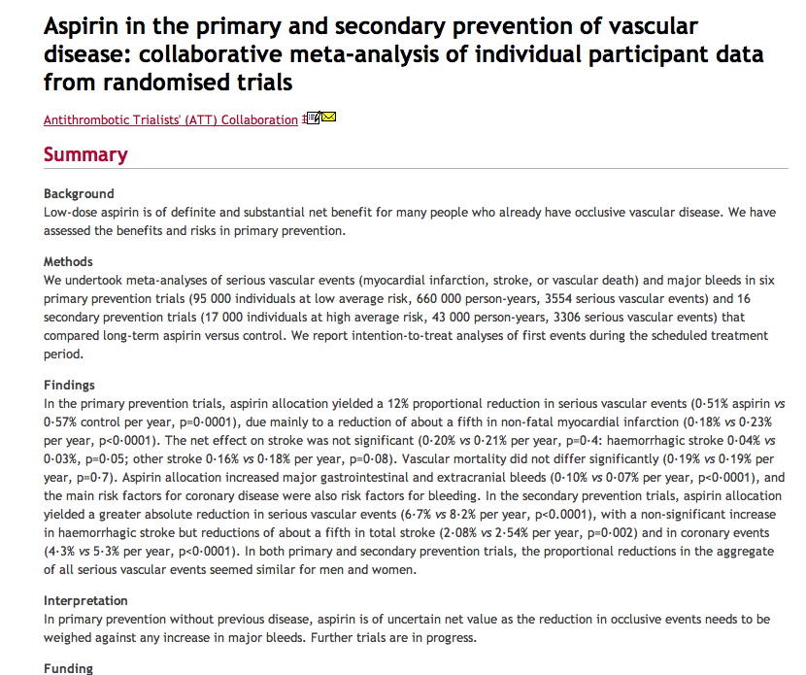
Evidence
2009
Anti-thrombotic Trialists Collaboration (Lancet 2009)
  Meta-analysis of 6 primary prevention studies (95’000 patients)
  Aspirin no effect on mortality or reducing stroke
  Extremely small reduction in non-fatal MI (ARR 0.05%) increased risk of major GI bleed (0.03% increase)
  Thus aspirin of ‘uncertain value’

Slide 25
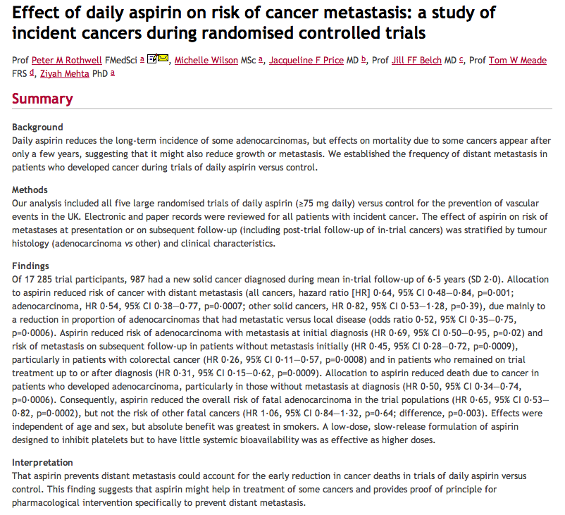
2012

Slide 26
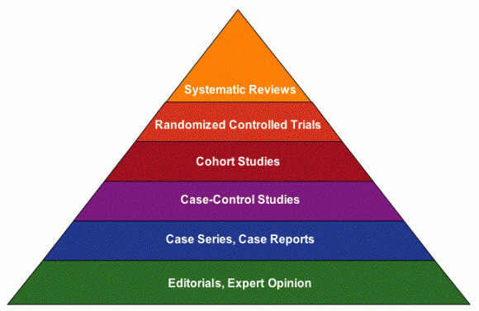
Types of evidence affect the quality
Quality

Slide 27
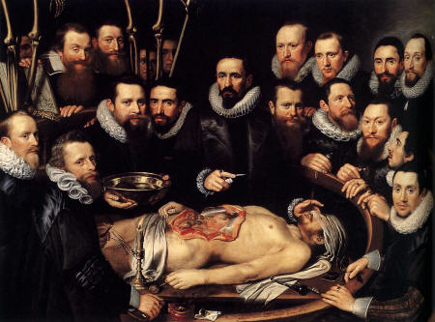
“A 21st century clinician who cannot critically read a study is as unprepared as one who cannot take a blood pressure or examine the cardiovascular system.”
BMJ 2008:337:704-705

Slide 28
The 5 steps of EBM
Formulate an answerable question
Track down the best evidence
Critically appraise the evidence for validity, clinical relevance and applicability
Individualize, based clinical expertise and patient concerns
Evaluate your own performance

Slide 29

Getting Evidence in to Practice
How do you “do” EBP?
What Evidence based practice do you do/help with?
What other EBP do you know of?

Slide 30
JASPA*
(Journal associated score of personal angst)
J: Are you ambivalent about renewing your JOURNAL subscriptions?
A: Do you feel ANGER towards prolific authors?
S: Do you ever use journals to help you SLEEP?
P: Are you surrounded by PILES of PERIODICALS?
A: Do you feel ANXIOUS when journals arrive?
YOUR SCORE? (0 TO 5)
0 (?liar)
1-3 (normal range)
>3 (sick; at risk for polythenia gravis and related conditions)
* Modified from: BMJ 1995;311:1666-1668

Slide 31
Median minutes/week spent reading about my patients:
Self-reports at 17 Grand Rounds:
Medical Students: 90 minutes
House Officers (PGY1): 0 (up to 70%=none)
SHOs (PGY2-4): 20 (up to 15%=none)
Registrars: 45 (up to 40%=none)
Sr. Registrars 30 (up to 15%=none)
Consultants:
  Grad. Post 1975: 45 (up to 30%=none)
  Grad. Pre 1975: 30 (up to 40%=none)
Notes:
31
This summarises the data from about 12 DGH’s around the England and Scotland.
In summary, HO’s (who don’t read at all) are being taught by old farts (who read 30 minutes a week).

Slide 32
Size of Medical Knowledge
1 disease per day for 30 years
To cover the vast field of medicine in four years is an impossible task.
- William Olser
NLM MetaThesaurus
  875,255 concepts
  2.14 million concept names
Diagnosis Pro
  11,000 diseases
  30,000 abnormalities (symptoms, signs, lab, X-ray,)
  3,200 drugs (cf FDAs 18,283 products)

Slide 33


Why do we need to use evidence efficiently?
5,000?
per day
Articles Per Year
2,000 per day
75 per day
EBP: informing decisions with the best up-to-date evidence
Notes:
so why do we need to use the evidence more efficiently today? Because there is an epidemic of evidence we need to keep up with and we cannot do this without new skills

Slide 34
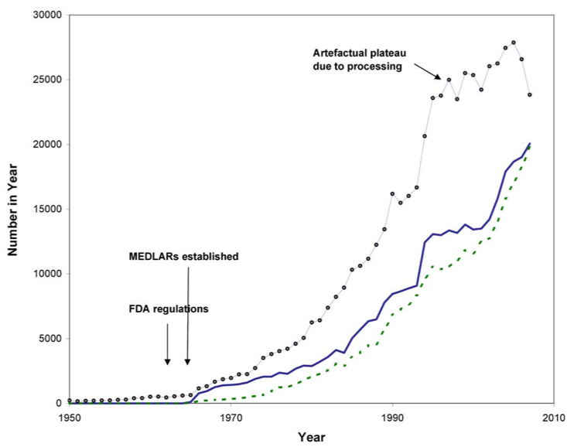

clinical evidence is increasing so rapidly we need better skills to keep up-to-date more efficiently than previous generations of clinicians
more efficiently
Bastian, Glasziou, Chalmers PLoS 2010 Vol 7 | Issue 9 | e1000326
Notes:
34
the figure on this slide illustrates the modern epidemic of evidence. The solid blue line shows the growth in number of published randomised controlled trials and you can see the dramatic increase in trials - with more than 5 times as many published today than in the 1980s. So its not surprising that we need to be far more efficient in keepoing up to date with the evidence today than we did 20-30 years ago. and Given that many of today's health professionals did most of their training more than 30 years ago, there is a lot of upskilling needed.
as an aside ...I was running an EBP workshop in Iran a few years ago and I had made a statement that one couldn't be a quality practitioner without EBP skills. An elderly physician near the front of the room put up his hand and said that this was his first EBP workshop so did that mean that for most of his practicing life he had been a poor quality doctor. My response was that for most of his practicing life, he could probably have kept up with the evidence without any specific EBP skills because there wasn't a lot of good clinical epidemiological evidence around but that was now changing rapidly and so he now needed these skills.

Slide 35
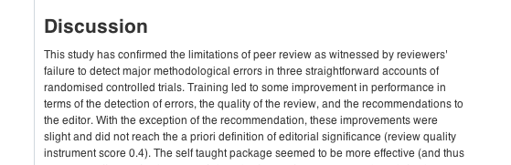
But we are (currently) poorly equipped to tell good from bad research
Schroter S et al
BMJ study of 607 reviewers
  14 deliberate errors inserted
Detection rates
  On average <3 of 9 major errors detected
  Poor Randomisation (by name or day) - 47%
  Not intention-to-treat analysis - 22%
  Poor response rate - 41%

Slide 36
Managing Information
“Push” and “Pull” methods
“Push” - alerts us to new information
  “Just in Case” learning
    Use ONLY for important, new, valid research
“Pull” – access information when needed
  “Just in Time” learning
    Use whenever questions arise
    EBM Steps: Question; search; appraise; apply

Slide 37

Your Clinical Questions
Write down one recent patient problem
What was the critical question?
Notes:
At a recent clinic or family or your own ….

Slide 38
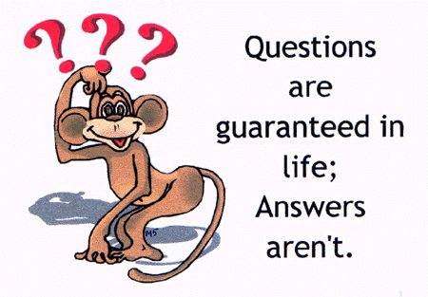
: Asking well-formulated questions
In your books

Slide 39
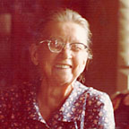
Angela is a new patient who recently moved to the area to be closer to her son and his family
She is 69 years old and has a history of congestive heart failure brought on by a recent myocardial infarctions.
She has been hospitalized twice within the last 6 months for worsening of heart failure and has a venous leg ulcer.
At the present time she reports she is extremely diligent about taking her medications (lisinopril and aspirin) and wants desperately to stay out of the hospital. She is mobile and lives alone with several cats but reports sometimes she forgets certain things.
She also tells you she is a bit hard of hearing, has a slight cough, is an ex-smoker of 20 cigs a day for 40 years. Her BP today is 170/90, her ankles are slightly swollen and her ulcer is painful and her pulse is 80 and slightly irregular.
What are your questions?

Slide 40
‘Background’ Questions
About the disorder, test, treatment, etc.
2 components:
a. Root* + Verb: “What causes …”
b. Condition: “… Ebola?”
* Who, What, Where, When, Why, How

Slide 41
‘Foreground’ Questions
About patient care decisions and actions
4 (or 3) components:
a. Patient, problem, or population
b. Intervention, exposure, or maneuver
c. Comparison (if relevant)
d. Clinical Outcomes (including time horizon)

Slide 42
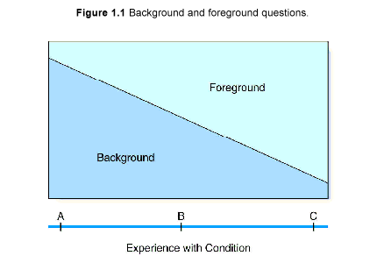
Background & Foreground

Slide 43
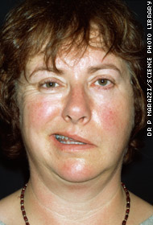

Slide 44
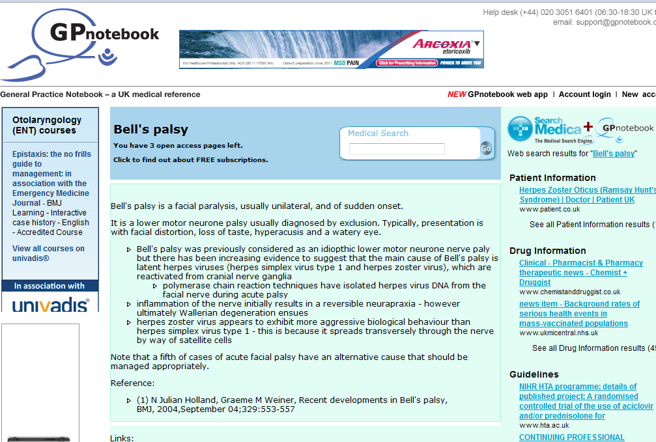
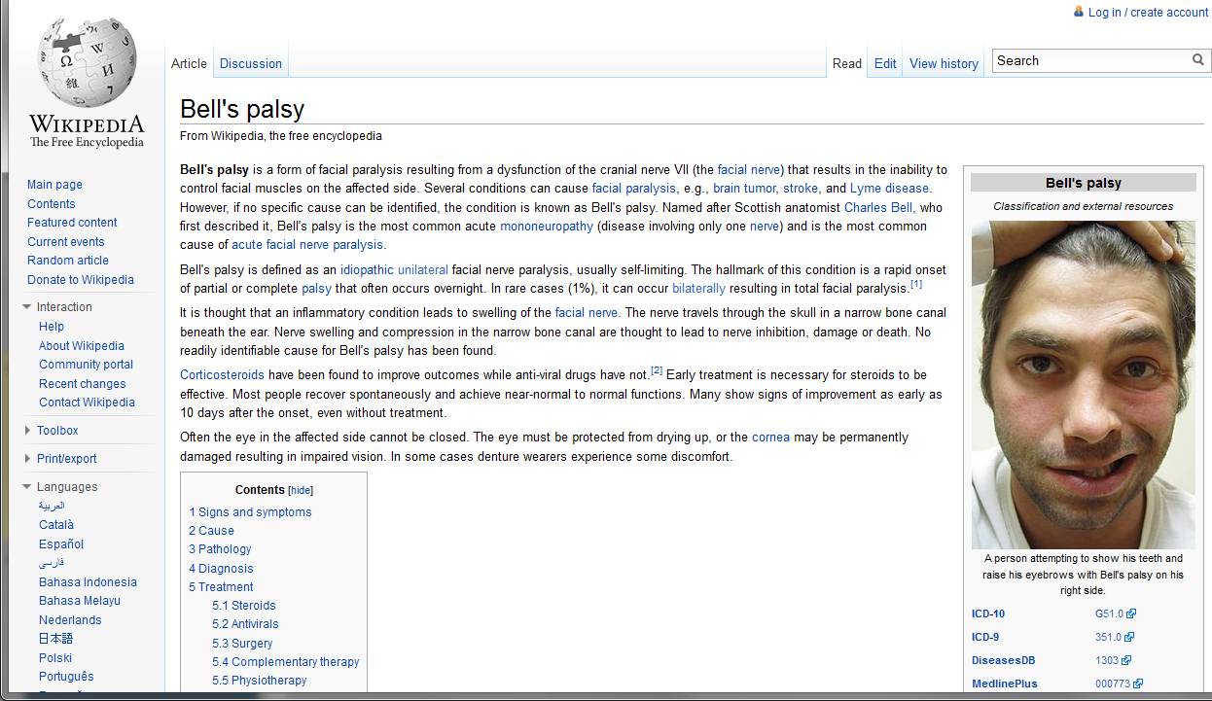
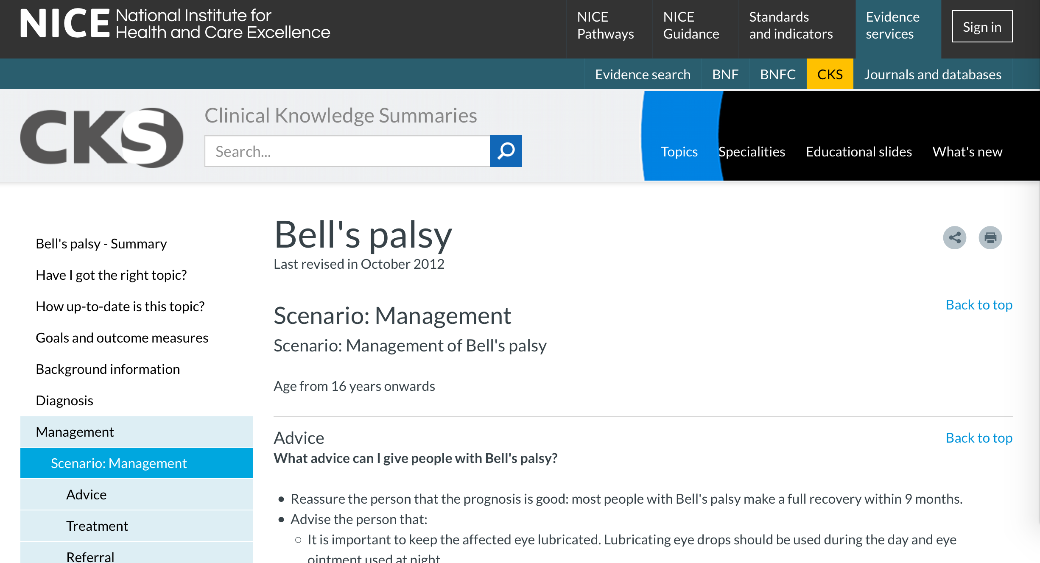

Slide 46
‘Foreground’ Questions
  About patient care decisions and actions
4 (or 3) components:
a. In Patients with Bell’s Palsy
b. Do (I) corticosteroids
c. Compared to placebo
d. Improve facial function (O) at 3 months

Slide 47
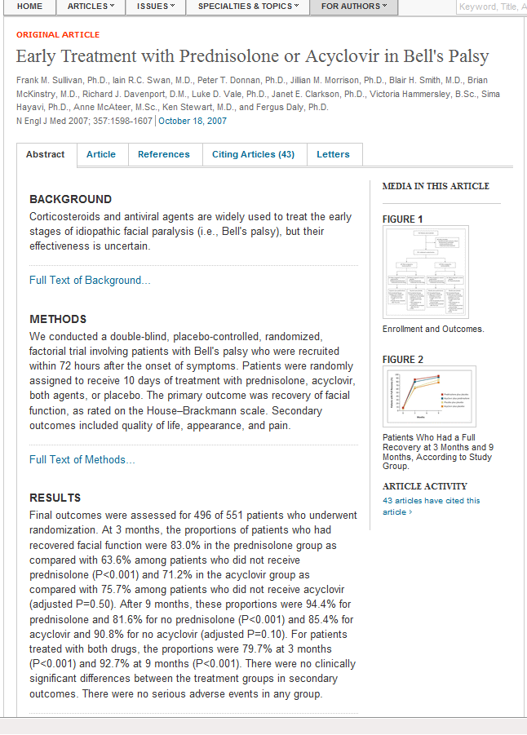
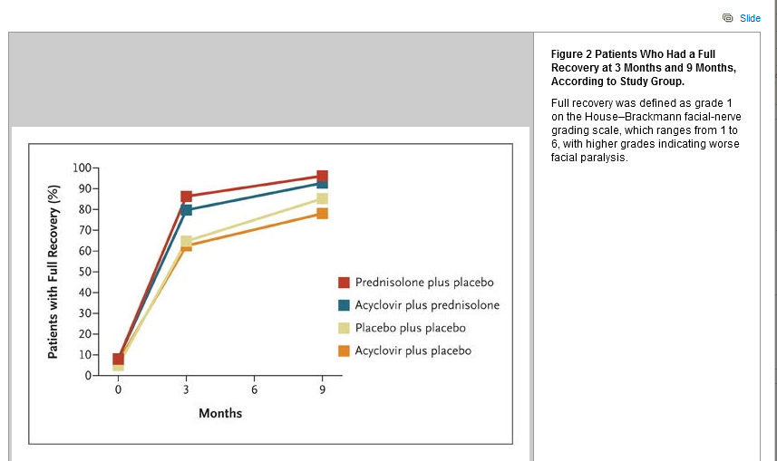

Slide 48


Does this intervention help?
www.cebm.net
For every 100 people with Bell’s palsy at 3 months
  83 in the corticosteroid group will have recovered facial function &
  64 in the placebo group will have recovered facial function
  Risk difference = 19%
  Relative Risk Reduction = 23%
  Number Needed to Treat = 6
  Natural Frequency 19 per 100

Slide 50
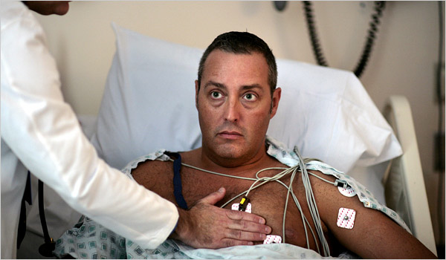
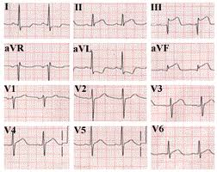
Background:
Patient presenting with MI
  What are the symptoms and signs of someone presenting with MI?
  What are the diagnostic tests for MI?
  What are the causes of MI?
  What are the treatments of MI?

Slide 51
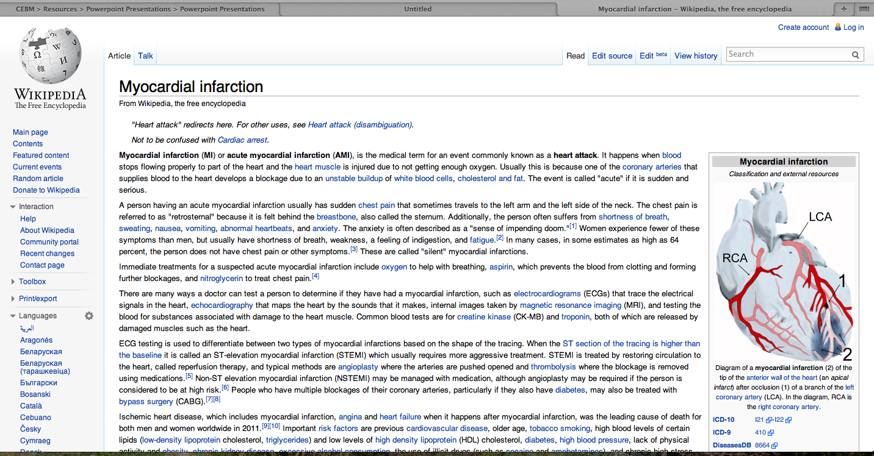
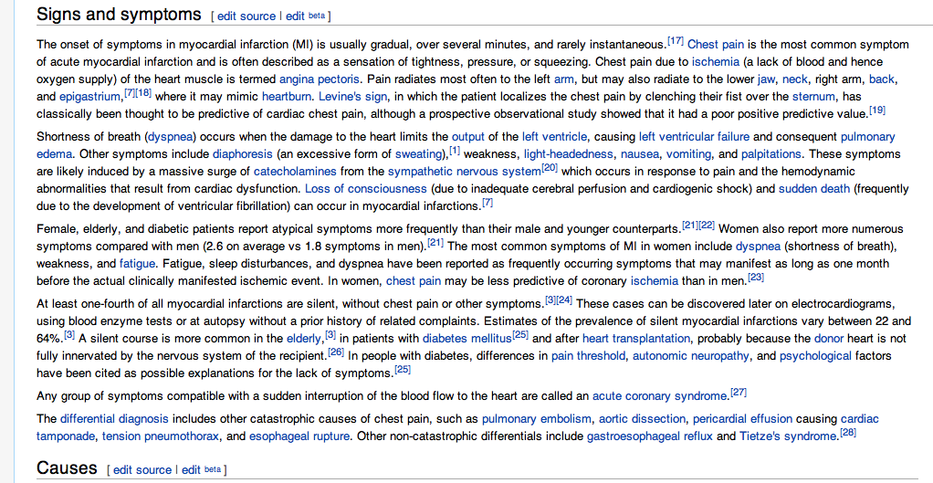

Slide 52
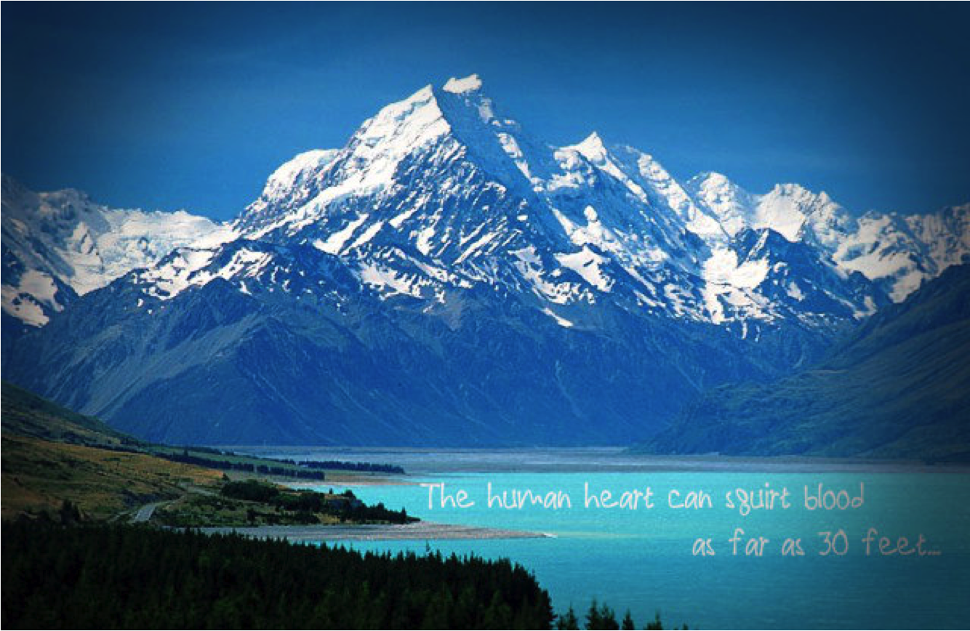
Know your background

Slide 53
Patient presenting with MI
Foreground’ Questions
About actual patient care decisions and actions
For treatment
4 (or 3) components:
In Patients with a MI
Does (I) cholesterol lowering therapy
Compared to placebo
reduce mortality (O)

Slide 54
Patient presenting with MI (7 types of questions)
1. How common is the problem | Prevalence
2. Is early detection worthwhile | Screening
3. Is the diagnostic test accurate | Diagnosis
4. What will happen if we do nothing | Prognosis
5. Does this intervention help | Treatment
6. What are the common harms of an intervention
7. What are the rare harms of an intervention

Slide 55

Example 1
Jean is a 55 year old woman who quite often crosses the Atlantic to visit her elderly mother. She tends to get swollen legs on these flights and is worried about her risk of developing deep vein thrombosis (DVT), because she has read quite a bit about this in the newspapers lately. She asks you if she would wear elastic stockings on her next trip to reduce her risk of this.

Slide 56
Example 2
CHILDHOOD SEIZURES
Childhood seizures are common and frightening for the parents, and the decision to initiate treatment is a difficult one. What is the risk of further recurrences following a single seizure of unknown cause? Are there any identifiable factors that modify this risk?

Slide 57
Example 3
VACCINATION AND NEEDLE LENGTH
You are the practice nurse and one of your colleagues tells you it is better to use a short needle than a long needle when immunising babies for their first ever vaccinations, as it reduces the swelling and decreases the parents anxiety about further vaccinations. You wonder if your colleague is correct?

Slide 58
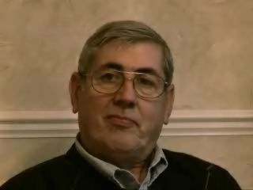

Slide 59
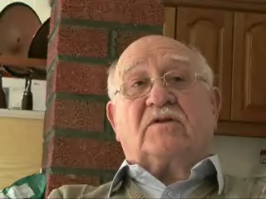

Slide 60
Example 4
CHILDREN AND ANTIVIRALS
You are the GP and the next patient brings their 3 year old child who is unwell with a fever, the mother wants to know whether she should give the child tamiflu?

Slide 61
Example 5
INFLUENZA AND NEAR PATIENT TEST
Your next patient is adamant they have influenza and knowing the diagnosis would help them in their decision to take antiviral treatment. You wonder how accurate is the near patient test?

Slide 62
Further Example
Susan is expecting her first baby in two months. She has been reading about the potential benefits and harms of giving newborn babies vitamin K injections. She is alarmed by reports that vitamin K injections in newborn babies may cause childhood leukaemia. She asks you if this is true and, if so, what the risk for her baby will be.

Slide 63
Your Clinical Questions
Write down one recent patient problem
What is the PICO of the problem?
Notes:
At a recent clinic or family or your own ….

Slide 64
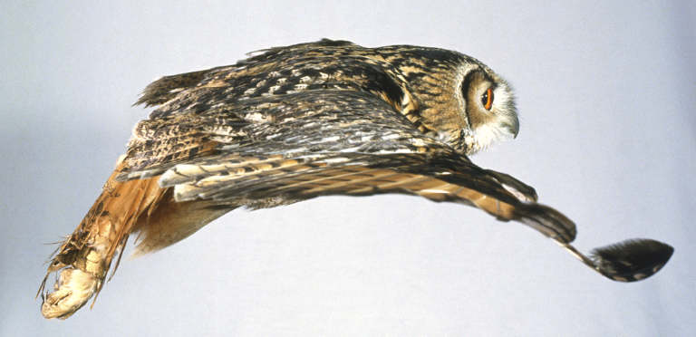
Questions
Recognize: your questions
Select: which questions to pursue
Guide: how to ask and answer
Assess: how well & what to improve

Slide 65
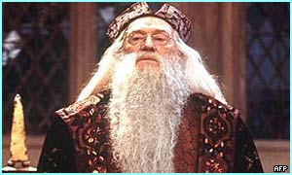
FAQ: How Long … ?
Proficient? Quickly
Mastery? Lifetime
Human expertise takes >10,000 hours, >10 years
→Deliberate practice

Slide 66
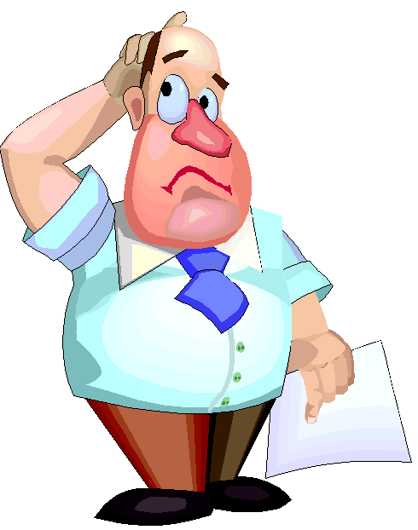

Any questions?

