Slide 1
Evidence-Based Medicine Thread Course
Dr Carl Heneghan
Director CEBM
Clinical Reader, University of Oxford

Slide 2
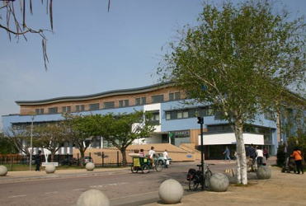

Slide 3
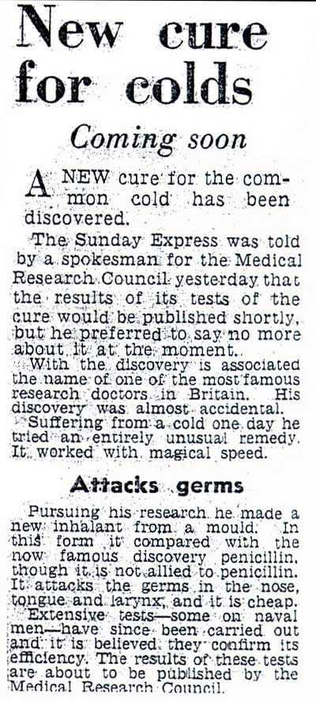
Why do we need EBM?
A more detailed account of the MRC patulin trial is available in:
Chalmers I, Clarke M. The 1944 patulin trial: the first properly controlled multicentre trial conducted under the aegis of the British Medical Research Council. International Journal of Epidemiology 2004;32:253-260

Slide 4
ACTIVE INGREDIENTS WITHDRAWN
THALIDOMIDE (1961) Congenital limb defects
BENOXAPROFEN (1982) Hepatotoxicity
PHENFORMIN (1982) Lactic acidosis
FENFLURAMINE (1997) Heart-valve abnormalities
ASTEMIZOLE (1999) Many drug interactions
PHENYLPROPANOLAMINE(2000) Hemorrhagic stroke
KAVA KAVA Liver abnormalities
CERIVASTATIN (2001) Rhabdomyolysis
CISAPRIDE (2000) Cardiac arrhythmias
ROFECOXIB (2004) Cardiovascular events
VALDECOXIB (2005) CVD events, skin reactions
COMFREY, SENECIO Nephrotoxicity
TEGASEROD (2007) Cardiovascular events
CLOBUTINOL (2007) Cardiac arrhythmia
Co-PROXAMOL (2007) Respiratory arrest
XIMELEGTRAN (2008) Liver toxicity
SIBUTRAMINE (2010) Cardiovascular events

Slide 6
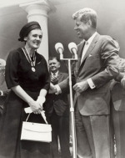

Slide 7
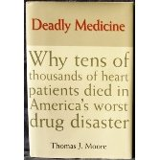
Why do we need RANDOMIZED CONTROLLED TRIALS ?
In the early 1980s newly introduced antiarrhythmics were found to be highly successful at suppressing arrhythmias.
The CAST trial revealed Excess mortality of 56/1000.
By the time the results of this trial were published, at least 100,000 such patients had been taking these drugs.
Notes:
7

Slide 8
ACTIVE INGREDIENTS WITHDRAWN
THALIDOMIDE (1961) Congenital limb defects
BENOXAPROFEN (1982) Hepatotoxicity
PHENFORMIN (1982) Lactic acidosis
FENFLURAMINE (1997) Heart-valve abnormalities
ASTEMIZOLE (1999) Many drug interactions
PHENYLPROPANOLAMINE(2000) Hemorrhagic stroke
KAVA KAVA Liver abnormalities
CERIVASTATIN (2001) Rhabdomyolysis
CISAPRIDE (2000) Cardiac arrhythmias
ROFECOXIB (2004) Cardiovascular events
VALDECOXIB (2005) CVD events, skin reactions
COMFREY, SENECIO Nephrotoxicity
TEGASEROD (2007) Cardiovascular events
CLOBUTINOL (2007) Cardiac arrhythmia
Co-PROXAMOL (2007) Respiratory arrest
XIMELEGTRAN (2008) Liver toxicity
SIBUTRAMINE (2010) Cardiovascular events

Slide 9
1000

Slide 10
Informed FDA in 2001 there was no increase in risk of death while they knew internally it was 3 times that of placebo
Spending $100 million dollars per year in direct to advertising consumers
2003 sales $2.5 billion per year

Slide 11
Merck, Rofecoxib & Alzheimers
Internal company data April 2001 from 2 Vioxx trials
Information submitted to the FDA in July 2001 used on‐treatment analysis that minimized the appearance of any mortality risk
Psaty et al. JAMA 2008;299:1813‐7

Slide 12
On treatment analysis
April 2001,
Company's internal intention-to-treat analyses of pooled data from these 2 trials identified a significant increase in total mortality
Overall mortality of 34 deaths among 1069 rofecoxib patients
and 12 deaths among 1078 placebo patients
HR, 2.99 (95% CI, 1.55-5.77).

Slide 13
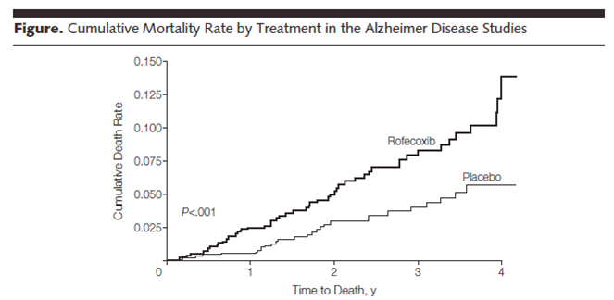

Slide 15
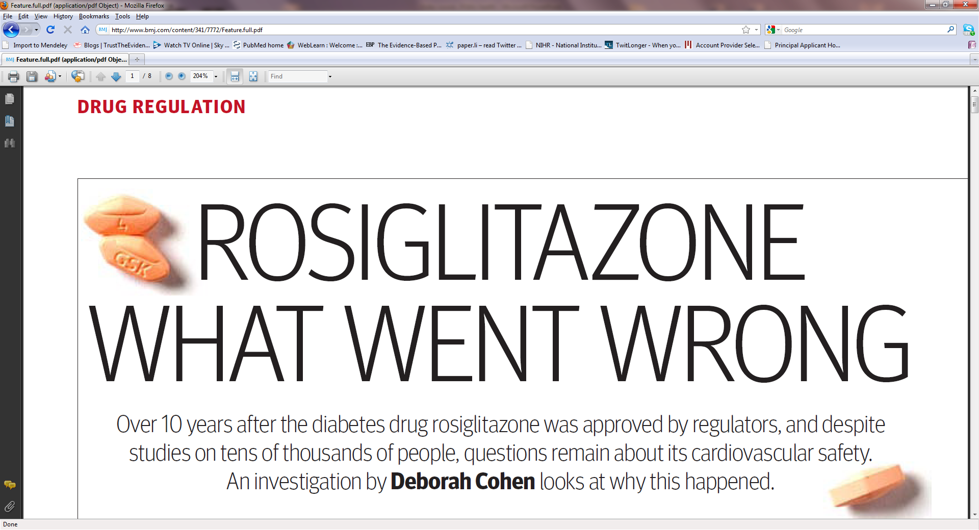

Slide 16
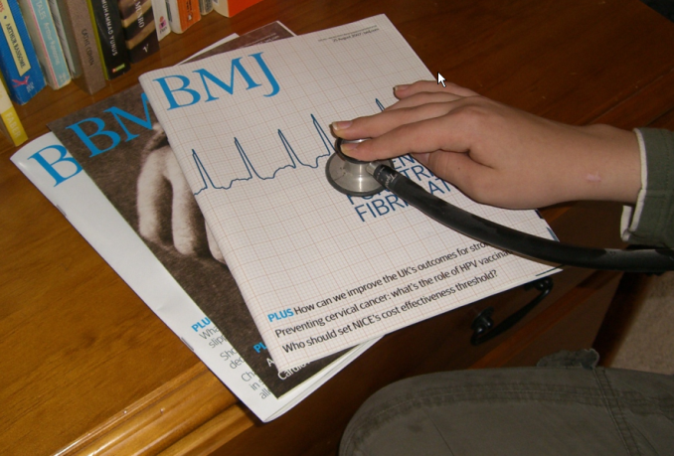
The 5 steps of EBM
Formulate an answerable question
Track down the best evidence
Critically appraise the evidence for validity, clinical relevance and applicability
Individualize, based clinical expertise and patient concerns
Evaluate your own performance

