Slide 1
1-day workshop on Evidence-Based Practice
November 26th 2010
Dr Carl Heneghan
Clinical Reader, University of Oxford
Director CEBM

Slide 2

Developing Evidence-Based Practice?
Carl Heneghan MA, MRCGP
Centre for Evidence Based Medicine
University of Oxford

Slide 3
One-Day EBP Workshop Program
Start | Topic
9:15 | Plenary: What is Evidence-based practice (Carl Heneghan)
10:00 | Group Tutorial: Asking well-formulated questions
10:55 | Morning Tea
11:15 | Plenary: Finding the best evidence (searching basics) - Nia Roberts
11:30 | Lab Tutorial: Cochrane and PubMed Searching (hands-on )
1.00 | Lunch
1:45 | Plenary: Rapid Critical Appraisal of intervention studies (Carl Heneghan)
2:30 | Small Group Tutorial: Followed by group work critical Appraisal of intervention studies (Ami Banerjee and Carl Heneghan )
3:30 | Afternoon Tea
3:45 | Small Group Tutorial: Critical Appraisal of intervention studies (Ami Banerjee and Carl Heneghan )
4:30 | Where to from here? / Evaluation / Close

Slide 4
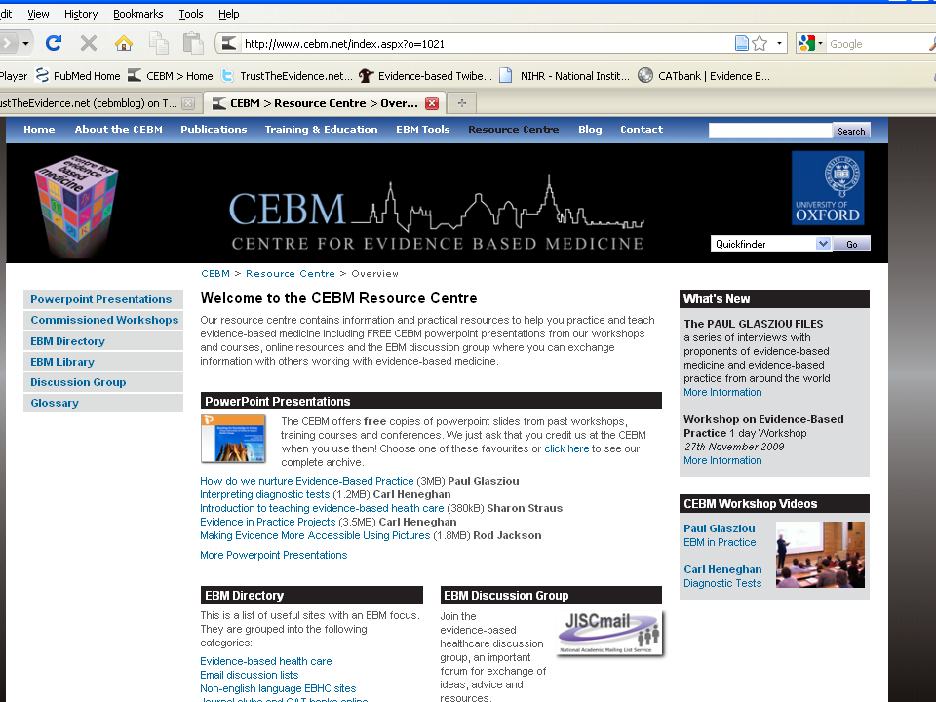

Slide 5
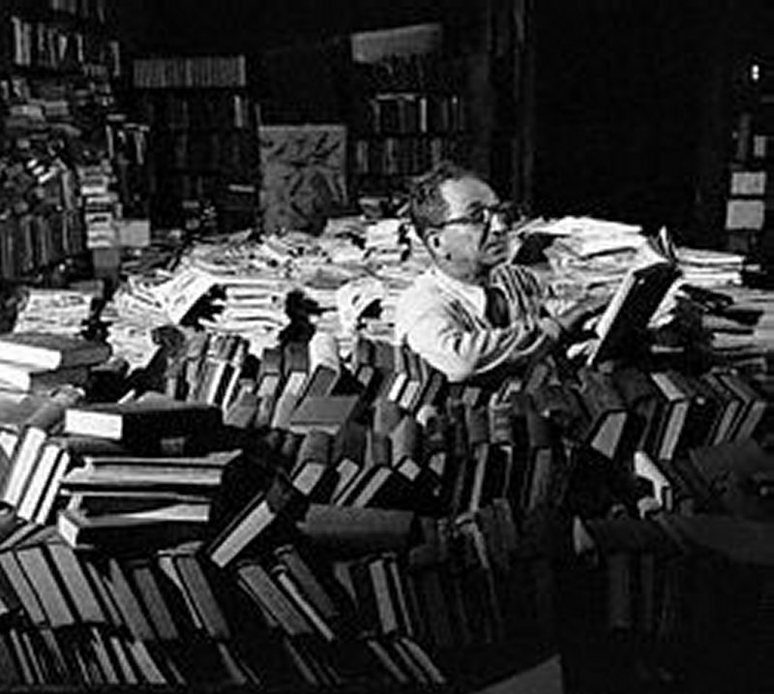
I am here because?
I wanted 3 days of work
Formulate an answerable questions

Slide 6
The aim of today
To understand what is EBP
To recognize questions
To develop focussed clinical questions
To find answers to your clinical questions
To assess the validity of an RCT
To assess the benefits and harms

Slide 7
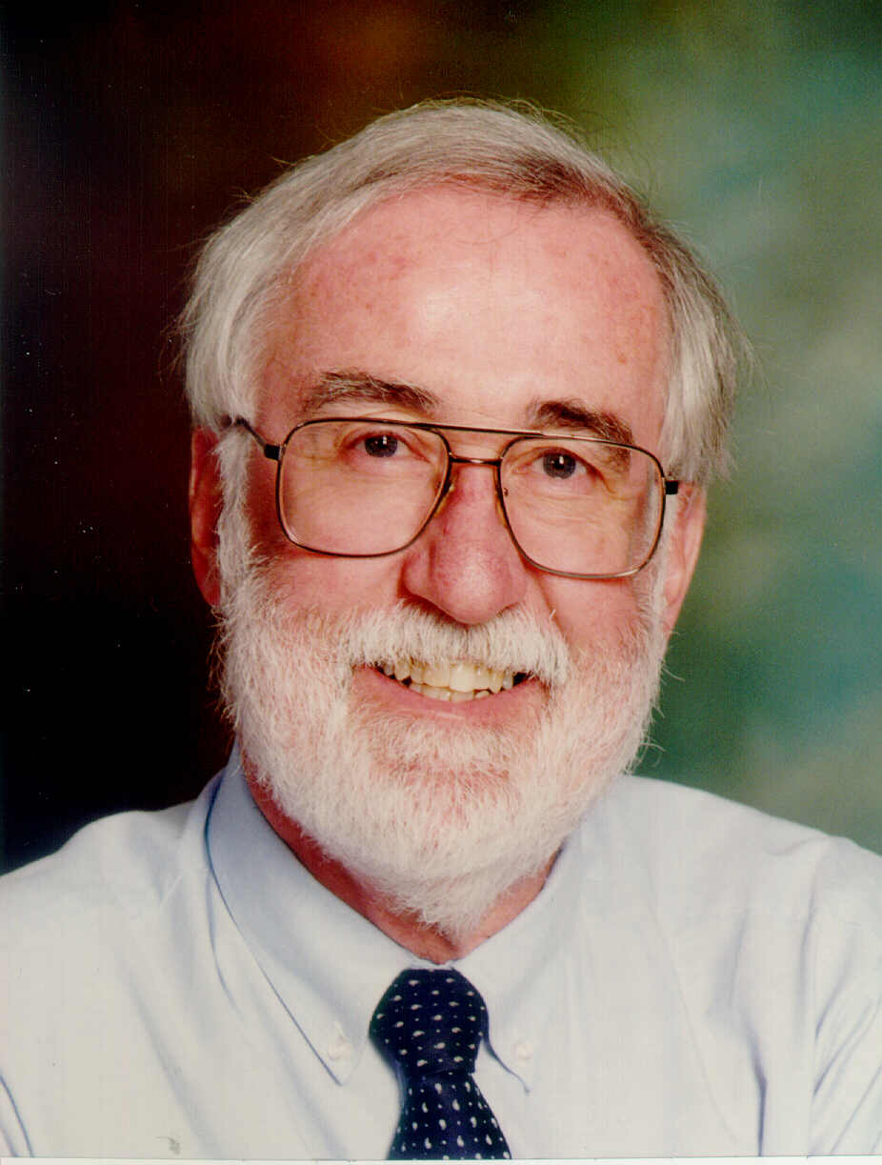
What is Evidence-Based Medicine?
“Evidence-based medicine is the integration of best research evidence with clinical expertise and patient values”
Notes:
Sackett DL, Rosenberg WMC, Gray JAM, Haynes RB, Richardson WS: Evidence based medicine: what it is and what it isn’t. BMJ 1996;312:71-2.
This definition of what EBM is and isn’t has gained wide acceptance and made it easier for us to get our points across.

Slide 8
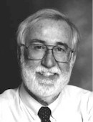
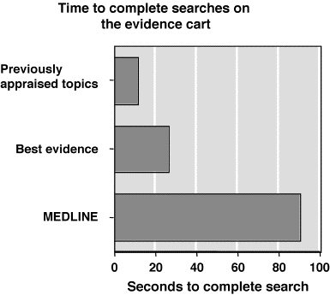
“Just in Time” learning
The EBM Alternative Approach
Shift focus to current patient problems
(“just in time” education)
  Relevant to YOUR practice
  Memorable
  Up to date
Learn to obtain best current answers
Dave Sackett
Notes:
8

Slide 9
Notes:
9

Slide 10
Notes:
10

Slide 11
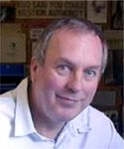

Would any of you have agreed to participate in a placebo controlled trial of prophylactic antibiotics for colorectal surgery after 1975?
Notes:
11

Slide 12
Reduction of perioperative deaths by antibiotic prophylaxis for colorectal surgery
Notes:
12

Slide 13
Would you ever have put babies to sleep on their tummies?
Notes:
13

Slide 14

Notes:
14

Slide 15
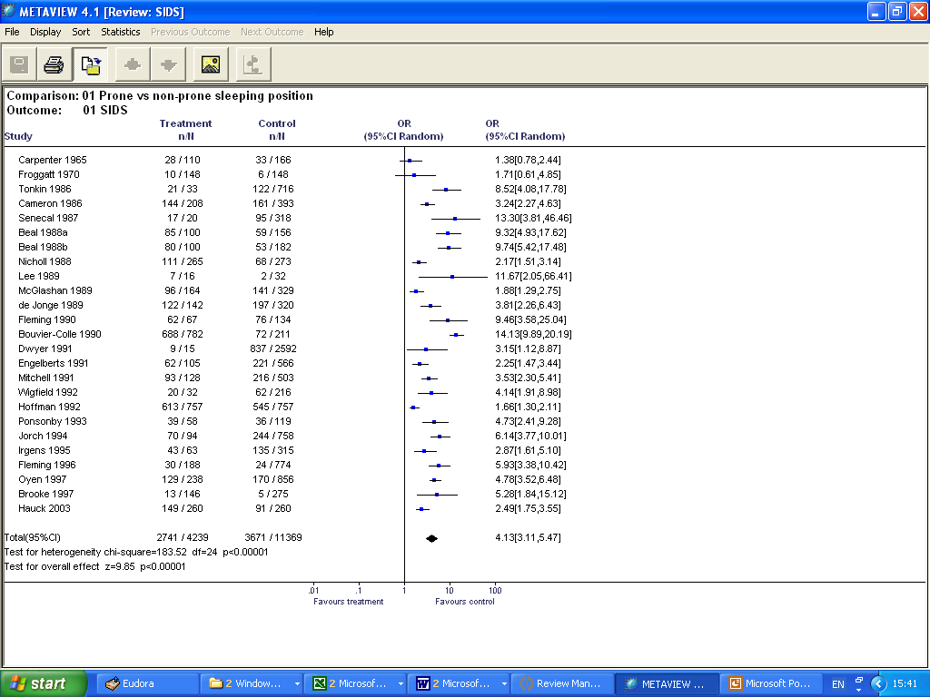
Notes:
15

Slide 16
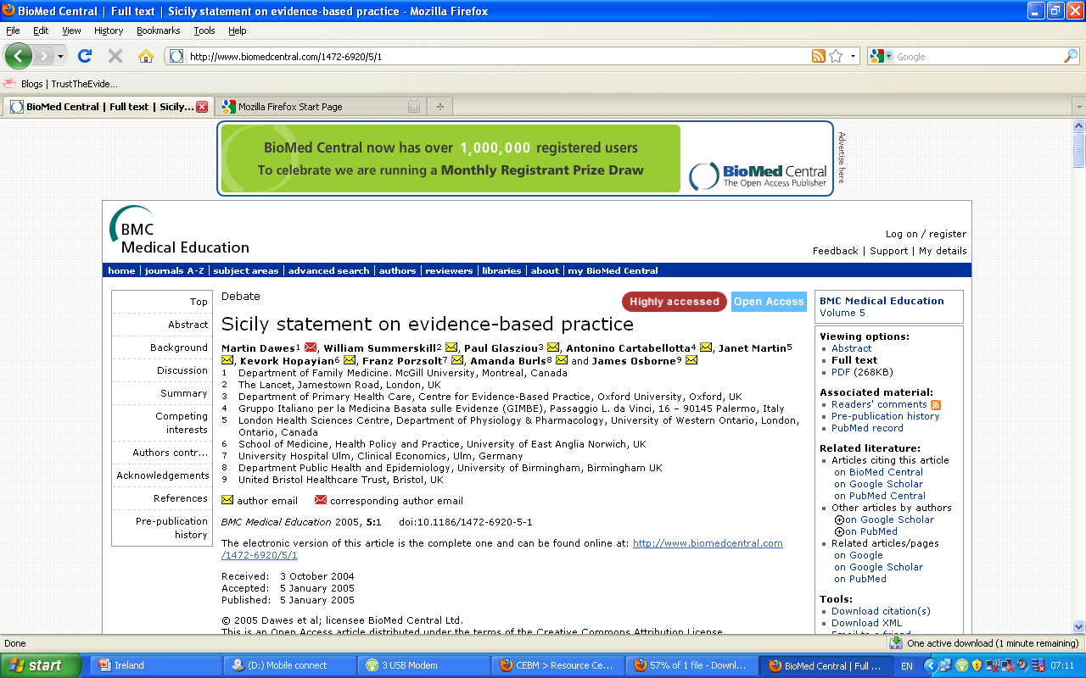

Slide 17
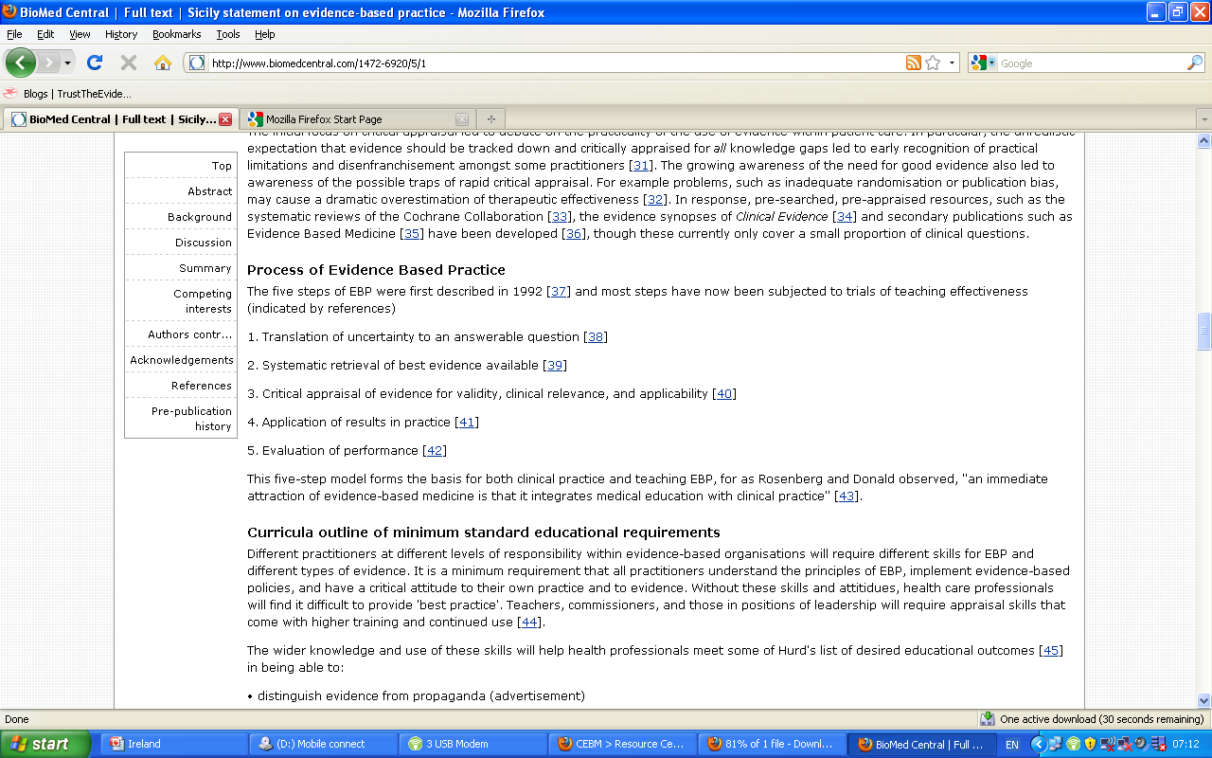

Slide 18
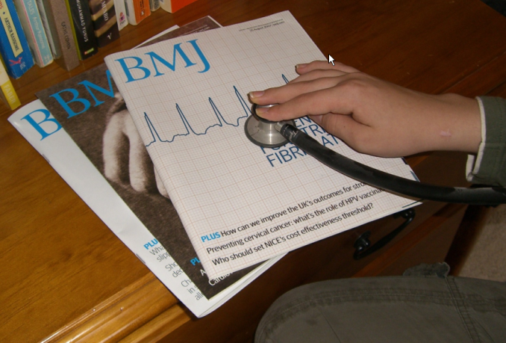
The 5 steps of EBM
Formulate an answerable question
Track down the best evidence
Critically appraise the evidence for validity, clinical relevance and applicability
Individualize, based clinical expertise and patient concerns
Evaluate your own performance

Slide 19


Getting Evidence in to Practice
How do you “do” EBP?
What Evidence based practice do you do/help with?
What other EBP do you know of?

Slide 20
JASPA*
(Journal associated score of personal angst)
J: Are you ambivalent about renewing your JOURNAL subscriptions?
A: Do you feel ANGER towards prolific authors?
S: Do you ever use journals to help you SLEEP?
P: Are you surrounded by PILES of PERIODICALS?
A: Do you feel ANXIOUS when journals arrive?
YOUR SCORE? (0 TO 5)
0 (?liar)
1-3 (normal range)
>3 (sick; at risk for polythenia gravis and related conditions)
* Modified from: BMJ 1995;311:1666-1668

Slide 21
Median minutes/week spent reading about my patients:
Self-reports at 17 Grand Rounds:
Medical Students: 90 minutes
House Officers (PGY1): 0 (up to 70%=none)
SHOs (PGY2-4): 20 (up to 15%=none)
Registrars: 45 (up to 40%=none)
Sr. Registrars 30 (up to 15%=none)
Consultants:
  Grad. Post 1975: 45 (up to 30%=none)
  Grad. Pre 1975: 30 (up to 40%=none)
Notes:
21
This summarises the data from about 12 DGH’s around the England and Scotland.
In summary, HO’s (who don’t read at all) are being taught by old farts (who read 30 minutes a week).

Slide 22
Size of Medical Knowledge
1 disease per day for 30 years
To cover the vast field of medicine in four years is an impossible task.
- William Olser
NLM MetaThesaurus
  875,255 concepts
  2.14 million concept names
Diagnosis Pro
  11,000 diseases
  30,000 abnormalities (symptoms, signs, lab, X-ray,)
  3,200 drugs (cf FDAs 18,283 products)

Slide 23
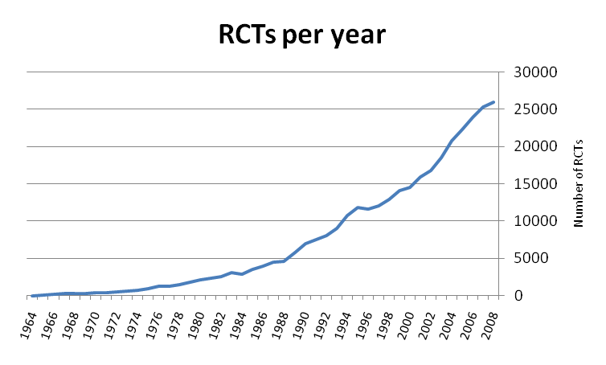
How many randomized trials are published each year

Slide 24
Changes in the past 12 months
A Survey of 43 EBM practitioners at 2009 EBM practice workshop

Slide 25
Most “interesting” research is wrong, but clinicians not skilled in appraisal
Flawed studies
  Hormone Replacement Therapy
  Beta-carotene and cancer
  MMR and autism
  Folate and CHD
Data mining
  Genes for anything
Small early studies
Ioannidis J. Why Most Published Research Findings Are False. PLoS 2005

Slide 26
But we are (currently) poorly equipped to tell good from bad research
Schroter S et al, accepted for Clinical Trials
BMJ study of 607 reviewers
  14 deliberate errors inserted
Detection rates
  On average <3 of 9 major errors detected
  Poor Randomisation (by name or day) - 47%
  Not intention-to-treat analysis - 22%
  Poor response rate - 41%

Slide 27

How do you currently keep up to date?
What resources do you use
What educational activities do you take part in

Slide 28
Managing Information
“Push” and “Pull” methods
“Push” - alerts us to new information
  “Just in Case” learning
    Use ONLY for important, new, valid research
“Pull” – access information when needed
  “Just in Time” learning
    Use whenever questions arise
    EBM Steps: Question; search; appraise; apply

Slide 29
“Just in Time” learning:
Intern’s information needs
Setting: 64 residents at 2 New Haven hospitals
Method: Interviewed after 401 consultations
Questions
  Asked 280 questions (2 per 3 patients)
  Pursued an answer for 80 questions (29%)
  Not pursued because
    Lack of time
    Forgot the question
Sources of answers
  Textbooks (31%), articles (21%), consultants (17%)
Green, Am J Med 2000

Slide 30
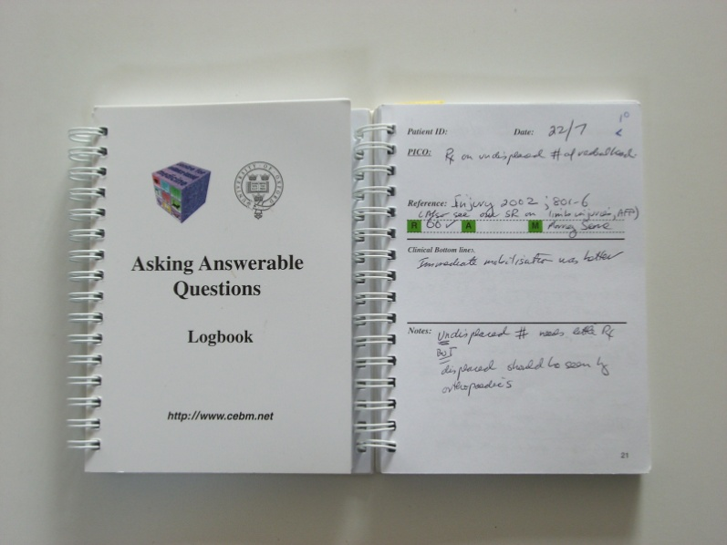

Slide 31
Keeping up to Date by “Just in Time” Education
Shift focus to your current problems
  Relevant to YOUR practice
  More memorable (and practice changed)
  Up to date
But Four Barriers
  Admitting we don’t know
  Skills in obtaining current best evidence
  Evidence Resources at the point of care
  Time

Slide 32
Coping with the overload: things you might consider

Slide 33
Your Clinical Questions
Write down one recent patient problem
What was the critical question?
Did you answer it? If so, how?
Notes:
At a recent clinic or family or your own ….

Slide 34
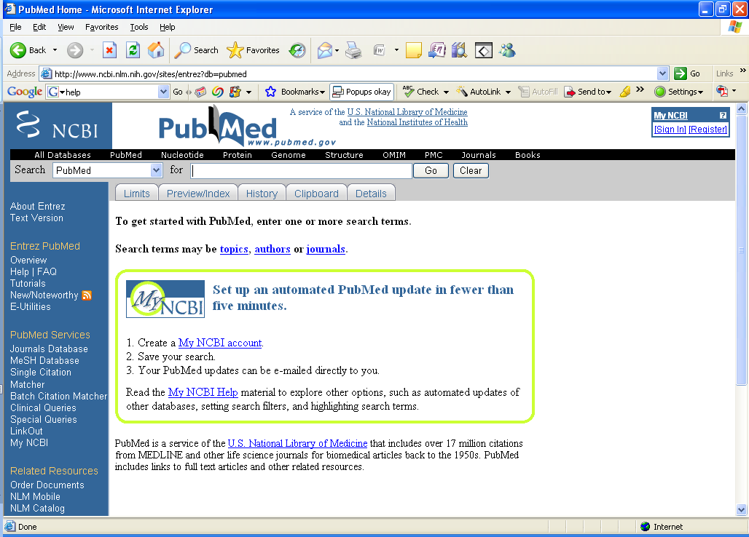
A recent patient of
mine in practice
Enter in to search box

Slide 35
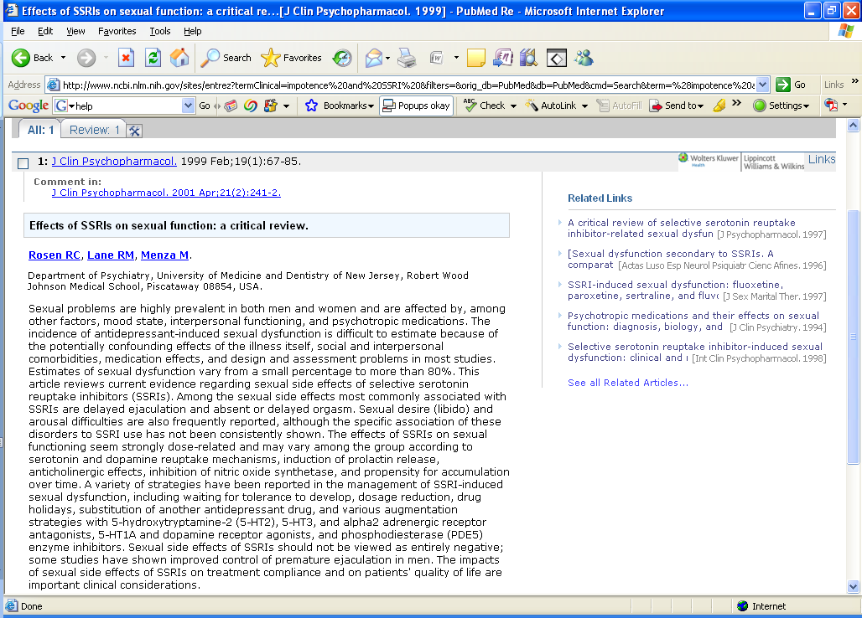
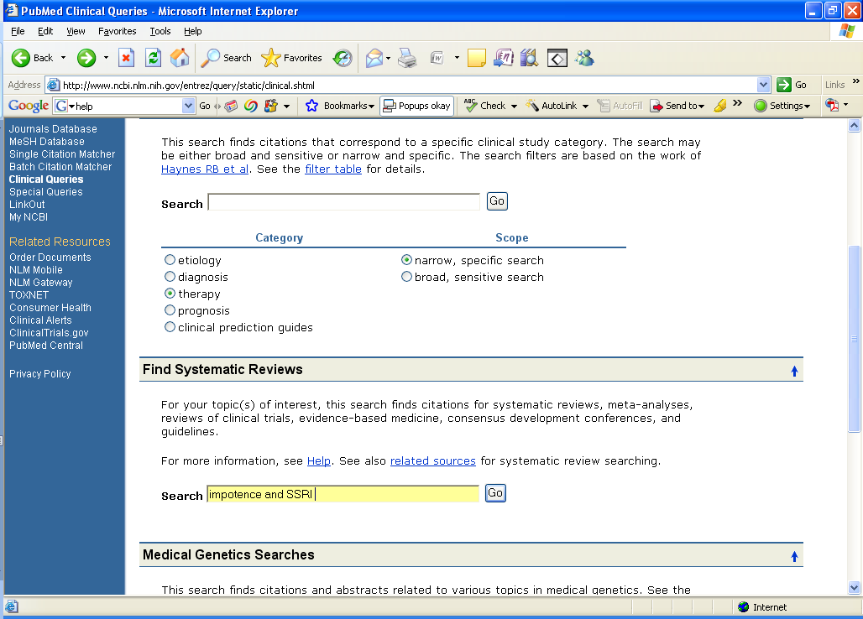
Enter in to search box

Slide 36
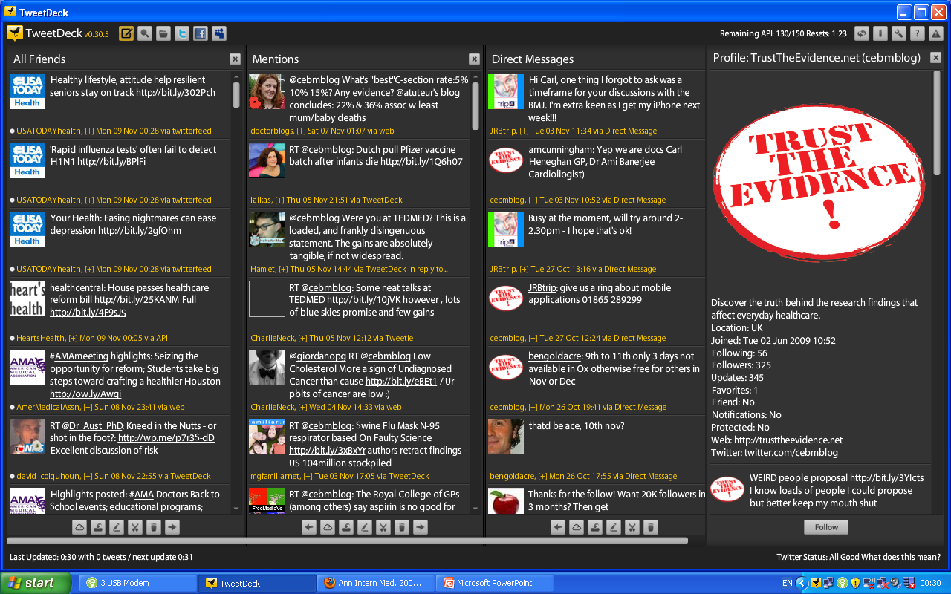

Slide 37
The Barriers to EBP
Attitude of question & inquiry
Know-how in finding, appraising, and applying evidence
Information Resources on tap
Lack of Time

Slide 38

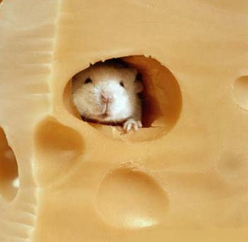
Conclusions
The information problem is bad and getting worse
All health care workers should be equipped to deal with the information problem
The mission is difficult but not impossible!

Slide 39
Take a break for two minutes

Slide 40

: Asking well-formulated questions
Page 21 in your books

Slide 41
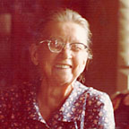
Angela is a new patient who recently moved to the area to be closer to her son and his family
She is 69 years old and has a history of congestive heart failure brought on by a recent myocardial infarctions.
She has been hospitalized twice within the last 6 months for worsening of heart failure and has a venous leg ulcer.
At the present time she reports she is extremely diligent about taking her medications (lisinopril and aspirin) and wants desperately to stay out of the hospital. She is mobile and lives alone with several cats but reprots sometimes she forgets certain things.
She also tells you she is a bit hard of hearing, has a slight cough, is an ex-smoker of 20 cigs a day for 40 years. Her BP today is 170/90, her ankles are slightly swollen and her ulcer is painful and her pulse is 80 and slightly irregular.
What are your questions?

Slide 42
‘Background’ Questions
About the disorder, test, treatment, etc.
2 components:
a. Root* + Verb: “What causes …”
b. Condition: “… SARS?”
* Who, What, Where, When, Why, How

Slide 43
‘Foreground’ Questions
About patient care decisions and actions
4 (or 3) components:
a. Patient, problem, or population
b. Intervention, exposure, or maneuver
c. Comparison (if relevant)
d. Clinical Outcomes (including time horizon)

Slide 44
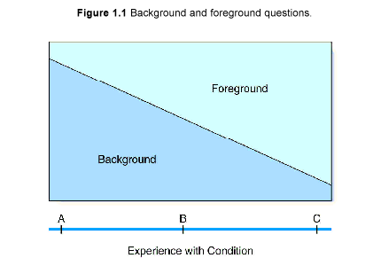
Background & Foreground

Slide 45
 | Patient or Problem | Intervention | Comparison intervention | Outcomes
Tips for Building | Describe a group of patients similar to your own | What intervention are you considering | What is the main alternative to the intervention | What do you hope to accomplish with the intervention
Example | “In elderly patients with congestive heart failure … | …does treatment with spirinolactone… | …when compared with standard therapy alone… | …lead to a decrease in hospitalization ”

Slide 46

Example 1 page 26
Jean is a 55 year old woman who quite often crosses the Atlantic to visit her elderly mother. She tends to get swollen legs on these flights and is worried about her risk of developing deep vein thrombosis (DVT), because she has read quite a bit about this in the newspapers lately. She asks you if she would wear elastic stockings on her next trip to reduce her risk of this.
P
I
C
O

Slide 47
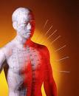
Example 2, page 26
Jeff, a smoker of more than 30 years, has come to see you about something unrelated . You ask him if he is interested in stopping smoking. He tells you he has tried to quit smoking unsuccessfully in the past. A friend if his , however, successfully quit with acupuncture. Should he try it? Other interventions you know about are nicotine replacement therapy and antidepressants
P
I
C
O

Slide 48

Example 3 page 27
At a routine immunisation visit, Lisa, the mother of a six-month-old tells you that her baby suffered a nasty local reaction after her previous immunisation. Lisa is very concerned that the same thing may happen again this time. Recently, a colleague told you that needle length can affect local reactions to immunisation in young children but you can’t remember the precise details
P
I
C
O

Slide 49
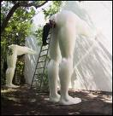
Example 2, page 28
Susan is expecting her first baby in two months. She has been reading about the potential benefits and harms of giving newborn babies vitamin K injections. She is alarmed by reports that vitamin K injections in newborn babies may cause childhood leukaemia. She asks you if this is true and, if so, what the risk for her baby will be.
P
I
C
O
Aetiology and risk factors

Slide 50
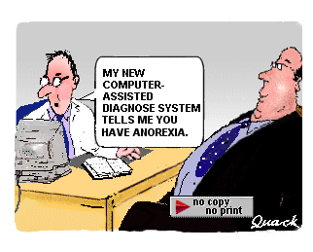
Example 1, page 29
Julie is pregnant for the second time. She had her first baby when she was 33 and had amniocentesis to find out if the baby had Down Syndrome. The test was negative but it was not a good experience, because she did not get the result until she was 18 weeks pregnant. She is now 35 and 1 month pregnant, and asks if she can have a test that would give her an earlier result. The local hospital offers serum biochemistry plus nuchal translucency ultrasound screening as a first trimester test for Down syndrome. You winder if this combination of tests is as reliable as a conventional amniocentesis
P
I
C
O
Diagnosis

Slide 51
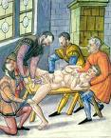
Example 2, page 32
Mr Thomas, who is 58 years old, has correctly diagnosed his inguinal lump as a hernia. He visits you for confirmation of his diagnosis and information about the consequences. You mention the possibility of strangulation, and the man asks ‘How likely is that?’ You reply ‘pretty unlikely’ (which is as much as you know at the time) but say that you will try to find out more precisely.
P
I
C
O
Prognosis

Slide 52
Your Clinical Questions
Write down one recent patient problem
What is the PICO of the problem?
Notes:
At a recent clinic or family or your own ….

Slide 53
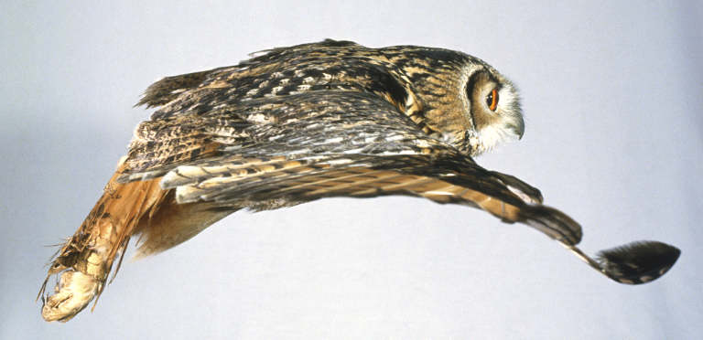
Questions
Recognize: your questions
Select: which questions to pursue
Guide: how to ask and answer
Assess: how well & what to improve

Slide 54
What Pushes Us … ?
Toward
curiosity
Prove colleagues wrong
Keeps coming up
Risk of patient harm
Want to do better
Anxiety
Avoid litigation
Internet informed patient
Away
Time
We already know the answer
Fatigue
Access
Inferiority complex-anxiety-afraid of admitting knowledge gaps
Cynical
Laziness
Lack of support
Previous failure at searching
Lack of resources
Noone else does it
Fear of change

Slide 55

The Real ‘Three R’s’ of Learning
Resilient
Reflective
Resourceful

Slide 56
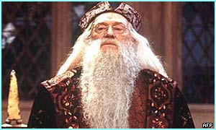
FAQ: How Long … ?
Proficient? Quickly
Mastery? Lifetime
Human expertise takes >10,000 hours, >10 years
→Deliberate practice

Slide 57


Any questions?

