Slide 1
“Learning Styles”
The challenge of applying the evidence-base underpinning teaching
Adrian Stokes
Director
CPD Centre
adrian.stokes@conted.ox.ac.uk

Slide 2
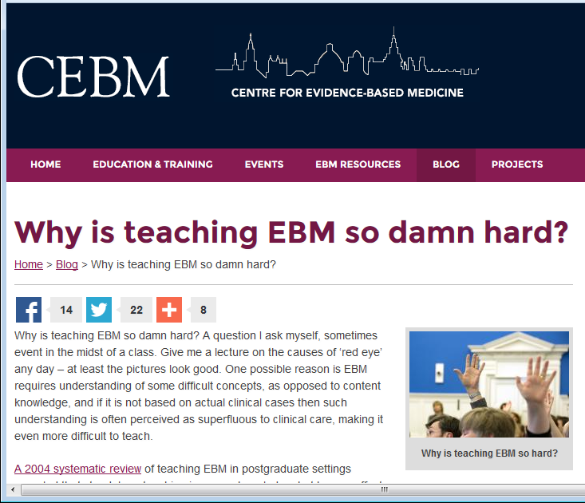

Slide 3
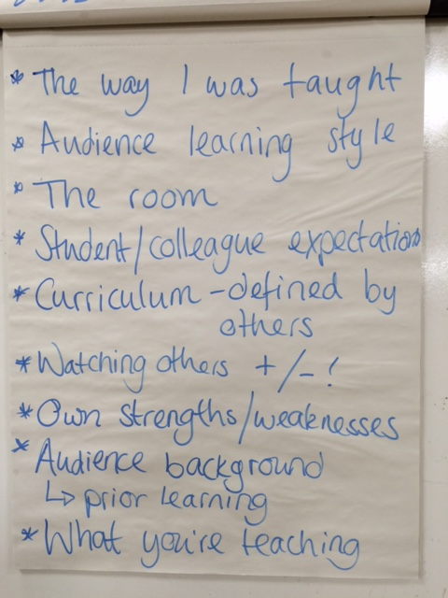
Why do we teach the way we do?
What some of you
suggested…

Slide 4
Why do we teach the way we do?
Requirements of the immediate context
Accepted practice in the discipline/field
Role models
Professional and personal values
Resource constraints
Our experience as learners of what is effective
What will help students do well in the exam
What gets positive student feedback
What the evidence tells us will be most effective?

Slide 5
BEME Collaboration
BEME rejects the legacy of medical education in which decisions have been made based on pseudoscience, anecdotes, and flawed comparison groups rather than empirical evidence. The BEME approach contends that in no other scientific field are personal experiences relied on to make policy choices, and in no other field is the research base so limited.
http://www.bemecollaboration.org/About+BEME/

Slide 6
Evidence and educational practice
EPPI-Centre http://eppi.ioe.ac.uk/
Evidence for Policy and Practice Information and Co-ordinating Centre, Social Science Research Unit, Institute of Education, University of London
Campbell Collaboration http://www.campbellcollaboration.org/
BEME Collaboration http://www.bemecollaboration.org/
Best Evidence Medical and Health Professional Education

Slide 7
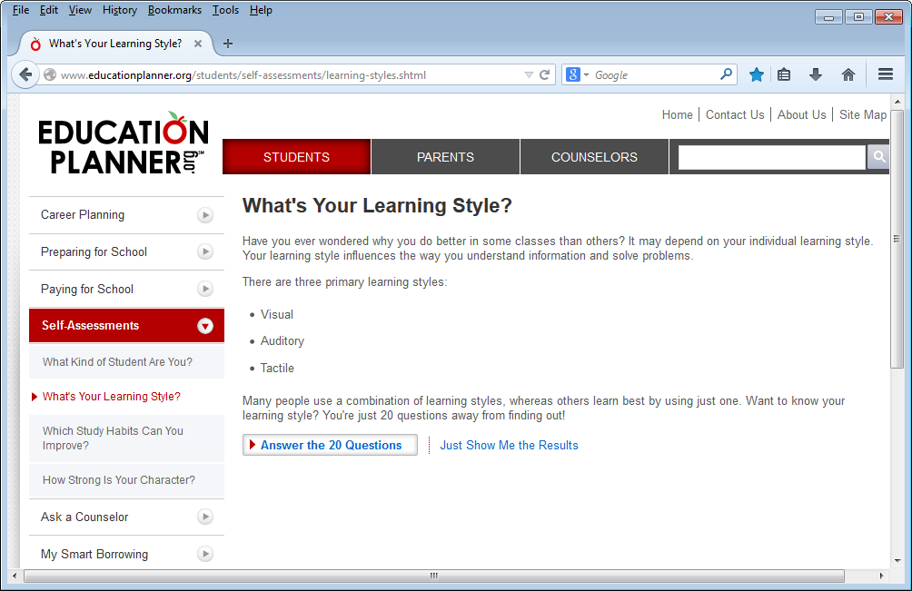
Learning styles
http://www.educationplanner.org/students/self-assessments/learning-styles.shtml

Slide 8
EducationPlanner.org
What's Your Learning Style? The Results
Adrian's scores:
Auditory: 30%
Visual: 35%
Tactile: 35%
You are a Visual/Tactile learner! Check out the information below,
or view all of the learning styles.

Slide 9
Other examples
Visual, Aural, Read/Write, Kinesthetic (VARK)
http://vark-learn.com/
http://www.vark-learn.com/english/page.asp?p=introduction
‘Based on your input you are a(n): auditory learner.’
Experiential learning
David Kolb, Peter Honey & Alan Mumford
http://www.businessballs.com/kolblearningstyles.htm
Approaches to study
Approaches and Study Skills Inventory for Students (ASSIST)
http://www.etl.tla.ed.ac.uk/questionnaires/ASSIST.pdf

Slide 10
Kolb's learning styles
Concrete Experience
Feeling
Accommodating
(feel and do)
CE/AE
Diverging
(feel and watch)
CE/RO
Perception Continuum
how we think about things
Active Experimentation Doing
Processing Continuum
how we do things
Reflective Observation Watching
Converging
(think and do)
AC/AE
Assimilating
(think and watch)
AC/RO
Abstract Conceptualisation Thinking
© concept david kolb, adaptation and design alan chapman 2005-06, based on Kolb's learning styles, 1984
Not to be sold or published. More free online training resources are at www.businessballs.com. Sole risk with user.
http://www.businessballs.com/freematerialsinword/kolb_learning_styles_diagram_colour.doc

Slide 11
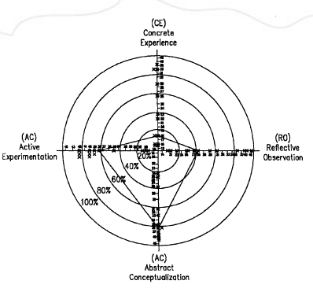
Sutliff & Baldwin (2001)

Slide 12
Approaches to study
Surface learning
Deep learning
Strategic learning

Slide 13
What is a learning style?
The term ‘learning styles’ is used as a description of the attitudes and behaviours that determine our preferred way of learning. Most people are unaware of their learning style preferences, they just know vaguely that they feel more comfortable with – and learn more from – some activities than others.
Honey and Mumford, ‘Introduction to learning and learning styles’, The Learning Styles Questionnaire: 80 item version
http://www.peterhoney.com/
Notes:
Now owned by Pearson

Slide 14
Definition: Broadly defined as one of the three primary ways in which a person can learn. Those include visual (sight), auditory (sound), and kinesthetic (actions/touch). An individual's preferred or best process by which they will learn is typically through one or a combination of these styles. In a more general sense, learning styles can include elements of the environment including their optimal time of day, lighting in the room, temperature of the room, etc. They also include a person's own emotionality, physical needs, and sociological needs. These are often discovered through a learning style inventory which is a short questionnaire often provided by the classroom teacher that allows them an avenue to more readily meet and [sic] individual student's needs.
http://teaching.about.com/od/gloss/g/Learning-Styles.htm

Slide 15
Steps, inferences and assumptions
People learn in different ways
These different ways can be characterised into identifiable ‘styles’
An individual’s style can be identified with a short self-report instrument
Knowing their style helps students learn
Knowing their students’ styles helps teachers plan their teaching
Matching students’ learning styles with a corresponding teaching style will improve outcomes

Slide 16
Should we be using learning styles?
What research has to say to practice
Frank Coffield, David Moseley, Elaine Hall, Kathryn Ecclestone
2004
Criteria:
Internal consistency
Test-retest reliability
Construct validity
Predictive validity
Must be independently verified
http://itslifejimbutnotasweknowit.org.uk/files/LSRC_LearningStyles.pdf

Slide 17
Critical issues
Psychometric weaknesses
The unwarranted faith placed in simple inventories
No clear implications for pedagogy
Decontextualised and depoliticised views of learning and learners
Lack of communication between different research perspectives
Coffield et al (2004)
See also Pashler et al (2008) Learning Styles: Concepts and Evidence. Psychological Science in the Public Interest. https://www.psychologicalscience.org/journals/pspi/PSPI_9_3.pdf
Notes:
Coffield et al found 71 worth considering; reviewed 13 in detail. Mitchell (1994) claimed there were over 100 models.

Slide 18
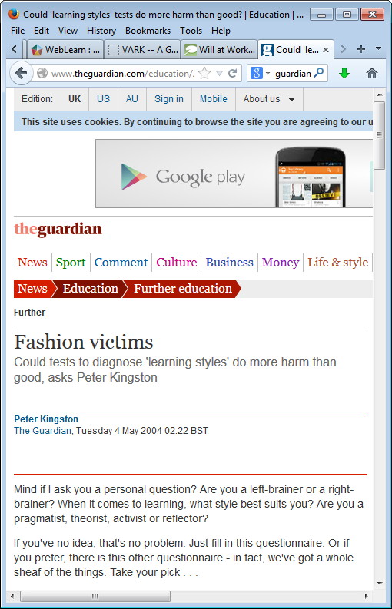
http://www.theguardian.com/education/2004/may/04/furthereducation.uk1

Slide 19
“This field suffers from serious conceptual confusion and a lack of accumulated theoretical knowledge,” says Coffield. “It’s deeply confusing even for psychologists attempting to make sense of it.”
http://www.theguardian.com/education/2004/may/04/furthereducation.uk1

Slide 20
Comment from student
"I learned that I was a low auditory, kinaesthetic learner. So there's no point me reading a book or listening to anyone for more than a few minutes…"
http://www.theguardian.com/education/2004/may/04/furthereducation.uk1

Slide 21
Comment from student
I'm a pragmatist and a bit of something or other - activist.
What do you reckon that tells you about your learning style, then?
Well, I'm gobby and like talking a lot and I don't like all that boring stuff in books, or when lecturers waffle on and it's not relevant…
http://www.theguardian.com/education/2004/may/04/furthereducation.uk1

Slide 22
Coffield comment:
“The commercial gains for creators of successful learning styles instruments are so large that critical engagement with the theoretical and empirical bases of their claims tends to be unwelcome.”
http://www.theguardian.com/education/2004/may/04/furthereducation.uk1

Slide 23
$1000 challenge!
Will Thalheimer's Learning Styles Instructional-Design Challenge
I will give $1000 (US dollars) to the first person or group who can prove that taking learning styles into account in designing instruction can produce meaningful learning benefits.
(2006)
http://www.willatworklearning.com/2006/08/learning_styles.html

Slide 24
But why oh why won’t this myth die?
http://elearnmag.acm.org/featured.cfm?aid=2070611

Slide 25
What about ‘teaching styles’?
http://www.teachingperspectives.com/tpi/

Slide 26
‘Teaching style’ -- 36 instruments…
Teaching Style Inventory x 3
Teaching Style Questionnaire
Teaching Styles Inventory for PBL
Teaching Styles Quiz
Teaching Styles Self Evaluation
Teaching Styles Self-Assessment Tool
Spectrum of Teaching Styles
Staffordshire Evaluation of Teaching Styles
Thinking Styles in Teaching Inventory
Preferred Thinking Styles in Teaching Inventory
Approaches to Teaching Inventory
University Teaching Inventory [ATI + self efficacy]
Teaching Perspective Inventory
Instructional Perspectives Inventory
Instructional Styles Inventory
Lecturers’ Conception of Teaching and Learning Questionnaire
Philosophies Held by Instructors of Lifelong-learners
Philosophy of Adult Education Inventory
Preferred Teaching Approach Inventory
Principles of Adult Learning Scale
Teacher Behavior Preferences Survey
Teaching Goals Inventory
Teaching Methods Inventory
Trainer Style Inventory
Training Style Inventory
Trainer Type Inventory
Effective Teacher Inventory
Clinical Teacher Characteristics Instrument
Supervisory Belief Inventory/Index
1:1 Teaching Styles Inventory
Perceptions of Teaching Environment
Constructivist Learning Environment Survey
Questionnaire [untitled] x 2

Slide 27
Organisations using the TPI
American Academy of Orthopaedic Surgeons
2nd Asia Pacific Medical Education Conference
Canadian Society for Medical Laboratory Science Forum, Hamilton ON
DUC - Deakin / Calgary Universities (On-line & F2F Study)
Duke - Graduate School Pathways
Instituto Tecnologico y de Estudios Superiores de Monterrey
Justice Institute of British Columbia
Korean - Instructors and Educators
North Michigan University Student Teachers
North Michigan University Supervising Teachers
OT Educators' National Survey
Pankey Institute Dental Faculty (Florida)
Pediatric Academic Societies - Educational Scholars Program
Provincial Instructor Diploma Program (VCC)
Pediatrics Department, Hershey Medical Center
Republic Polytechnic, Singapore
PSU-JFDP Junior Faculty Development Program
Society for Education in Anesthesia
SoTL - Multinational Teaching Fellows
U21 - Global
U of T - Toronto Teaching Scholars Program
UBC - Certificate in Practice Education in Health Services
UBC - Faculty SoTL Leadership Program
UBC - Teacher Education Longitudinal Study
UC Davis - Teaching Scholars Program
UNAP-TDI - Universidad Arturo Prat
University of Southern Queensland
UTEC - UTHSCSA: San Antonio
UUI - Kennslufraedi HI (University of Iceland)
Vancouver Coastal Health: Educators' Workshop
Worldwide Universities Network US/UK
As at 6th September 2013
Notes:
Does it matter?
Take up by institutions
Issues: non-judgemental
Teaching as a highly personal activity
Emotional investment
No one right way to do it
Teachers are born not made

Slide 28
The ‘matching’ hypothesis
Matching students’ learning styles with the teacher’s style of teaching improves learning

Slide 29
Getting everything working together
What do you want the learners to be able to do?
Constructive alignment
What teaching methods and learning activities are suitable?
How will you find out what has been learnt?
John Biggs (1999) Teaching for Quality Learning at University (SRHE and Open University Press, Buckingham)

Slide 31
References and useful sources
Allinson, C. W. & Hayes, J. (1996) The cognitive style index: a measure of intuition-analysis for organizational research, Journal of Management Studies, 33(1), 119-135.
Biggs, J. (1999) Teaching for Quality Learning at University (Buckingham, SRHE and Open University Press).
Blake, R. R. & Mouton, J. S. (1972) What is instrumented learning? Training and Development Journal (January), 12-20.
Brookfield, S. (1995) Becoming a critically reflective teacher (Wiley).
Coffield, F., Moseley, D., Hall, E. & Ecclestone, K. (2004) Learning styles and pedagogy in post-16 learning: a systematic and critical review (London, Learning and Skills Research Centre, Learning and Skills Development Agency).
Coffield, F., Moseley, D., Hall, E. & Ecclestone, K. (2004) Should we be using learning styles? What research has to say to practice (London, Learning and Skills Research Centre, Learning and Skills Development Agency).
Collins, J. B. & Pratt, D. D. (2011) The Teaching Perspectives Inventory at 10 years and 100,000 respondents: reliability and validity of a teacher self-report inventory, Adult Education Quarterly, 61(4), 358-375.
Conti, G. J. (1990) Identifying your teaching style, in: M. W. Galbraith (Ed) Adult learning methods: a guide to effective instruction (Malabar, FL, Krieger).
Conti, G. J. (2007) Identifying your educational philosophy: development of the philosophies held by instructors of lifelong-learners (PHIL), MPAEA Journal of Adult Education, 36(1), 19-35.

Slide 32
Dahlgren, L. O., Eriksson, B. E., Gyllenhammar, H., Korkeila, M., Saaf-Rothoff, A., Wernerson, A. & Seeberger, A. (2006) To be and to have a critical friend in medical teaching, Medical Education, 40(1), 72-78.
Dupin-Bryant, P. A. (2004) Variables related to interactive television teaching style: in search of learner centered teaching style, International Journal of Instructional Technology and Distance Learning.
Evans, C. & Vermunt, J. D. (2013) Styles, approaches, and patterns in student learning. British Journal of Educational Psychology, 83 (2): 185-195.
Glickman, C. D. (1985) Supervision and instruction: a developmental approach (Boston, MA, Allyn & Bacon).
Hargreaves, D. (2005) About Learning: Report of the Learning Working Group. London: Demos.
Holcomb, T. R., Ireland, R. D., Holmes Jr, R. M. & Hitt, M. A. (2009) Architecture of entrepreneurial learning: exploring the link among heuristics, knowledge, and action, Entrepreneurship: Theory & Practice, 33(1), 167-192.
Illing, J. (2007) Thinking about research: frameworks, ethics and scholarship (Edinburgh, Association for the Study of Medical Education).
Jones, R. (2011) Key tools and techniques in management and leadership of the allied health professions (London, Radcliffe Publishing).
Meyer, J. H. F. & Eley, M. G. (2006) The approaches to teaching inventory: a critique of its development and applicability, British Journal of Educational Psychology, 76(3), 633-649.
Mitchell, D. P. (1994) Learning style: a critical analysis of the concept and its assessment, in: R. Hoey (Ed) Design for learning: aspects of educational technology (London, Kogan Page).
Mohanna, K., Chambers, R. & Wall, D. (2007) Developing your teaching style: increasing effectiveness in healthcare teaching, Postgraduate Medical Journal, 83(977), 145-147.

Slide 33
Mohanna, K., Chambers, R. & Wall, D. (2008) Your teaching style: a practical guide to understanding, developing and improving (Abingdon, Radcliffe).
Mohanna, K., Cottrell, E., Wall, D. & Chambers, R. (2011) Developing your teaching style and techniques, in: R. Jones & F. Jenkins (Eds) Key tools and techniques in management and leadership of the allied health professions (London, Radcliffe Publishing), 119-128.
Pashler, H., McDaniel, M., Rohrer, D. & Bjork, R. (2008) Learning Styles: Concepts and Evidence. Psychological Science in the Public Interest, 9 (3): 105-119.
Pratt, D. D., Arseneau, R. & Collins, J. B. (2001) Reconsidering ‘good teaching’ across the continuum of medical education, Journal of Continuing Education in the Health Professions, 21(2), 70-81.
Pratt, D. D. & associates (1998) Five perspectives on teaching in adult and higher education (Malabar, Florida, Krieger Publishing Company).
Pratt, D. D., Boll, S. L. & Collins, J. B. (2007) Towards a plurality of perspectives for nurse educators, Nursing Philosophy, 8(1), 49-59.
Steinert, Y., Mann, K., Centeno, A., Dolmans, D., Spencer, J., Gelula, M. & Prideaux, D. (2006) A systematic review of faculty development initiatives designed to improve teaching effectiveness in medical education: BEME Guide No. 8, Medical Teacher, 28(6), 497.
Sutliff, R. I. & Baldwin, V. (2001) Learning styles: teaching technology subjects can be more effective, Journal of Technology Studies, 27(1), 22-27.
Trigwell, K. & Prosser, M. (2004) Development and use of the approaches to teaching inventory, Educational Psychology Review, 16(4), 409-424.
Trigwell, K., Prosser, M. & Ginns, P. (2005) Phenomenographic pedagogy and a revised Approaches to teaching inventory, Higher Education Research and Development, 24(4), 349-360.

Slide 34
Vaughn, L. M. & Baker, R. C. (2008) Do different pairings of teaching styles and learning styles make a difference? Preceptor and resident perceptions, Teaching and Learning in Medicine, 20(3), 239-247.
Vollers, J. M. (2008) Teaching and learning styles, International Anesthesiology Clinics, 46(4), 27-40.
Wall, D. (2007) Evaluation: improving practice, influencing policy (Edinburgh, Association for the Study of Medical Education).
Willingham, D. Learning styles don't exist. [online] Available from: https://youtu.be/sIv9rz2NTUk (Accessed 15 September 2015).

